Slide 1
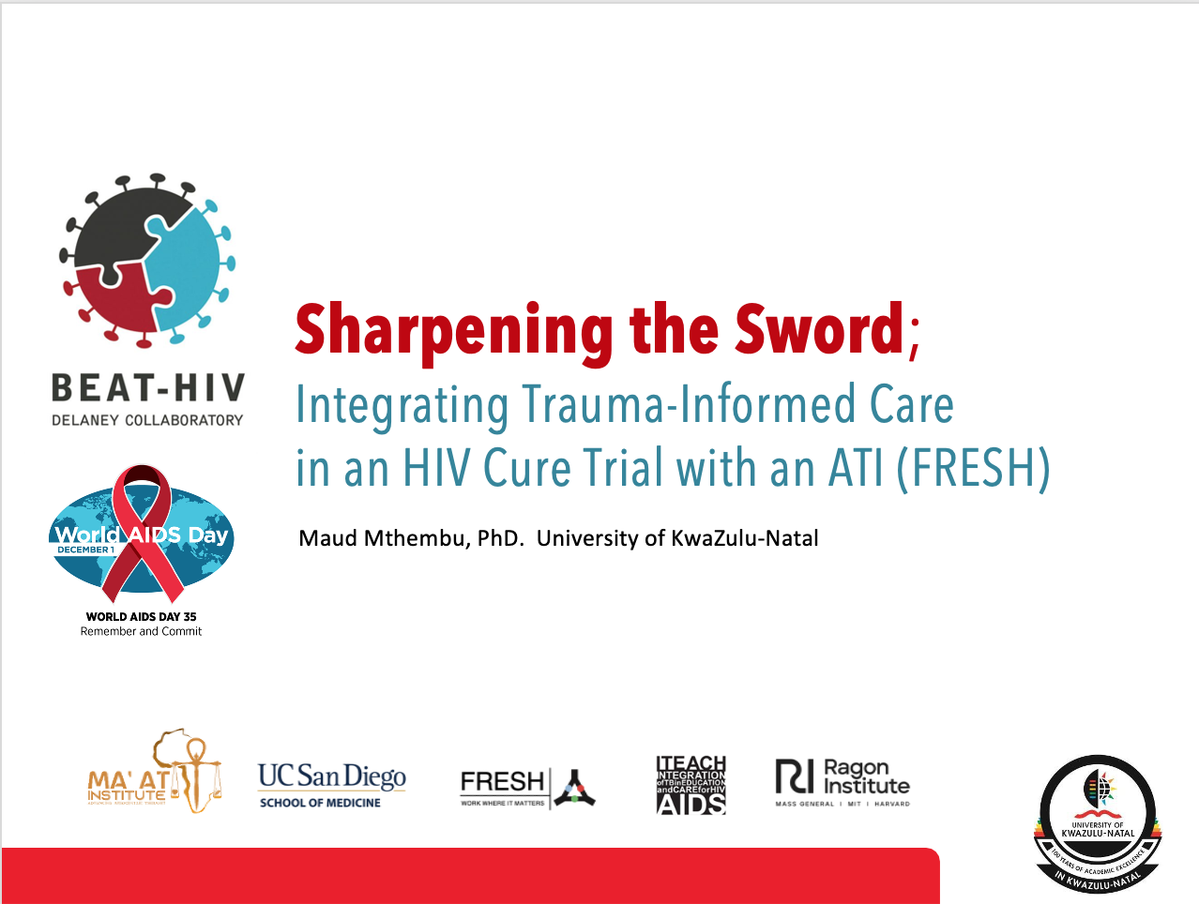
Gender-Based Violence Disclosures (Izigaxa) of Young Women Enrolled in a Socioeconomic and Curriculum-Based Programme in KwaZulu-Natal, South Africa: Opportunities for integrating Trauma-informed Care
Dr. Maud Mthembu|Ms. Nosipho Funeka| Ms. Khanyisa Ngwane |Dr. Nolwazi Ngcobo
Ms. Thenjiwe Andiswa Mlotshwa | Dr. Karine Dube |Dr. Krista Donga
ASASWEI International Conference 10-12 September 2025

Slide 2
Presentation
Content
This presentation will cover the following topics:
Introduction and Background
Study Focus and Setting
Methodology
Findings
Recommendations and Conclusion

Slide 3
Introduction and Background
Gender-based violence (GBV) is widely recognised as a critical human rights issue and a global health crisis of epidemic proportions that inherently impacts social progress (World Health Organisation, 2024.
Globally, it is estimated that one in three women (30%) have faced sexual and physical violence in their lifetime, with this violence being more prevalent among ethnic minorities and in developing countries (WHO, 2024).
In South Africa, 33.1% of women over the age of 18 years have experienced physical assault regardless of their partnered status (Zungu, Petersen, Parker, et al., 2024). A study conducted by Aboagye (2023) indicated the low rate of help-seeking behaviour in sub-Saharan Africa.
This indicates the complex nature of help-seeking trends in South Africa among GBV victims and survivors; and suggests a need for more awareness and advocacy for GBV.
Women and girls from lower socioeconomic backgrounds and with limited education, face a heightened risk of GBV.
Notes:
Impacts of GBV transcend the intrapersonal (micro), extends to mezzo and macro. Particularly access to health, education, economic productivity and social stability which obstructs progress towards achieving Sustainable Development Goals (Ditter and Qi, 2024
SDG 3 (which promotes good health and well-being); and SDG 5 (promotes gender equality) are key goals that highlight the attainment of social progress by alleviating violence against women (United Nations, 2015).

Slide 4
Introduction and Background
A woman's age, level of education, wealth status, and marital status are among the factors that influence her ability to disclose experiences of violence and seek help (Dickson et al., 2023; Aboagye et al, 2023).
Economic hardship forces young women to engage in transactional relationships for financial support, leading to increased exposure to exploitation and violence (Kyegombe, 2020).
Women’s Empowerment Programs (WEPs) have been recognised as an important vehicle for empowering girls in developing countries such as South Africa (Dupuy et al., 2018).
WEPs offer a platform for GBV survivors to feel heard and uplifted, but they also contribute to aid in addressing gender inequalities and promote socioeconomic growth which furthers social progress.
Notes:
Add SDG goals

Slide 5
Study Focus and Context
Study Focus
Females Rising through Education Support and Health
Study aim:Explored GBV disclosures (izigaxa) among young women enrolled in the SECP, focusing on the experiences and perspectives of Socioeconomic Empowerment and Curriculum-based programme (SECP) team.
FRESH is a clinical research site located in Umlazi township, Durban. It was launched in 2012 .
It was designed as a program to respond to the high prevalence of HIV infection in KwaZulu-Natal through early virus detection by testing participants regularly.
It enrols young women between the ages of 18 to 24 years who are at high risk of contracting HIV.
Includes a Socioeconomic Empowerment and Curriculum-based Programme that provides life and job skills training(Ndung’ u, Dong et al., 2018).

Slide 6
THEORETICAL FRAMEWORK: TRAUMA INFORMED CARE
1. Maintaining Client Safety
4.
Empowerment. Voice and Choice
5. Collaboration
6.
Identity, culture and context
7.
The Me I want to be
3.
Peer support and Mutual Self-Help
2. Trustworthin-ess and transparency
Trauma Informed Care
Coined by Maxine Harris and Rodger Fallot 2001.
Recognise the possibility that individuals may have experienced some form of trauma.
Underpinned by seven principles.
Relevant in contexts where women face significant socio-economic challenges, such as unemployment, GBV, substance abuse, and unresolved trauma.
Figure 1: 7 Principles of Trauma-Informed Care

Slide 7
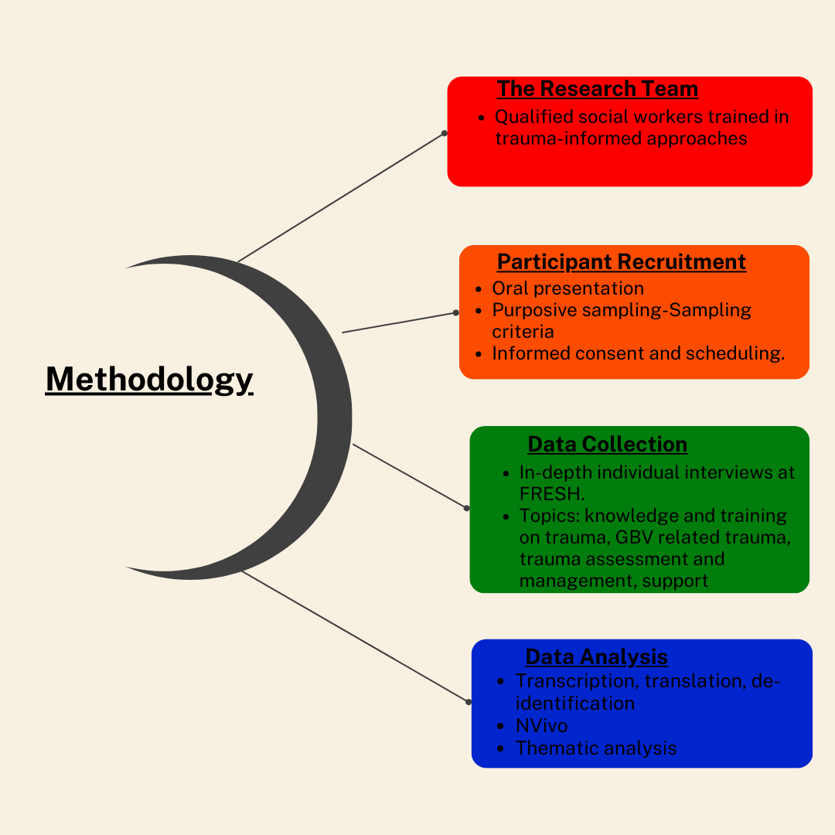

Slide 8
Theme 1: “Izigaxa”: Perceptions on Young Women’s Experiences of GBV
Young women to freely discussed issues of GBV, HIV and sexual reproductive health with peers in similar age groups.
These spaces enabled authentic and meaningful discussions about young women’s experiences of GBV, particularly within healthcare settings
isiZulu term, izigaxa it encapsulates the painful and complex GBV disclosures reported by young women enrolled at FRESH
GBV often normalized or unrecognized
Early emotional abuse and negative messaging from caregivers contribute to low self-worth, normalizing abusive relationships and emotional numbness.
Disclosing GBV experience will not automatically translate to leaving the abusive relationship.
Facilitator emotional impact i.e. overwhelming feelings , anxieties, uncertainties, vicarious trauma
Empathy and shared experience i.e. personal experiences, allowing for deeper empathy and opportunities to empower peers through shared understanding.

Slide 9
Theme 2: Exchange-Based Relationships and Young Women’s GBV Experiences
Deep-rooted structural challenges, including limited education, poverty, unemployment, social class, and gender inequality are key factors that perpetuate violent relationships.
A tolerance of physical, emotional and sexual abuse due to food insecurity, unemployment, housing dependency and lifestyle maintenance (O’Mullon, 2024).
Financial dependency can create power imbalances in transactional relationships.
Strips young women of their autonomy to voice discomforts, negotiate sexual consent or terminate these relationships without compromising their ability to sustain livelihoods
  “Because I live with him, either way he maintains me” Most of our – the kids – they go to stay with boyfriends for the sake of [because], “I get food – he buys me what I want – of which it’s something that I don’t get at home because there isn’t anyone who works and the situation is bad. So, if this guy can provide for me, it does not matter that he beats me or that he sleeps with me by force when I do not want to of which I don’t see that as rape – it’s just that some days Miss, I also don’t want to but then he does it but he’s not raping me.” (P10)
Young women may also engage in concurrent, transactional sexual encounters to maintain various livelihoods which makes them vulnerable to contracting HIV and experiencing violence during these short-term encounters (Thomas, Nalumansi, Reichman et al., 2023)
Notes:
Thus, exchange-based relationships may also increase young women’s vulnerability to remain in physically and emotionally abusive relationships which further entraps them in cycles of abuse that may cause physical and psychological traumas (Heron, Eisma and Browne, 2022).

Slide 10
Theme 3: Integrating Trauma-Informed Care to Support Young Women with GBV Experiences
Group work is the primary method used to deliver the SECP classes which is a method that can potentially enhance collective healing and mutual support.
GBV survivors strategically tested and then disclosed once the environment was safe. The participants’ management of incremental disclosure shaped the outcome.
Awareness of personal beliefs and acknowledging diverse beliefs were seen by the SECP facilitators as necessary to develop authentic relationships with young women.
Women’s disclosure of abuse requires the listener to attend to verbal and non-verbal communication while respecting a young woman’s choice and agency regarding when and how they shared their story.
Disclosing GBV may not bring immediate solutions but it initiated further support through linkages with formal support structures and institutions.

Slide 11
Theme 4: Building Resilience Through Empowerment Programmes
The intersection of GBV and societal structural challenges remains a key hindrance towards drastic progress for women.
The need to transform the socioeconomic conditions of young women was highlighted as critical to support GBV survivors’ decision to leave abusive relationships.
When young women are entrapped in abusive relationships, it may be difficult for them to broaden their horizons and realise their full potential.
WEPs provide young women with the agency to remain or leave GBV relationships. These programmes also act as catalysts for social progress through problem-solving and the potential to explore possibilities.
  “When she leaves here, she decides for herself; she has skills of doing a CV so that she is employable, or she has skills she goes back to school. So basically, we do that in class.” (P8)
The SECP has a successful completion rate, observable growth and development in individuals. This progress not only benefits the participants themselves but also contributes to broader social advancement.

Slide 12
The SECP team reported underlying pre-existing trauma and experiences associated with GBV among young women, linking them with appropriate support was emphasized.
Despite the availability of online mental health support services, the SECP team was unsure whether enrolees used these resources, and the continuity of care was unclear.
The value of accessible, consistent, in-person professional counselling was viewed as critical resource for young women.
There was a general preference among the team to refer SECP enrolees to in-house contact support. The availability of immediate resources is critical after disclosing the abuse as well as ensuring access to immediate and long-term counselling.
Capacity building
Theme 5
The value of Counselling and Intrapersonal support

Slide 13
Recommendations and Conclusion
WEPs like SECP are an effective tool in influencing social progress through their potential to address gender inequalities, promote economic growth and access to healthcare services to support GBV survivors.
WEPs effectively create physical and psychological safe spaces, enabling open and meaningful discussions around GBV experiences.
WEPS help bridge the mental healthcare gap; however, access to professional therapy and counselling remains critical for survivors.
Capacity Building: Skilled facilitators are essential for managing GBV disclosures, providing appropriate social support, and ensuring a continuum of care.
Integrating Trauma-Informed Care (TIC)
Linking GBV education with economic and skills development initiatives helps promote financial autonomy and reduce women’s vulnerability to abuse.
Notes:
Add applicable SDGs

Slide 14
Thank You!

Slide 15
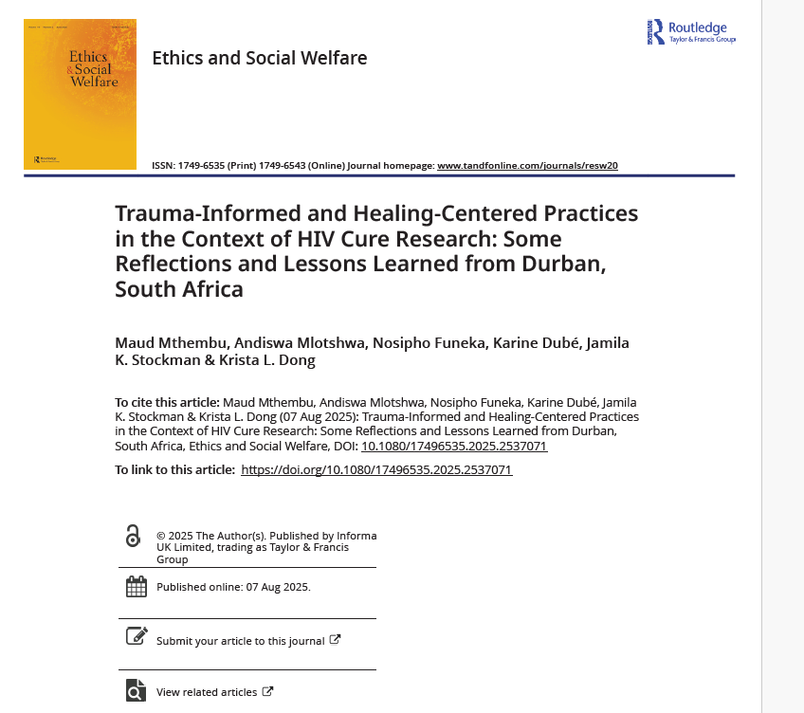
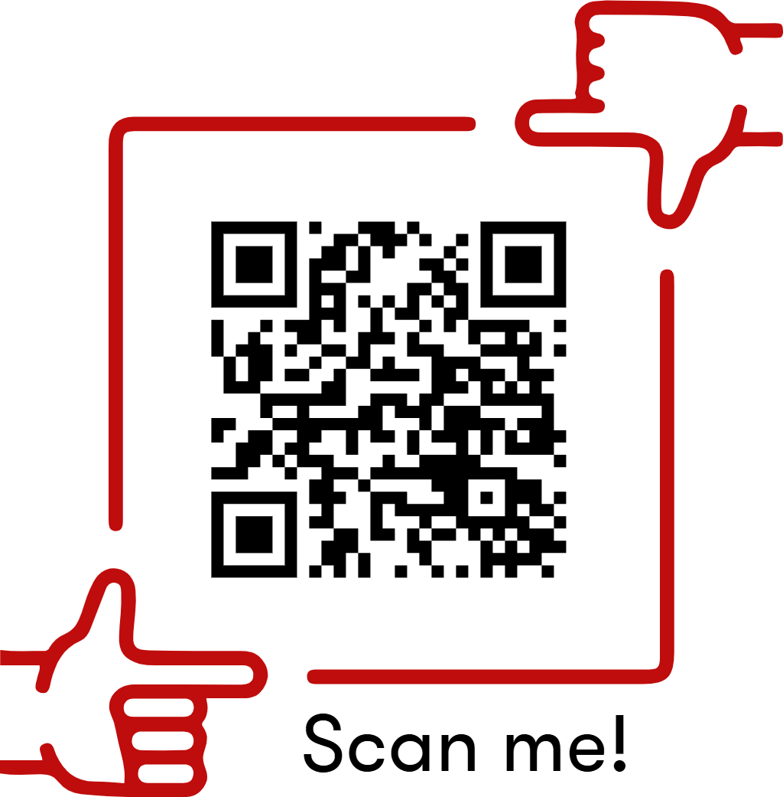
Please download and read our paper!

