Slide 1

ASASWEI CONFERENCE
THEME 1: Social, economic, and Environmental Justice

Slide 2


Influence of Natural Hazards on Farmers’ Livelihoods and Mental Health in the SADC Region
By: FK Matlakala, NB Chilwalo & KM Rantho
Koketso.Matlakala@nwu.ac.za

Slide 3
Introduction
Natural hazards disrupt livelihoods, social support, and food security
Psychological effects include anxiety, depression, trauma, and eco-anxiety
Farmers in the Southern African Development Community (SADC) are highly vulnerable

Slide 4
Problem statement
Farmers in SADC are at high risk due to droughts, floods, bushfires, and extreme climate events
Past studies emphasised economic/environmental impact but overlooked mental health
Limited access to resources and mental health services worsens vulnerability
There is a knowledge gap cumulative psychological impact of hazards on rural farmers

Slide 5
Why social workers and farmers?
Provide psychosocial support for anxiety, depression, trauma, and ecological grief
Strengthen family and community support networks disrupted by hazards
Advocate for farmers’ voices in policy and integrate mental health in climate frameworks
Facilitate resilience through indigenous knowledge and community-driven strategies

Slide 6
Aim and objectives
Aim
The aim was to scope literature on the influence of natural hazards on farmers’ livelihoods and mental health (2014–2024)
Objectives
1. Map methodologies on the psychological and socioeconomic challenges of farmers
2. Identify psychological and socioeconomic challenges during natural hazards
3. Determine coping strategies used by farmers when faced with natural hazards

Slide 7
Methodology
Guided by Arksey & O’Malley (2005) framework for scoping reviews
Databases: PubMed, EBSCOhost, ProQuest, Science Direct, Sabinet
Timeframe: 2014–2024
PRISMA-ScR guidelines applied
706 articles screened → 8 studies included
Analysis: content analysis

Slide 8
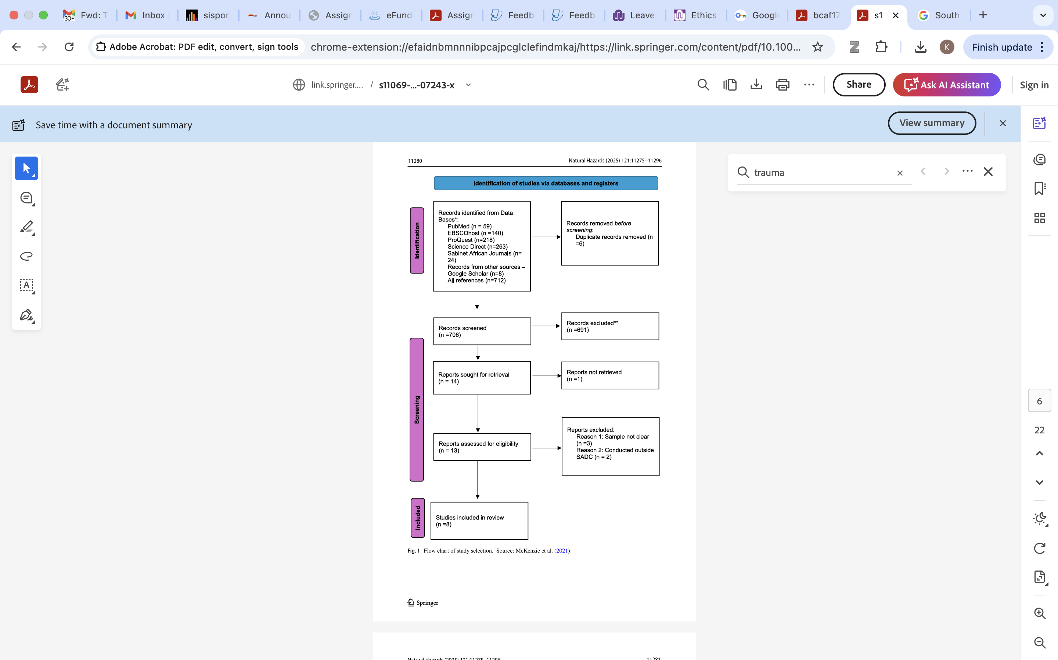
Summarised data gathering process

Slide 9
Findings - Methodological mapping
4
Angula et al. 2016
Dumenu and Takam Tiamgne 2020
Makuvaro et al. 2017
Rusinga et al. 2014
Mixed methods
3
Berker et al. 2015;
Matlakala et al. 2021;
Rankoana 2022
Qualitative approach
1
Ngoma et al. 2024
Quantitative approach

Slide 10
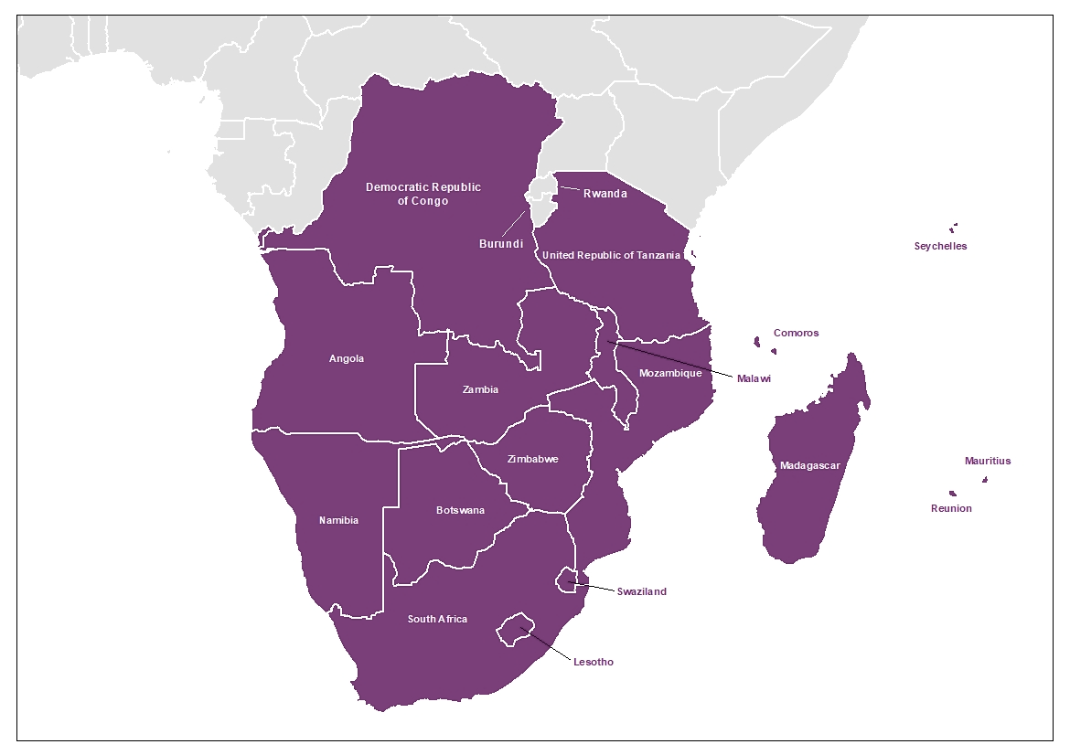




Findings – countries included (n=8)
2
2
1
3

Slide 11
Findings - Challenges
Theme 1: Psychosocial challenges
The structural and socio-political conditions exacerbate the impact of climate hazards, exposing farmers to increased mental health distress, including anxiety, depression, trauma, and ecological grief (Becker et al. 2015; Cunsolo and Ellis 2018; Obradovich et al. 2018; Gawrych 2022).

Slide 12
Findings - Challenges
Theme 2: Economic/resource constraints faced by farmers during natural hazards in SADC
The occurrence of natural hazards in SADC has resulted in the loss of agricultural productivity, that led to food insecurity (Angula and Kaundjua 2016; Becker et al. 2015; Makuvaro et al. 2017; Rankoana 2022; Matlakala et al. 2021)
We have also noted loss of income (Angula and Kaundjua 2016; Dumenu and Takam Tiamgne 2020; Makuvaro et al. 2017; Matlakala et al. 2021) for most farmers.
The scoped articles showed that the loss of production resulted from reduced crop yields, loss of grazing areas, and decreased number of livestock (Angula and Kaundjua 2016; Dumenu and Takam Tiamgne 2020; Makuvaro et al. 2017; Rankoana 2022).
Meanwhile, other authors have revealed that farmers experienced shortages of resources such as water, seeds, fertilisers, and labour to counteract harsh climate conditions (Makuvaro et al. 2017; Ngoma et al. 2024; Matlakala et al. 2021).

Slide 13
Findings - Challenges
Theme 3: Coping strategies used by farmers during natural hazards in SADC
Farmers in SADC, particularly in South Africa, Namibia, Zimbabwe, and Zambia, have shown the use of innovative agricultural practices and crop diversification to lessen the damage caused by natural hazards such as floods and drought.
These farmers use practices such as mulching, zero tillage, and agroforestry to improve the quality of the soil and make it resilient against the impact of natural hazards (Dumenu and Takam Tiamagne 2020; Makuvaro et al. 2017; Rankoana 2022; Rusinga et al. 2014).
In addition, farmers select drought-resistant plants and seek planting schedules to ensure the survival of their crops during climate shocks (Dumenu and Tiamgne 2020; Rankoana 2022; Rusinga et al. 2014).
Furthermore, studies have shown that some farmers use preventive strategies such as digging trenches and maintaining their resources to ensure they are prepared for natural hazards (Angula and Kaundjua 2016; Becker et al. 2015; Dumenu and Tiamgne 2020).

Slide 14
Discussion
Farmers face interconnected economic and psychological stressors
Mental health support is missing in climate adaptation policies
Resilience improved by:
- Indigenous knowledge
- Interprofessional collaboration
- Community-driven strategies

Slide 15
Implications for Practice
Integrate mental health into climate resilience & disaster management
Develop culturally relevant, community-driven policies
Strengthen adaptive capacity in agriculture
Foster multi-sectoral collaboration (health, social work, agriculture, disaster management)
Address intersectional vulnerabilities and intergenerational trauma

Slide 16
Conclusion
Natural hazards threaten farmers’ livelihoods and mental health in SADC
Evidence shows long-term psychological and socioeconomic consequences
Need for holistic, interdisciplinary, and community-driven resilience frameworks
Mental health integration is critical to sustainable adaptation strategies

Slide 17

THE END
THANK YOU

