Slide 1

An Examination Of The Impact Sharenting Through Social Media Has On The Rights And Protection Of Children
By Raylene Meth
Supervisor: Dr. Rowena Benard

Slide 2
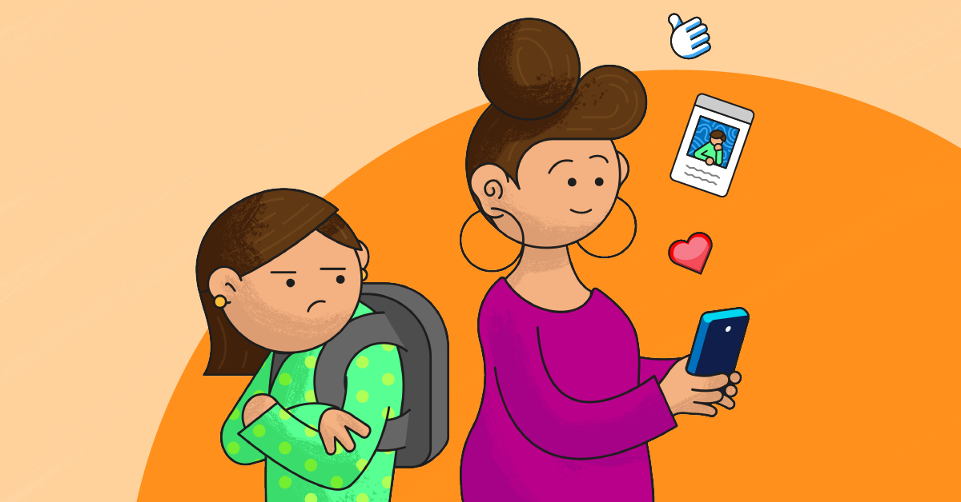
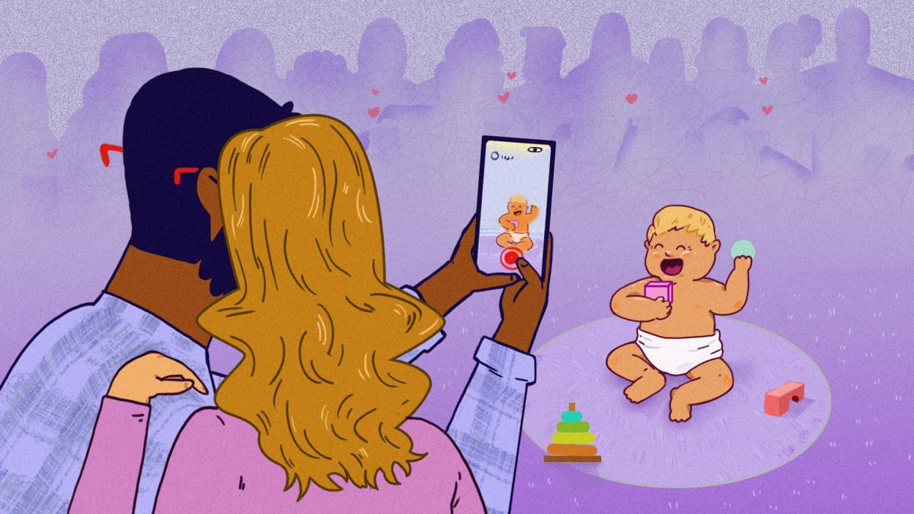
Introduction
•The Collins Dictionary (2022) defines sharenting as “the habitual use of social media to share news, images, etc., on one’s children”.
Parents increasingly document the lives of their children publicly, which has become close to societal standard. As a result, before they can even walk, many children already have an excessive number of images, videos, posts, and updates about their lives on social media. This type of activity is known by the phrase sharenting, which was created from the word’s “share” and “parenting” (Brosch, 2018).
It is estimated that by 2030, the practice of ‘sharenting’ could be responsible for as many as seven million cases of identity theft (MaryAnne, 2021). A study conducted by Barclays Bank estimates that by 2030, two-thirds of identity theft could be attributed to “sharenting” (Coughlan, 2018).
These therefore have made sharenting an area of concern and a topic of research by increasing numerous of scholars around the world (Brosch, 2018); however, the knowledge of this phenomenon is still under researched

Slide 3

Aims and Objectives of the Study
To examine the impact of sharenting through social media has on the rights and protection of children
To identity the extent to which parents considered the BIC
To determine whether the law adequately protects children from sharenting.
To draw lessons for South Africa from other jurisdiction on how they dealt with sharenting
To provide recommendations on how to reduce the impact sharenting has on South African children

Slide 4

Research Methodology
This study adopted a desk research method.
Desk research is a type of a research whereby either quantitative or qualitative data or both are collected from secondary sources, without going to the field (Jaleel and Prasad,2018).
In the case of this study, the data collected was qualitative. The target materials were journal articles, legislation, cases, books and gazette documents. The materials obtained were reviewed to respond to the research questions in the study.

Slide 5

Limitations of the study
Data Source :Relied solely on existing data from secondary sources.
Reviewed published literature, including books, articles, and gazetted documents.
Target Population: Did not collect data directly from target groups (parents, children, or social media) leading to no control over subjects.
Data Availability: Difficulty in finding specific data due to limited literature on the topic.
Researcher was restricted to information available online. Also taking into consideration that the study was conducted during covid.

Slide 6
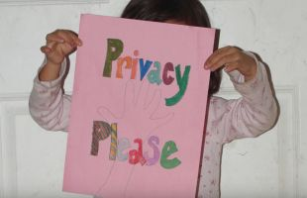
The Harms of Sharenting
Steinberg (2019) divided the potential risks of sharing into four categories.
The Physical damages: Such as data collecting,fraud,identity theft and digital kidnapping.
Infringement on the rights of the child, such as a right to private family life.
Digital Citizenship Harm, refers to the negative impact that arise from irresponsible or unethical behaviour such as mental distress, reputational damage, exposure to scams and cyberbullying.
Digital kidnapping is a phenomenon whereby unrelated people post pictures of babies and other material online under false pretenses that they are the parents of the child (O’Neill, 2015). O’Neill (2015) stressed that a digitally kidnapped child could be presented with new personal details and a fresh start to a completely new online life.

Slide 7


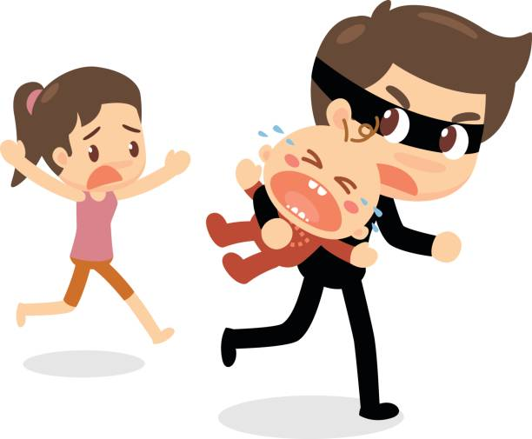
Conti……..
Another way in which sharenting leaves children vulnerable is through “geotagging” which is defined as ‘the addition of geographical information such as latitude and longitude coordinates, street addresses, town names, postal zip codes, or telephone area codes to websites, images, videos, smartphone transmissions, and various other data types and sources’ (Tech Target Contributor, 2013).
The Positives about Sharenting
Acts as a platform for parental advice and reduces feelings of isolation (Jiow, Lim & Lin, 2016; Clark et al., 2015). Parents often use social media platforms to seek social validation and document memories for family friends.
Helps preserve memories and gain social support (Blum-Ross & Livingstone, 2017; Gaëlle & Verswijvel, 2018).

Slide 8
Theoretical Frame Work
Communication Privacy Management Theory (CPM)
This theory was introduced by Sandra Petronio in 2002. It provides insight into how individuals make decisions about revealing and protecting personal information.
It provides that individuals perceive themselves as owners of private information and have the right to decide if and how it will be shared (Petronio, 2004).
Once personal information is shared (e.g., with a friend), the original owner loses some control over how it is shared further.
Once parents share their child’s private information on social media, they lose complete control over that information to the social media platform.

Slide 9
Analysis of Laws Protecting Children International Laws
UNCRC
ACRWC
African Charter on The Rights and Welfare of the Child
The United Convention on The Right of the Child
The UN Convention on the Rights of the Child (UNCRC) was adopted in 1989, representing a significant commitment by world leaders to children's rights and welfare (de Alcântara Mendes & Ormerod, 2019).
The UNCRC's core principles include non-discrimination, the best interests of the child, optimal development, and the right to be heard (Lansdown et al., 2022).
Key Articles for this study
Article 2: Guarantees recognition without discrimination.
Article 3: Prioritizes the child's best interests.
Article 6: Ensures rights to life, survival, and development.
Article 12: Affirms the right to express opinions suitable to their age (Lansdown & Vaghri, 2022).
ACRWC was adopted by the Organization of African Unity (OAU) in 1990 and effective since 1999 (OAU, 1999).
ACRWC outlines children's rights and sets principles for their welfare, complementing the UNCRC (UNICEF, 1990).
Article 7 grants children the right to express their views and be heard.
Article 8 ensures the right to peaceful assembly and association, requiring parental consent for information sharing.
Article 10 protects children’s right to privacy from unwarranted parental interference.
Article 15 declares child labour unacceptable, including using children's images for financial gain without consent (Kumar & Schoenebeck, 2015; Webb, 2013).

Slide 10
National Laws Protecting Children
The Constitution of South Africa
The Children’s Act no 38 of 2005
Section 28(1) of the Constitution mandates parents to render strict parental care to their children whether at home or outside of the home. This indicates that parents who expose a child to any form of danger at home or in the public space, can be held liable by the court
Children are entitled to protection from neglect, abuse, and exploitation.
Section 14 ensures all individuals, including children, have a right to privacy and protection of their communications.
"Sharenting" is not explicitly addressed but falls under parental duties, requiring protection of children's digital lives (Steinberg, 2019; O’Neill, 2015).
There are currently no legal models addressing sharenting; courts would need to evaluate cases judiciously (Fisher & Smith, 2020). Lack of legal model.
The act grants rights and protection to every child in South Africa, mandating government enforcement.
Sharing a child’s information on social media can lead to unfair discrimination regarding their health, appearance, or family background (Gaëlle & Verswijvel, 2018; Autenrieth, 2018; Ammari et al., 2015).
A child's right to participate in public play and recreational activities can be compromised by information sharing that poses dangers (Pomerance, 2013).
If shared information negatively impacts a child's physical, social, or mental development, it does not serve the child's best interests (Lichtenstein, 2017; Gaëlle & Verswijvel, 2018).
The Act may require mechanisms to control harmful sharing (Lichtenstein, 2017; Gaëlle and Verswijvel, 2018).

Slide 11
The Protection of Personal Information Act
POPIA is a South African law regulating the processing of personal information (Sage Legal Information, 2022). It regulates how data is collected, stored and shared to protect individual’s privacy.
It was enacted in line with Section 14 of the South African Constitution, which grants the right to privacy and protection against illegal handling of personal data (Protection of Personal Information Act, 2013).
It emphasizes the protection of all individuals’ personal information including children but does not have specific provisions exclusive to children.
Hertzog et al, (2021) mentioned that the POPIA help improve how children’s data is handled and restricts access to personal information so only those who need it can .
It is important to note that the term sharenting is not mentioned in POPIA, though the Act has captured most of the necessary parties (children; competent persons) and medium (electronic communication) involved in sharenting.

Slide 12
Lessons from USA and EU on SHARENTING
Few countries have specific legislative guidelines addressing sharenting; studying these can provide insights for South Africa.
This research study analyzed how the USA and EU handles sharenting issues to identify lessons applicable to South Africa.
Why these two countries? The USA and EU are recognized for their human rights advocacy and are home to major social media platforms (Peters, 2012; Shelton & Carozza, 2013; Bossetta, 2018; Ariyo, 2022).
The USA is notable for being the birthplace of significant social media platforms, including Facebook, YouTube, WhatsApp, Instagram, TikTok, Snapchat, and Twitter.
Children’s Online Privacy Protection Act (USA) :Its primary goal is to regulate online service providers in the U.S. to protect the privacy of children under the age of 13 (FTC, 1999). The Federal Trade Commission (FTC) is responsible for its enforcement. COPPA mandates that websites aimed at children must have privacy policies that disclose data collection practices.
The General Data Protection Regulation (GDPR) (European Union) :The GDPR enforces severe fines against anyone that transgresses its privacy and security criteria (Donovan, 2020). Recital 38 of the GDPR stipulates that: “children merit specific protection with regard to their personal data, as they may be less aware of the risks, consequences and safeguards concerned and their rights in relation to the processing of personal data”.
It must also be noted that neither of these two mentioned regulations deal with the potential risks of sharenting instead leaving it up to parents to decide what is best for the child.

Slide 13
Findings
Parents frequently disclose their children's private information on social media without consent and do not always take time to read the fine prints of the social media sites they partake on. The right to privacy and protection are frequently violated.
Sharenting is usually done with positive intentions to connect with family and friends.
Excessive sharing may potentially harm the child by directing a total stranger from the net to your door step. Best interests are not always considered when posting.
Lessons can be learned from other countries on regulating sharenting.
South Africa has both local and international laws that govern the protection of children; however sharenting is not explicitly addressed within any of these legal frameworks.

Slide 14
Findings
POPIA places the responsibility on parents to determine whether the personal information of their children may be processed by a responsible party (a company or individual who determines the purpose and means for processing personal information and then uses the information).
The Children’s Act of 2005 does not specifically prohibit the sharing of children's photographs but emphasizes that children’s privacy rights should be respected and upheld. The law prioritizes the best interests of the child in such cases.
Section 28(2) of the South African Constitution reiterates that in matters involving children, their best interests must take precedence.
The study underscores that "sharenting" is a global issue that requires attention, emphasizing the need for parents to prioritize their child's privacy rights and best interests amid the evolving landscape of social media.
While recognizing that "sharenting" is a new phenomenon, the conclusion suggests the need for parents to act responsibly until broader regulations are established to manage the practice.

Slide 15
Conclusion
Sharing children’s personal information on social media by parents is a global issue that deserves careful attention, especially when it comes to children’s right to privacy.
While "sharenting" is a relatively new trend, it’s crucial that, before governments and policymakers create broad rules, parents prioritize protecting their children. Children deserve to be treated with respect and their privacy should always be safeguarded as afforded in the constitution. Their best interests must come first, recognizing that they are independent individuals with rights, even at a young age.

Slide 16
Recommendations
On the bases of this study, the following recommendations are made :
Awareness campaigns on sharenting: A robust awareness regarding sharenting and the relevance of safety and privacy of children’s information on social media is of great importance. Awareness campaigns should target families, schools, and workplaces to encourage careful posting. Responsible agencies in South Africa should regularly publish reports on child privacy policy compliance.
Strict enforcement measures are needed for violators of child privacy rules on line. A need to identify an appropriate agency to enforce child information privacy on social media, reviewing legislation to explicitly address sharenting, and implementing local initiatives against non-compliant sites is recommended by this study.
Best practices for parents : Children's self-awareness and identity are affected by their online presence. Parents must understand the risks of sharenting and ideally refrain from sharing at all. If they do share, they should monitor privacy settings, assess what information can be collected about their child, and be cautious about the content shared. As children grow, parents must recognize the importance of allowing them to express their own boundaries regarding online content.

Slide 17
Recommendations
Policy makers / law : The study highlights the importance of protecting children’s right to privacy from their parents, especially in the context of sharenting. This right should consider the child's age and developmental stage.
Current South African laws do not specifically protect children from parents sharing their personal information, making children vulnerable to online risks. South African policy makers should consider enacting legislation specifically addressing sharenting, with clear rules to prevent unfair collection and use of children’s personal information on social media.

Slide 18
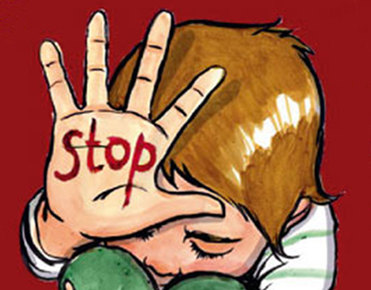


Slide 19
References
Autenrieth, U. (2018). Family photography in a networked age: Anti-sharenting as a reaction to risk assessment and behaviour adaption. In G. Mascheroni, C. Ponte, & A. Jorge (Eds.), Digital parenting: The challenges for families in the digital age (pp. 219–232). The International Clearinghouse on Children, Youth and Media. http://www.divaportal.org/smash/get/diva2:1265024/FULLTEXT01.pdf#page=221
Ammari, T., Kumar, P., Lampe, C., & Schoenebeck, S. (2015, April). Managing children’s online identities: How parents decide what to disclose about their children online. In Proceedings of the 33rd annual ACM conference on human factors in computing systems (pp. 1895–
1904). Association for Computing Machinery. https://doi.org/10.1145/2702123.2702325
Bannon, S., Ford, K., & Meltzer, L. (2011). Understanding millennials in the workplace. The CPA Journal, 81(11), 61-65.
Bartholomew, M.K., Schoppe-Sullivan, S.J., Glassman, M., Kamp Dush, C.M. & Sullivan, J.M.
(2012). New Parents’ Facebook Use at the Transition to Parenthood. Family Relations. 61
(3), pp. 455 – 469. doi:10.1111/j.1741 – 3729.2012.00708.x.
Bossetta, M. (2018). The digital architectures of social media: Comparing political campaigning
on Facebook, Twitter, Instagram, and Snapchat in the 2016 US election. Journalism & mass communication quarterly, 95(2), 471-496.
Brosch, A., 2016. When the child is born into the Internet: Sharenting as a growing trend among parents on Facebook.
Brosch, A., 2018. Sharenting: Why Do Parents Violate Their Children's Privacy?

