Slide 1
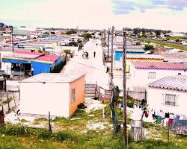


UNIVERSITY OF THE WESTERN CAPE
BEYOND REMOVAL:
A Policy and Practice Framework for Reunification, Family Preservation, and Support
PRESENTED BY
Lauren Fisher (UWC Final Year Social work Student)

Slide 2


THE CHALLENGE: POVERTY, NEGLECT, AND CHILD REMOVAL
CONTEXT...
Family From Eersteriver, Cape Town 2 Parents, Father “Employed” 3 Children, including a 3-month-old baby One dwelling (Hokie) Reported and under investigation for neglect

Slide 3

POLICY AND LEGAL CONTEXT
CHILDREN’S ACT 38 OF 2005: Define Neglect
REVISED WHITE PAPER ON FAMILIES: Vision and
support
Bridging the gap between policy and practice
03

Slide 4

Methodology
THEORETICAL FRAMEWORK
INFORMING THEORIES | Ecological Systems Theory: Understanding the Broader Context A Rights-Based Approach: Upholding Social Justice
RESEARCH STUDY METHODS | Qualitative Case Study: An In-depth Exploration Data Collection: Interviews & Document Analysis Key Participants: Voices from Families, Social Workers, and Policymakers
Back to Agenda
04

Slide 5
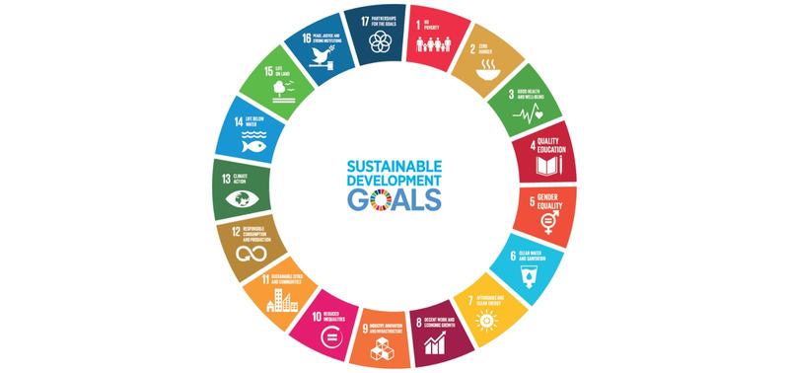

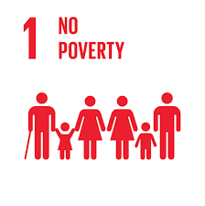
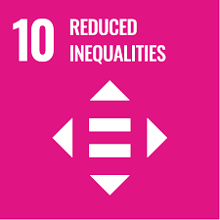
REUNIFICATION AS A COLLECTIVE RESPONSIBILITY
Contribution to the SDG’s
“A CHILD PROTECTION SYSTEM MUST DO MORE THAN REMOVE CHILDREN FROM UNSAFE ENVIRONMENTS; IT MUST ALSO SUPPORT FAMILIES TO HEAL AND REUNIFY.”
Despite frameworks like the Revised White Paper on Families (2021), families impacted by poverty are often separated without a meaningful reunification plan. Social workers assess a family’s ability to provide a "conducive environment," but little is done to help them achieve this standard.

Slide 6
PRELIMINARY FINDINGS
Poverty Misinterpreted as Neglect | Inadequate Post-Removal Support
Systemic Injustice The Breakdown of Support Overworked Social workers | When Poverty meets neglect Poor Aftercare services Barriers to Reunification Family Preservation Principles What happens after the child has been removed? Families receive insufficient support, undermining reunification efforts and perpetuating intergenerational trauma.
Back to Agenda
05

Slide 7

TOWARDS A JUSTICE-BASED CHILD PROTECTION SYSTEM
Specialists
Compassion
Social Work Practice
Towards a Justice-Based Child Protection System
Resource Reallocation
Policy Reform
Monitoring & Accountability
Upholding Rights

Slide 8

CONCLUSION AND FUTURE DIRECTIONS
“BEYOND REMOVAL”
 | “A CALL FOR A FAMILY CENTERED SYSTEM””
“URGENCY”
 | “COMPASSION”
Thank you for listening...

