Slide 1
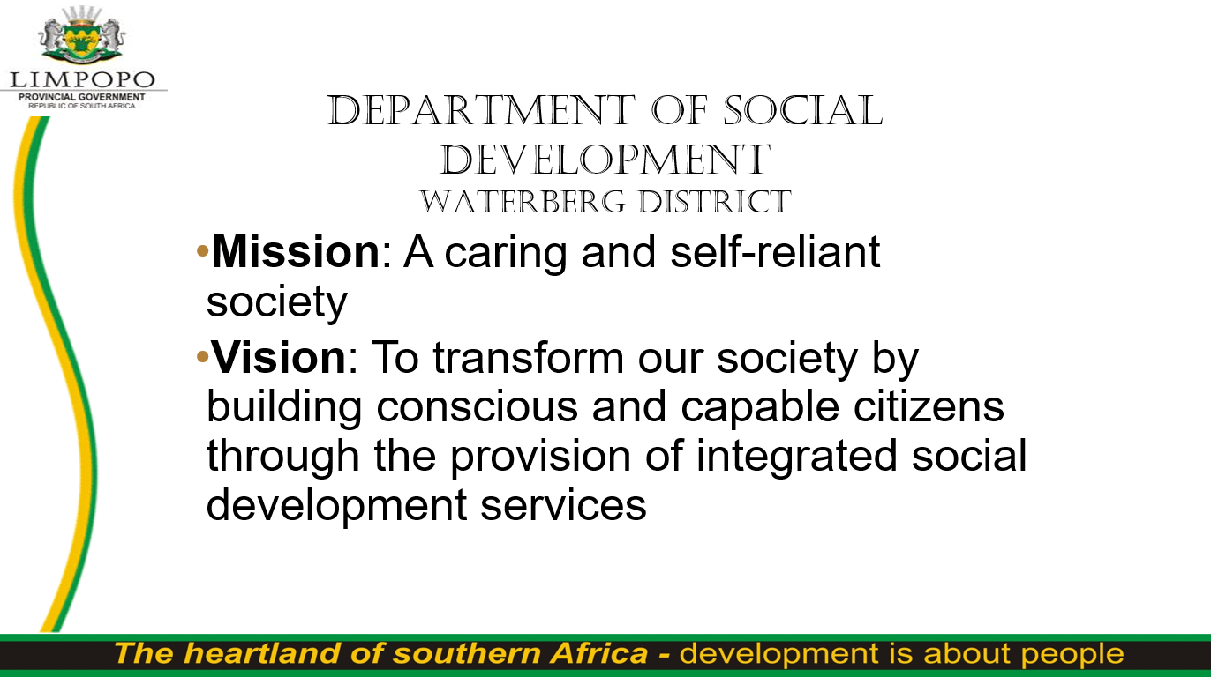

Slide 2






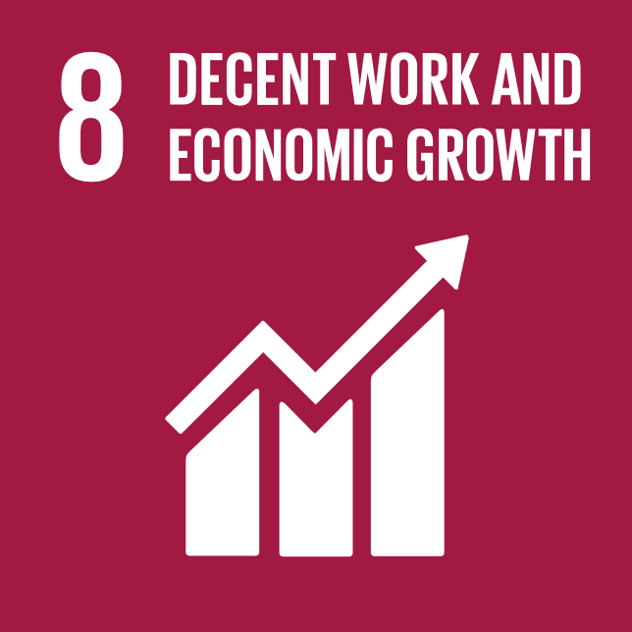

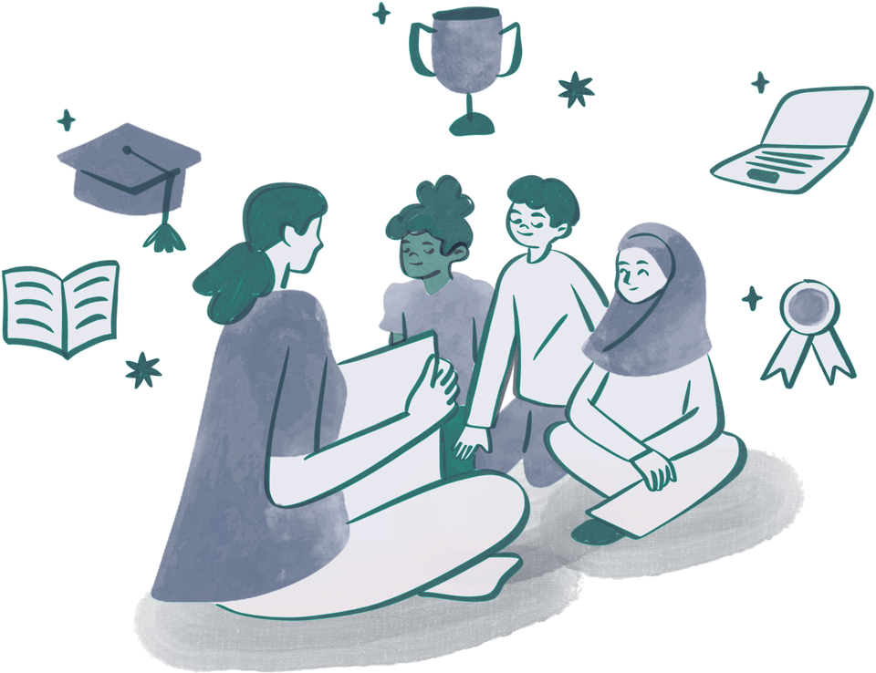


SOCIAL DIALOGUE & ACHIEVEMENTS OF SDGS
THE ROLE OF SOCIAL WORK IN ACHIEVING SUSTAINABLE DEVELOPMENT GOALS
LangaOK@dsd.limpopo.gov.za
PRESENTED BY:
LANGA ONICCAH MOKHOLOANA
DEPARTMENT OF SOCIAL DEVELOPMENT, LIMPOPO PROVINCE

Slide 3



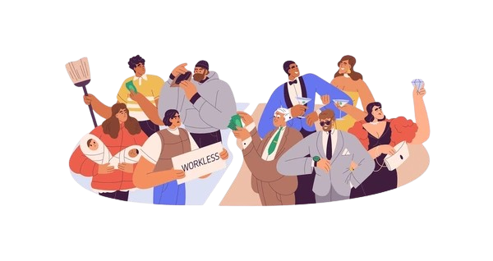


SOUTH AFRICA’S DEVELOPMENTAL CHALLENGES
Social, economic & environmental difficulties
South Africa faces complex social, economic, and environmental challenges that hinder sustainable development. High youth unemployment, inequality, fragmented service delivery, and adversarial institutional cultures limit meaningful progress. To overcome these obstacles, inclusive and coordinated efforts are urgently needed, with a focus on empowering communities and fostering collaborative governance.
Fragmented collaboration & adversarial dialogue
Need for inclusive, coordinated approaches

Slide 4

WHAT IS SOCIAL DIALOGUE?
• Inclusive conversations between government, civil society, and communities
• Promotes equity, resilience & collaboration
• Aims to replace conflict with shared governance

Slide 5




SOCIAL WORK AT THE CENTER
Social workers are uniquely positioned at the crossroads of government, civil society, and communities. Their role goes beyond service delivery they build trust, advocate for justice, and ensure that the voices of the vulnerable are heard. By promoting ethical leadership, citizen engagement, and policy responsiveness, social workers help create inclusive and sustainable pathways for development
Bridges gaps between communities & institutions
Builds trust & ethical leadership
Encourages citizen participation
Drives policy responsiveness

Slide 6




URGENT AREAS TO ADDRESS
South Africa must urgently confront key issues hindering sustainable development. High youth unemployment continues to limit economic participation, while poor education quality affects long-term growth. The dual nature of the labour market and heavy reliance on social grants highlight systemic inequalities. These areas require targeted intervention to unlock the country’s full potential and empower its people.
Youth unemployment & Education quality
Labour market dualism
Role of social grants

Slide 7


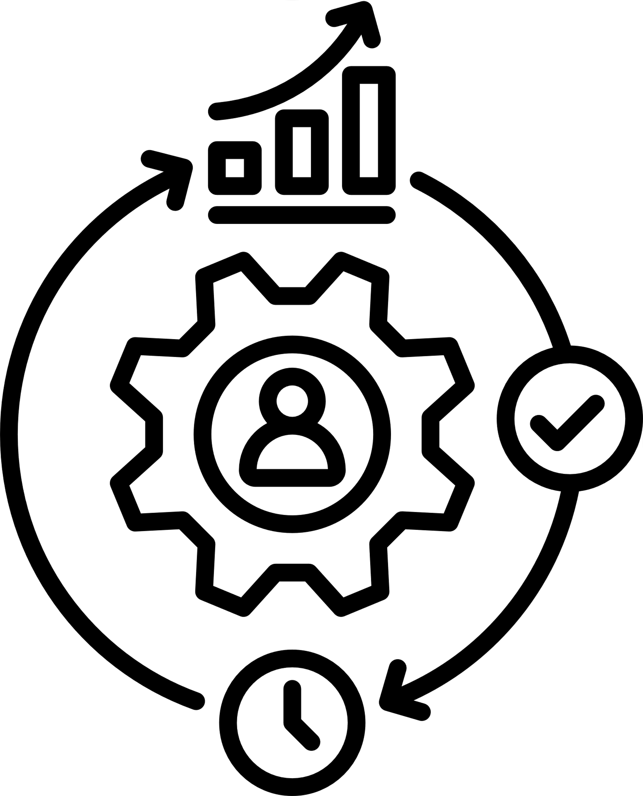

FROM CONFLICT TO COLLABORATION
Transforming social dialogue requires shifting from adversarial interactions to genuine collaboration. This involves strengthening institutional capacity, fostering talent mobility and encouraging active citizen participation. When communities, government and civil society work together through open dialogue and mutual trust, sustainable and inclusive development becomes possible.
Strengthen institutional capacity
Promote talent mobility
Engage active citizenry & align with policy reform & education

Slide 8




RECOMMENDATIONS
To build a just and sustainable future, we must embrace ethical leadership, reinvigorate shared governance, and empower civil society to hold institutions accountable. Social innovation and coordinated stakeholder action are essential to address complex social challenges and ensure no one is left behind. The time to act collectively is now.
Reinvigorate shared governance
Ensure ethical leadership
Foster civil society accountability
Use social innovation in service delivery

Slide 9


THE POWER OF SOCIAL WORK
• Social workers are essential to achieving SDGs
• They promote peace, justice & development
• Need for integrity, inclusion & advocacy
Call to Action
Social workers are key agents of change in achieving the Sustainable Development Goals. Through their commitment to justice, empathy, and ethical service, they help build peaceful, inclusive, and resilient communities. Their advocacy and frontline experience make them essential in driving development that is people-centered and sustainable.
Let us recognize and support the vital role of social workers in shaping a better future.
Now is the time for bold leadership, inclusive dialogue, and united action.
Together, we can build communities rooted in justice, resilience, and shared responsibility.
Be the voice. Be the bridge. Be the change.

Slide 10

CONCLUSION
Social work plays a vital role in shaping a just and sustainable future. By championing ethical leadership, strengthening collaboration between government, civil society, and communities, and empowering citizens to participate in decision-making, we can drive meaningful change. Together, we have the power to build inclusive, resilient, and thriving communities where no one is left behind.
“Be the voice. Be the bridge. Be the change.”
Social workers are more than service providers — they are catalysts for justice, equity, and transformation. Their work reminds us that lasting progress is built on trust, collaboration, and shared responsibility. When we embrace ethical leadership and collective action, we create the conditions for sustainable development and empower future generations to thrive.

Slide 11







SOCIAL DIALOGUE & ACHIEVEMENTS OF SDGS
CONTACT ME
Phone
+27 60 757 9354
Email
LangaOK@dsd.limpopo.gov.za
where to find me
Social Work Supervisor – Mahwelereng DSD

