Slide 1
The profile of people using nyaope admitted in substance abuse treatment centers Tshwane district
B Lekgau, M Mathibe

Slide 2
Background
15 percent of the Youth in SA are susceptible to different substances including Nyaope (Mokwena,2016)
Nyaope is a trendy drug that is found mainly in SA black township.
Easily accessible and cheap, contributing to it being a drug of choice to youth in SA ((Fernandes & Mokwena, 2016; Bala & Kang’ethe, 2021; Mamukeyani et al., 2023).
Nyaope is a Tswana name meaning something without a purpose
First appeared in SA between 2000 and 2006 specifically in Tshwane District (Mokwena and Huma, 2014).

Slide 3
Background cont.
Its composition therefore remains unspecified (Nzaumvila et al., 2023).
The limited knowledge of the constituents of nyaope is seen as a challenge when it comes to treatment (Khine & Mokwena, 2016)
Nyaope treatment is very complex, creating a need for specialised health-oriented interventions (Fernandes & Mokwena, 2016; Monyakane, 2018).
Relapse is part of the substance abuse recovery process however, it can discourage the whole process (Motsepe, 2022).
The illegalisation of Nyaope in 2014 was aimed at controlling it use (Mokwena, 2015) However the prevalences are still rising creating a need for treatment.

Slide 4
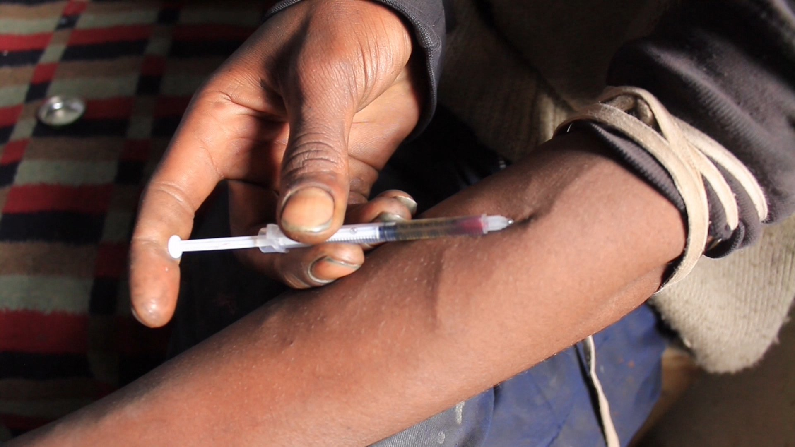
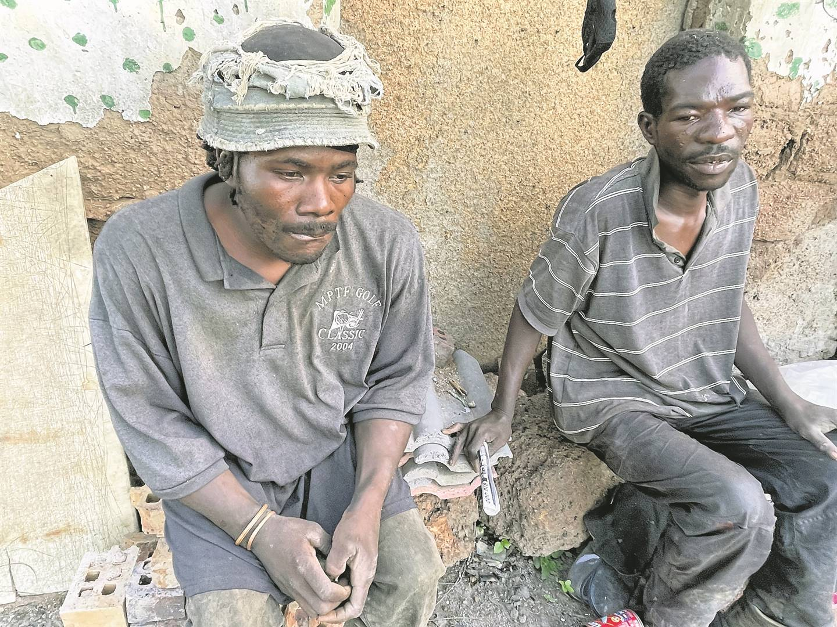
Problem statement
Although Nyaope is a public health problem it has received minimal attention as national crisis (Strauss, 2022).
There is dearth of literature on the people using nyaope admitted in the substance abuse treatment center.

Slide 5
Study Method
Quantitate approach, Cross sectional descriptive design.
Standardised self-administered questionnaires that were adapted from the study by Swanepoel et al (2016).
Google forms.
Smart phones with internet connectivity were utilised.
Study was intended to be conducted in all five treatment centers and 2 gave permission.
Non-probability convenience sampling was used due to unknown study population (Leavy, 2017; Pandey & Pandey, 2021).
Raosoft Calculator
Sample size 224.

Slide 6
Study Method cont.
Stata software Version 14.
Descriptive statistics used for analysis.
Data presented in tables, charts and graphs.

Slide 7
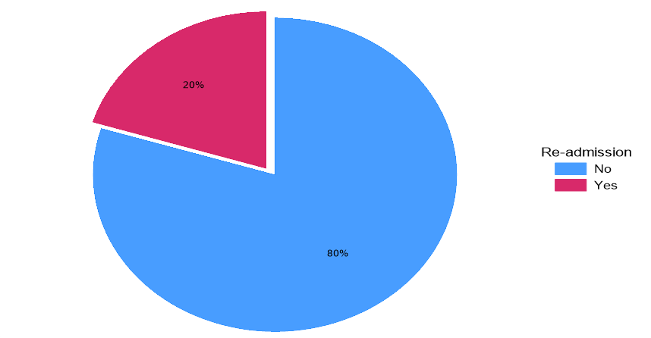
Results
Age 18-54
Highest qualification was High school
Unemployed and single
Majority started using cigarette(64%)
Nyaope used as a coping mechanism

Slide 8
Conclusion and recommendations
Majority of the users are young but there are old people.
Common amongst Black.
Stress is a main contributor to nyaope use.
Relapse is part of the process.
Social services
Public treatment centers
Family intervention
Policy makers reviews on Cigarette

Slide 9
References
Mamukeyani, E., Mashamba, T.J. and Onya, H., 2023. The lived psychological experiences of the youth resulting from the use nyaope drug in Sekhukhune District, Limpopo Province, South Africa. African Journal of Social Work, 13(3), pp.147-154.
Mokwena, K.E. and Fernandes, L., 2015. Exploring the role of external locus of control in the use of nyaope: a qualitative enquiry. Pula: Botswana Journal of African Studies, 28(1), pp.41-50.
Mokwena, K.E. and Huma, M., 2014. Experiences of nyaope users in three provinces of South Africa: substance abuse. African Journal for Physical Health Education, Recreation and Dance, 20(sup-1), pp.352
-363.
Nzaumvila, D.K., Mash, R. and Helliwell, T., 2023. Exploring the perspectives of community members on use of nyaope in Tshwane, South Africa. South African Family Practice, 65(4).

Slide 10



