Slide 1

Quizzing the Integration of entrepreneurship in social work education: The case study of Gauteng universities, South Africa. ASASWEI 2025 CONFERENCE Sub-theme:Social Work Education, Transdisciplinarity and Curriculum Development
Dr GB Bhuda
Social Work Department
University of South Africa

Slide 2

INTRODUCTION
South Africa is grappling with unemployment
The official unemployment rate rose to 33.2% in Q2 of 2025
The rate increased from 32.9% in the first quarter
The expanded definition, which includes those discouraged from seeking work, place the rate at 42.9% in Q2; a slight decrease from 43.1% in Q1.
Total number of unemployed persons rose to 8.4 million
Source: Stats SA Quarterly Labour Force Survey

Slide 3

INTRODUCTION
SA graduates also struggle to find employment upon completing
In Q2_2022 graduate unemployment rate was at approximately 10,2%
In Q2_2023 the rate was 9.6 8% (slight decrease from 2022)
In Q2_2024 the rate decreased by 2.1 percentage points to 9.7%
The Q2 2025 graduate unemployment rate in South Africa was 12.2%, an increase from 11.7% in Q1 2025
The markets continue to be unstable (- funding impact for sector)
Source: Stats SA Quarterly Labour Force Survey

Slide 4
Background of the study
Approximately over 10 000 qualified Social Workers are unemployed (Luwaca 2023).
This is despite the shortage of qualified social workers in the country
There are currently over 9 000 vacant positions within the Department of Social Development alone (DSD 2023).
According to the National Development Plan, the country needs 55 000 social workers by 2030.

Slide 5
Study Problem and Goal of study
Social work graduates are struggling to secure employment and even with this realisation it seems they are also struggling to create their own employment. There is also some reports of their exploitations in the NGO sector- work environments and low wages. This is despite the rigorous 4 years training programme they undergo during which they are trained to work with individuals, groups, organisations and communities from all spheres of life (lower, middle and upper class). The study seeks to quiz the integration of entrepreneurship in social work education

Slide 6
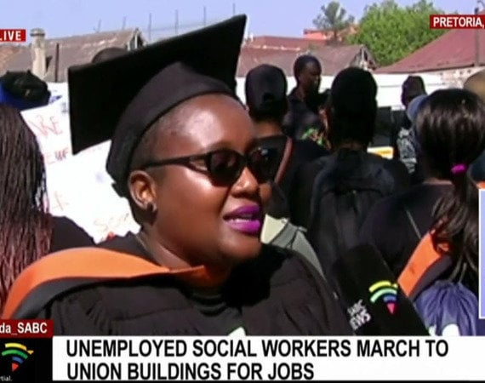
In March 2023 the Unemployed Social Workers Movement created a petition titled Fight against unemployment of Social Workers in South Africa
At the time the petition received about 8 000 signatures
In November 2023, the Portfolio Committee on Social Development convened to address issues raised in the petition

Slide 7
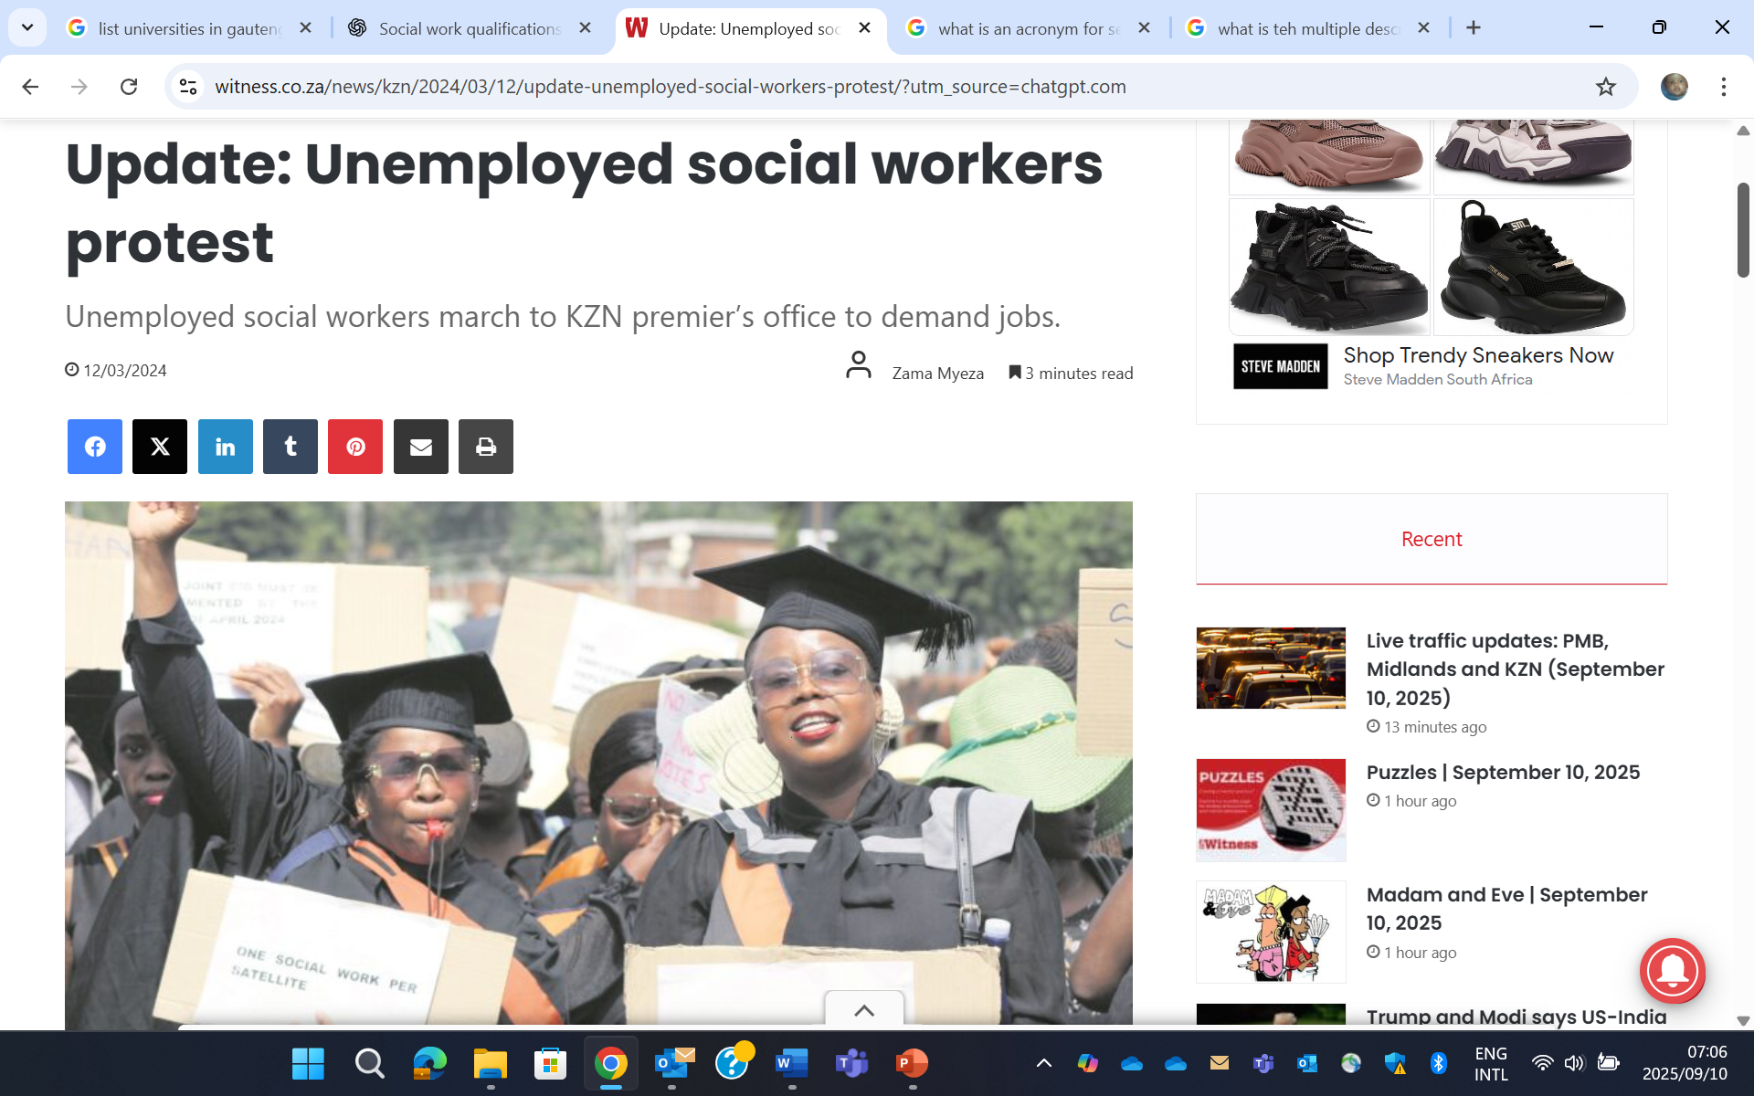
Their demands include:
• Appointment of qualified social work graduates into full-time positions; • The discontinuation of the department’s internship programme; • Better communication from the department; and • Treasury to allocate budgets for the unemployed to be absorbed into the Department of Social Development.

Slide 8
Research Methodology
Type: Desktop study (ongoing)
Design: Multiple descriptive case study design
Sources of data collection:
SAQA (Social work qualification standards)
Curriculums of 4 “traditional” Universities (SMU excluded).
SACSSP Board for Social Work Policy on continuing professional development (CPD) for social workers and social auxiliary workers
Data collection method: Qualitative systematic review

Slide 9
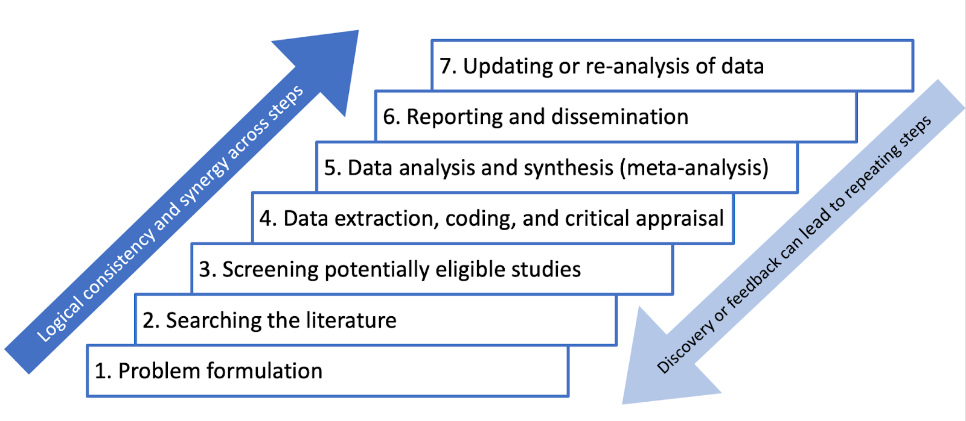
Systematic review and meta-analysis

Slide 10
Preliminary Findings
Social work programme details of the 4 universities do not mention entrepreneurship. (- Still to be completed: review their elective modules checking if entrepreneurship modules not housed within business or management programmes).
SACSSP CPD policy and norms and standards (2019/2021) also do not refer to entrepreneurship as a specific competency or encouraged area of development.
SAQA also does not explicitly mention "entrepreneurship" as a required component of social work education. However, it does encourage innovation, leadership, and capacity building in community development and management.

Slide 11
Why entrepreneurship and How?
Because different skills and competencies are needed to prepare students for the evolving job market
Community Development & Empowerment: Skills Training Hubs; Community Farming Co-operatives; youth Enterprise Incubators
Social Innovation & Technology: Mobile App Development – Apps connecting communities with social services (e.g., GBV helpline, food bank directory); Digital Peer-Support Platforms – Online groups for mental health, parenting, or unemployment support, monetised through subscriptions or funding.
Advocacy & Awareness: Gender-Based Violence (GBV) Support Projects and Human Rights & Civic Education Enterprises – Offering training services for schools, NGOs, and workplaces.

Slide 12
Conclusion
It cannot be not business as usual
In the words of the late Steve Bantu Biko before his death at the hands of South Africa's Security Police in 1977.
“We have set on a quest for true humanity, and somewhere on the horizon, we can see the glittering prize. Let us march forth with courage and determination, drawing strength from our common plight, our brotherhood and sisterhood. In time, we shall be in a position to bestow on South Africa the greatest possible gift— a more human face.”

