Slide 1
Proposed process guidelines for parental rights and responsibilities investigations in determining the best interests of the child in family law matters.
Dissemination of Process Guidelines
Sussarah Maria Elizabeth Nell PhD 3847467

Slide 2
Acknowledgement to
Supervisor Prof Glynnis Dykes
Co-supervisor Dr Shenaaz Carelse
Sussarah Maria Elizabeth Nell PhD 3847467

Slide 3

FOCUS / AIM
This study focused on the lack of standardised process guidelines for specifically Social Workers in private practice who deal with family law matters regarding the best interest of the child in parental rights and responsibilities investigations.
The South African Children’s Act 38 of 2005 sets out the legislation and procedures for determining the best interests of the child in terms of section 7. However, it was not clear how these stipulations should be carried out; and therefore, the result created inconsistency and confusion.
The study aimed to develop process guidelines in determining the best interests of child standard in parental responsibilities and rights investigations in the South African context. A qualitative research approach, intervention, and development research design were followed.

Slide 4
BACKGROUND
The researcher will present the six phases of the process guidelines, which include a pre-investigation protocol, risk assessment, child assessment, parent-child relationship assessment, parental capacity, and collateral investigation. These phases also included related checklists, which will guide the Social Worker in private practice.
Together, these phases and checklists illustrate the structure of the guidelines and the kinds of tasks that the Social Worker will focus on throughout the phases of the investigation.
The significance of the study and the guidelines is that they are designed for Social Workers who function in the legal arena on Parental responsibilities and rights investigations, determining the best interests of child, which had to rely on international guidelines that were not created with the Children’s Act 38 of 2005 in mind, and the specific sections in the Children’s Act related to family law.

Slide 5
STUDY PROCEDURES
TESTED IN A
6-MONTH PILOT STUDY WITH 12 SWIPP
FOCUS GROUP WITH
12 SWIPP INTERVIEWS WITH 6 ATTORNEYS
DEVELOPMENT
OF DRAFT PROCESS GUIDELINES
AMEND DRAFT PROCESS GUIDELINES
AMENDED DRAFT PROCESS GUIDELINES
DRAFTED PROCESS GUIDELINES WERE PRESENTED TO THE ONLINE DELPHI STUDY 95 % CONSENSUS IN 1ST ROUND
FINAL PROCESS GUIDELINES DISSEMINATION AT ASAWEI CONFERENCE
SYSTEMATIC
REVIEW –
3 THEMES EMERGED
LINKED WITH BIC - 14 CRITERIA

Slide 6
PROCESS GUIDELINES

Slide 7
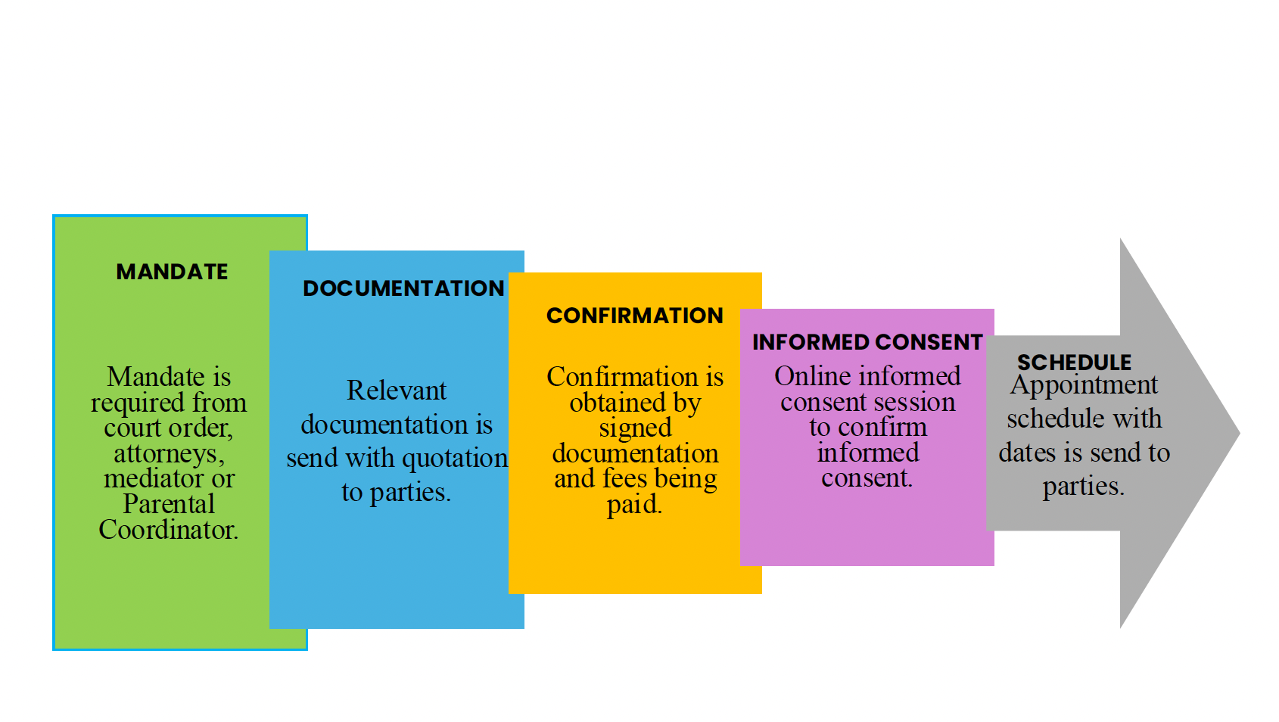
PRE-INVESTIGATION PROTOCOL

Slide 8
RISK ASSESSMENT
Proceed with the process at the beginning and throughout the investigation.

Slide 9
CHILD ASSESSMENT

Slide 10
PARENTAL CAPACITY

Slide 11
PARENT CHILD RELATIONSHIP
ASSESSMENT OF
f.
OBSERVATIONAL INTERACTIONAL SESSIONS
Whether the parent can provide the basic physical and emotional security and other needs of the child.
The parents’ roles in relation to their parental responsibilities and rights.
Parent-child observational interactional session in a formal setting.
Co-parenting dimensions, including availability, sensitivity, acceptance, and cooperation.
A child’s relationship and quality of attachment with a parent.
To conduct an observational interactional session with other relevant parties if needed.
Consistency and quality of caregiving tasks..
The attitude of the parent towards his/her parental responsibilities and rights.

Slide 12
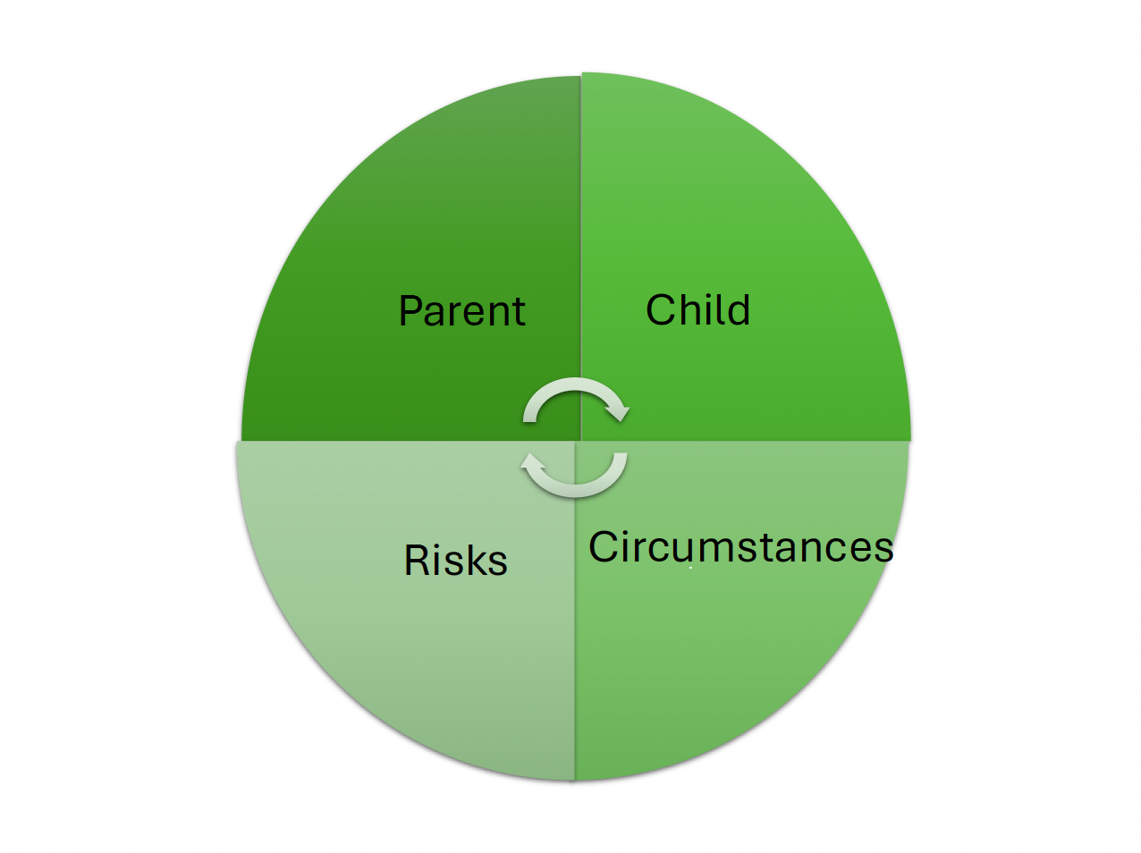
COLLATERAL INVESTIGATION

Slide 13
LAST WORDS

Slide 14


THANK YOU
QUESTIONS

