Slide 1


FINANCIAL LITERACY AS A PILLAR FOR SOCIAL PROTECTION: PROMOTING SUSTAINABLE LIVELIHOODS IN IMPOVERISHED COMMUNITIES
Marquin E. Smith, Adriaan Jordaan & Lambert K. Engelbrecht
ASASWEI CONFERENCE: 10 - 12 SEPTEMBER 2025

Slide 2

“Social protection goes well beyond direct cash or in-kind support; it includes policies and programs that bridge skill, financial, and information gaps, helping households and workers manage crises, escape poverty, navigate transitions, and seize employment opportunities” – World Bank (2025)

Slide 3
Introduction and Background
South Africa is faced with severe chronic poverty, unemployment and inequality.
In Q1 of 2025, the official unemployment rate rose to 32.9%, while the expanded unemployment rate increased to 43.1%. The youth unemployment rate also increased to 62.4%.
The lack of employment in SA forces individuals to enter the informal employment sector, such as day labouring where they are confronted with several injustices like exploitation, social exclusion, food vulnerability etc.
In 2024, approximately 30.4 million people in South Africa (55%) lived below the 2023 upper-bound poverty line (R1,634 per person per month [R55 a day], and about 13.8 million (25.2%) lived below the food poverty line (R796 per person per month [R27 a day].
This has led to a significant dependence on the government for survival through social grants.

Slide 4
Introduction and Background cont.
During the recent 2025/26 budget speech, the Minister of Finance allocated R284.7 billion for the disbursement of social grants - affirming this intervention as a cornerstone of the government's response to persistent high levels of poverty, unemployment, and inequality.
In South Africa, social protection, particularly social assistance, is rights-based and constitutionally mandated.
This paper argues that grant recipients must evolve from passive beneficiaries to active agents in their own development.
This paper adds to a growing body of literature underscoring the urgent need for targeted financial empowerment initiatives to facilitate ta transition from poverty to sustainable economic engagement. Within this context, financial literacy emerges as a critical strategy for empowerment—one that can be effectively delivered through the social work profession.

Slide 5
From a passive beneficiary to being an active agent: An SL approach
This paper is theoretically located within the Sustainable Livelihood Framework.
This approach identifies key assets that enable people in poverty to pursue livelihood activities and strategies. These include:
ASSET | DESCRIPTION
FINANCIAL | Represent the liquidity at a person's disposal, which is mostly accessed through savings, credit, heritage, right-based services and entitlements such as Cash Transfers (United Nations Development Programme, 1990).
HUMAN | Refer to skills, knowledge and the ability to conduct livelihood activities, as well as good health (Carney et al., 1999).
SOCIAL | Social capital assets connote networks of mutual support that exist within and between households, extended family and communities that people can mobilise to access resources (Adato et al., 2016; Sidloyi & Bomela, 2016).
NATURAL | Natural assets refer to environmental assets such as land and common property resources (Nnaeme et al., 2020).
PHYSICAL | The basic infrastructure and producer goods that support livelihoods and enhance productivity (Scoones, 1998).

Slide 6
From a passive beneficiary to being an active agent: An SL approach cont.
In a research study conducted by Patel et al. (2022), it was found that social grant beneficiaries do engage in livelihood activities such as:
        Buying and selling goods
        Supplying goods
        The provision of services e.g. building; repairs
        Running restaurants or taverns
        Renting accommodation
        Traditional healing
        Fafi (betting)
        Farming (subsistence and commercial)
        Beadwork
This study further found that grants acted as Grant acts as seed money, helped to grow and sustain businesses, invested grant money, grants assist with cash flow, support consumption smoothing, and investing in future livelihoods (Patel et al., 2022).

Slide 7
From a passive beneficiary to being an active agent: An SL approach cont.
Patel et al. (2022) showed that grants can be highly transformative for the grant beneficiaries looking to grow their livelihoods and becoming an active agent.
However, barriers to non-engagement in livelihood activities includes - amongst others - lack of access to capital, credit, small loans & lack of experience, knowledge & information e.g. financial literacy skills to initiate a livelihood activity.
Therefore, this paper is advocating for a policy shift by suggesting the integration of financial literacy programmes within the broader social protection space.
Financial literacy empowerment can enhance the capitals/assets of individuals/households and contribute to the NDP objectives, Aspiration 1 of the Africa Agenda, as well as several SDG’s.

Slide 8

Understanding financial literacy
Within this context, financial literacy may be defined as having the knowledge, skills, values and, consequently, habits required to successfully manage money at the personal and family level for earning, spending, saving, borrowing, and investing (Engelbrecht, 2015; Engelbrecht & Ornellas, 2019).
Empowering service users with financial knowledge and skills, can result in upward economic migration (Sherraden, 2010; 2018).
Lusardi & Mitchell (2014) emphasise the practical application of financial knowledge, noting that true financial literacy is demonstrated in behaviour (budgeting, saving, avoiding over-indebtedness).

Slide 9
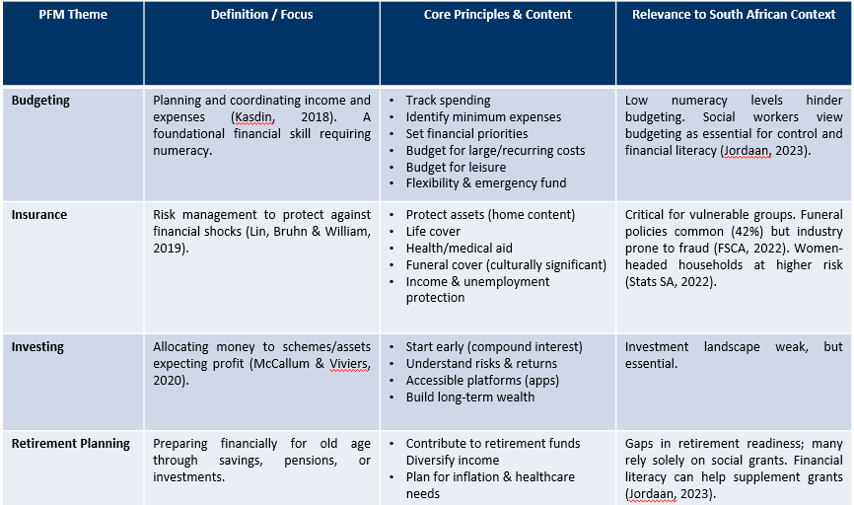
Personal Financial Management (PFM) as an Application of Financial Literacy

Slide 10
Towards a Conceptual Framework: Financial Literacy as a Key Pillar
Earning: Linking grants to income-generating opportunities.
Spending: Budgeting techniques (needs vs wants). Managing daily expenses in low-income households. Avoiding unnecessary debt encouraged by credit providers.
Saving: Importance of emergency funds. Stokvels, savings groups, and low-cost savings products. Safe saving habits in rural/urban contexts.
Borrowing: Understanding credit, interest rates, and repayment obligations. Risks of over-indebtedness and loan sharks. Accessing microfinance responsibly.
Investing: Basics of investing (formal and informal) .Long-term planning (education, housing, small businesses). Understanding risk and return.
Protection & Planning: Insurance (health, funeral, agriculture).Financial fraud awareness (scams, identity theft).Planning for retirement or unexpected shocks.
Financial
Social
Human
National & International Frameworks:
NPD (2030): Poverty Alleviation
Africa Agenda (2063): Aspiration 1
SDGs (2030): 1, 2, 3, 4, 5
Community Work
Create awareness on macro level.
Group work
Life Skills Group with a focus on financial empowerment.
Case Work
Individual Psychosocial support services – forming part of the IDP of service user.
Family Preservation services
Mapping of sustainable livelihood activities.
BROAD THEMES
ENHANCING ASSETS

Slide 11
Conclusion
It is evident that Social Grant beneficiaries can transform from passive beneficiaries to change agents – taking control of their circumstances.
Financial literacy initiatives has the potential to enhance several assets/capitals leading to the promotion of principles relating to the sustainable livelihoods framework.
Through this proposed framework, the SW profession can contribute more directly and sustainably to the national and international frameworks.
However, are we prepared to reimagine social work practice in a contemporary South Africa?

