Slide 1

FINANCIAL CAPABILITY DEVELOPMENT AS A DRIVER FOR POVERTY ALLEVIATION IN SOUTH AFRICA: THE NEED TO TRAIN SOCIAL SERVICE PROFESSIONALS
Marquin E. Smith & Lambert Engelbrecht
ASASWEI CONFERENCE: 10 - 12 SEPTEMBER 2025

Slide 2
Introduction and Background
South Africans continue to be faced with high levels of poverty, unemployment and vulnerability, despite significant efforts from their government and decades of numerous offerings of international aid to overcome poverty.
The figure on the next slide signals how unemployment increase over the years.
Poverty and vulnerability have recently worsened significantly for most people in the world, including South Africans, due to global economic shocks such as Covid-19, wars, and political instabilities.
To combat poverty and vulnerability, the South African Government has already adopted, more than two decades ago, a developmental approach to social welfare – as mandated by the White Paper for Social Welfare (RSA, 1997; RSA, 2016).
Thus, SSP’s ommitted themselves in principle to social development, which implies “… promoting people’s welfare in conjunction with a comprehension process of economic development” (Midgely, 1995, p.250).

Slide 3
Introduction and Background cont.
South African Unemployment Rate: 2004 – 2024

Slide 4
Introduction and Background cont.
According to Weyers (2013), the social development approach is predicated on the idea that appropriately designed and implemented programmes would enhance its economic development, however both the scope of social work practice (RSA, 2022) and the current standards for the Bachelor of Social Work (Council on Higher Education [CHE] in South Africa is silent on economic development, financial literacy and financial capability development.
More than two decades ago Hall and Midgley (2004) held the view that while human welfare development is needed to lessen poverty, development has no meaning if it does not increase the income and well-being of all.
Therefore, financial capability development could and should play a significant role in alleviating poverty among poor households in South Africa and in increasing their overall wellbeing.

Slide 5
What is financial capability?
Financial capability is defined as the combination of knowledge, skills, attitudes and behaviour that a person needs in order to make sound financial decisions to support financial wellbeing (Arnold & Rhyne, 2016; Rousseau & Venter, 2016; Storchi & Johnson, 2016, Xiao et al., 2022).
Sherraden (2010) refers to financial capability as requiring both the ability to act (knowledge, skills, confidence and motivation) and the opportunity to act (through appropriate financial products and financial institutions).
Bambeni (2021) notes that there are core elements that constitute financial capability: i.e. 1) financial literacy, 2) financial inclusion, 3) financial behaviour, 4) economic opportunities and 5) economic self-sufficiency (cf. Engelbrecht, 2008b, 2009, 2011; Jordaan, 2020; Jordaan, 2023).
In Kenya financial capability practices are beneficial to the financial wellbeing of individuals. However, Owuor et al. (2023) admit that social workers in Kenya struggle to tackle service users’ increasingly complex financial problems due to lack of knowledge on how to do so.

Slide 6
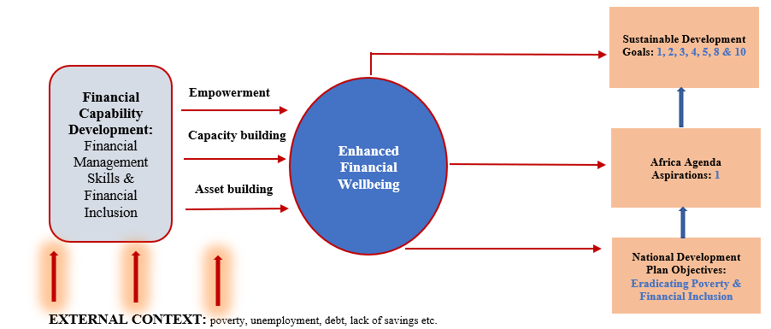
Financial Capability Development as a response to the objectives of National and International Frameworks

Slide 7
Institutional Frameworks & Financial Capability Development
Financial capability cannot be understood or operationalised in isolation from the institutional context in which it operates.
Important to note and understand are the key Policy and Legislative Framework for Financial Capability Development:
Policy/Legislative Framework | Purpose
The National Credit Act (NCA) | Aiming to promote responsible borrowing, safeguard consumers, and curb predatory lending practices
The Consumer Protection Act (CPA) | Safeguarding consumers against unfair practices in goods and services markets. It guarantees rights to disclosure, fair value, and recourse mechanisms
Retirement Reform and the Two-Pot System | The reform aims to strike a balance between short-term liquidity needs and long-term retirement adequacy.

Slide 8
Towards Core Content Areas for curricula in the training of Social Service professionals
Content Area | Brief Description
Money Management and Household Financial Resilience | Money management lies at the heart of financial capability (Jordaan, 2023). It encompasses cash-flow tracking, budgeting, managing irregular income, and building emergency savings.
Debt Literacy and Consumer Protection | Debt literacy involves understanding the costs, risks, and rights associated with credit, and the mechanisms available to address over-indebtedness.
Savings, Asset-Building, and Retirement Planning | Savings and asset-building are critical to financial resilience and long-term security. The FCAB model emphasises that assets provide a buffer against shocks, facilitate investment in education and livelihoods, and contribute to intergenerational well-being
Social Assistance Navigation | Social grants are not only a poverty-alleviation mechanism but also a cornerstone of household financial management in South Africa. Financial capability in this context requires knowledge of eligibility criteria, application processes, fraud risks, and budgeting with social grants.
Livelihoods, Work, and Microenterprise Development | Combining financial training with asset transfers, livelihood coaching, and market linkages produces sustained improvements in income and financial resilience. South African evidence indicates that microenterprise initiatives often fail due to inadequate financial planning, poor record-keeping, and limited access to affordable credit.

Slide 9
Conclusion
Financial capability development is an essential skill for Social Service Professionals, in particular social work & community development.
Despite the above, the current curricula is silent on financial capability – thus making it difficult for social service professionals to participate in financial capability development interventions and subsequently combating poverty.
Training social workers and community development in financial capability would position the profession to directly contribute to the advancement of the NDP (2030); Africa Agenda – Aspiration 1 and SDG’s.
Knowledge and skills pertaining Financial Capability development is no longer optional but a necessity in order to respond to the contextual realities of the country.

