Slide 1

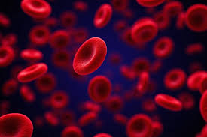
Enhancing Social Work Intervention in the HIV and AIDS Response through Integrated Community-Based Approaches
By
Lerato Songo
Social worker

Slide 2
Content of presentation
Context and background
01
Research methodology
02
Results
& recommendations
03

Slide 3
01. Context & Background
HIV & AIDS
Approximately 7.8 million people live with HIV as of 2022 in SA
SDG 3: Good Health & wellbeing
Social worker’s role in HIV and AIDS
PROFESSIONAL JOURNEY
Masters Degree in Social Work
Duration: 2021-2022
Capturing a social worker’s voice

Slide 4
02. Research Methodology
Qualitative research study
Exploring social worker’s role and experiences in fighting HIV & AIDS
In-depth interviews with 10 social workers
DSD, Tshwane Region
Goal: Experiences of social workers
Objectives:
  Challenges
  Resilience in collaboration

Slide 5
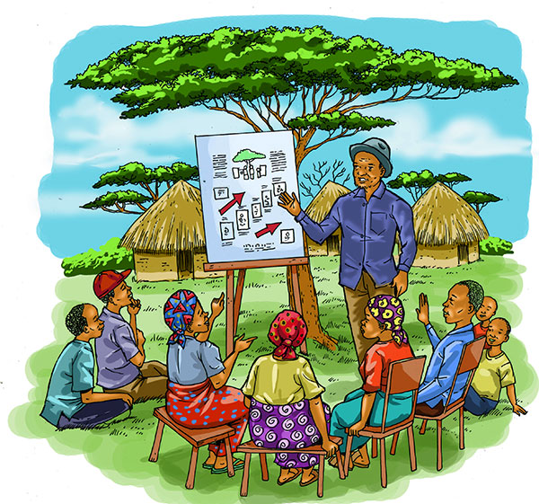
03. Results and recommendations
Social workers role found to be educational in nature
High caseload and burnout
Awareness is not enough
We need to address structural hindrances of communities
We need to enhance Social Work Interventions
through Integrated Community-Based Approaches
PhD studies exploring further
Hybrid studies

Slide 6


