Slide 1
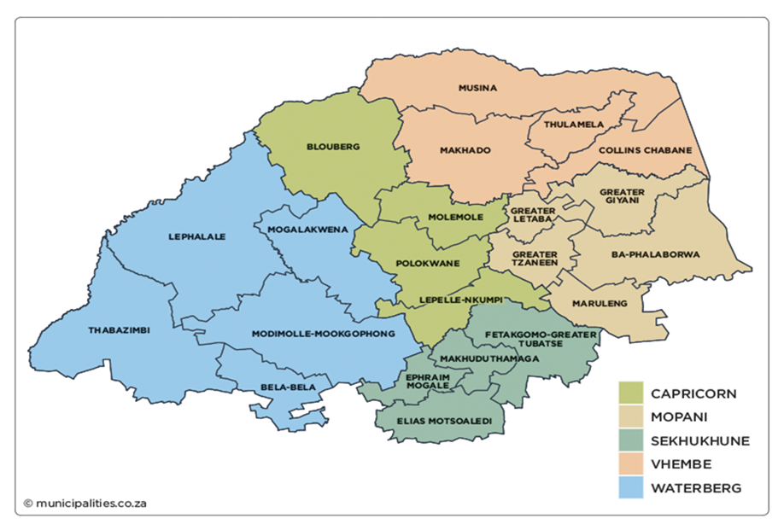


NAVIGATING MARRIAGE POST-INFIDELITY: LIVED EXPERIENCES OF MARRIED WOMEN AND THEIR NEED FOR SOCIAL WORK SERVICE
Ms Manare Belsie Ngwasheng¹ and Prof. Rembuluwani Paul Mbedzi²
^{1&2} Department of Social Work, University of South Africa, Pretoria, South Africa
INTRODUCTION AND BACKGROUND
Infidelity remains a significant challenge in marital relationships, often resulting in emotional distress, trust issues, and even marital dissolution ^{[1]}.
Several marriages may overcome the betrayal of infidelity, many others fail immediately after the unfaithfulness is realized, leading to separation of the married partners ^{[2]}.
While some choose to end their marriage following infidelity ^{[3]}, others decide to remain and attempt to rebuild their relationship ^{[4]}.
The decision to stay in a marriage post-infidelity is complex and influenced by various emotional, psychological, cultural, and social factors ^{[5]}.
Social workers play a crucial role in assisting married women post-infidelity as they provide emotional support, facilitate communication, and help them develop coping strategies to navigate their relationship challenges.
However, the effectiveness of social work interventions in post-infidelity marriages is not well documented, leaving a gap in understanding the specific needs of married women and the best practices for intervention ^{[6]}.
This study aimed to explore the lived experiences of married women on how they navigate their marriages post-infidelity and their need for social work services.
RESEARCH METHODOLOGY
SUGGESTIONS FOR SOCIAL WORKERS REGARDING SUPPORT SERVICES TO MARRIED WOMEN POST-INFIDELITY
Approach: Qualitative research approach was used to explore meanings, emotions, perceptions, and experiences.
Data Collection: Semi-structured interviews offered flexibility to explore participants’ perspectives.
Research Designs: Phenomenological approach examined participants’ lived experiences and how they assigned meaning to their situations; Exploratory design investigated this under-researched area to uncover new insights; Descriptive approach provided a detailed account of participants’ perspectives without focusing on causality; and Contextual design analysed experiences within natural settings, emphasising social and personal influences.
Theoretical Framework: Resilience theory and Strength-based theory.
Data analysis: Tesch’s eight-step process for qualitative analysis and independent coder ^{[7]} .
Trustworthiness: The study adhered to credibility, transferability, dependability, and confirmability ^{[8]}.
Ethical considerations: Informed consent, Confidentiality, Anonymity, Debriefing, Beneficence, and Ensuring no harm to participants were prioritised throughout the research.
Men should be encouraged to use services.
Social workers should offer counselling to children and families.
Hold separate counselling sessions.
Hold support groups.
Guide or help them learn how to cope.
There should be regular follow-up through home visitations and use of technology for better access to the services.
Promote awareness in communities
Reduce fees.
Be empowered to provide tailored support for each individual.
RECOMMENDATIONS
Practice Guidelines | Social Work Education | Social Work Training | Social Welfare Policy | Future Research
Develop clear guidelines for social work services that address married women’s post-infidelity needs and perspectives | Include infidelity and its impact on married women in social work curricula to equip future practitioners. | Implement DSD training programs to strengthen services for married women post- infidelity. | Enhance policies to support married women with counseling, legal/financial recognition, community support, and awareness campaigns. | Expand studies to other provinces to better understand married women’s post-infidelity needs and services.
RESEARCH FINDINGS AND DISCUSSION
All participants were female, aged between 29 and 48 years, representing a diverse range of life stages and marital experiences.
They all identified as African, with their residences spanning both urban and rural areas in and around Polokwane (Capricorn district, Limpopo Province).
Discovery of infidelity: Discovered through phone messages, calls, friends, colleagues and rumours.
Reasons for staying: Love & commitment for each other, children, financial dependence & entanglement, loneliness, stigma, religious and cultural reasons.
Life experience post-infidelity: Experience low self-esteem, insecurity, lost trust for husband, lack of communication, and self-blame.
Coping strategies: Counselling/therapy, talks to friends/family, self-care (hiking, exercising, meditation etc.), flirt with a few guys/cheat back, cry and pray.
Services sought from social workers: Individual counselling and counselling.
Gaps identified in service: Some indicated the services were effective, others found them ineffective, most highlighted that social workers had no understanding of complexities or cultural context, they lacked training, empathy and understanding of the reasons they remain in marriage post-infidelity.
CONCLUSION
Married women emphasised the importance of accessible, flexible, and personalised support services, highlighting the need for emotional support, specialised counseling, and community engagement.
They advocated for reducing stigma around therapy, addressing financial barriers, and offering both individual and joint sessions to facilitate healing and trust-building.
These insights provide valuable guidance for social workers in enhancing their approach to supporting women who have chosen to stay in their marriage post-infidelity.
Source:https://www.micoope.com.gt
REFERENCES
Rokach, A. & Chan, S.H. (2023). Love and infidelity: Causes and consequences. International Journal of Environmental Research and Public Health 20(5):3904.
Watson. (2019). Unfaithfulness in marriage: what is infidelity?. https://www.bookwriters.com/unfaithfulness-in-marriage-what-is-infidelity/. (Accessed on 12/12/2023).
Coburn, H. (2018). Together after infidelity: A relational story of moving forward. (PhD thesis). Vrije Universiteit Brussel.
Wenger & Frisco. (2021). Extradyadic sex and psychological distress among married and cohabiting young adults: an examination of internalized and externalized responses. Journal of family issues 42(4):785-812
Wampler, K. & Blow, A. (2020). The handbook of systemic family therapy: Volume 3. John Wiley & Sons.
Hertlein, K.M., Chang, J., VanYperen, A., Fatkin, K. & Nakamura, S. (2022). Experiences after infidelity via internet communication: Surveillance, ambivalence, and termination. Sexual and Relationship Therapy 37(4):537-556. https://psycnet.apa.org/doi/10.1080/14681994.2021.1907568.
Tesch, R. (1990). Qualitative research. Falmer Press.
Bryman, A. (2016). Social research methods. Oxford University Press.

