Slide 1
Barriers of successful reunification service for children placed in Child and Youth Care Centre's

Slide 2
INTRODUCTION
Manana Molefe is currently employed by the Department of Social Development Vrede Satellite office and responsible for Warden area.
10 years experience in generic Social Work
The topic that I will be presenting will be based on Barriers of successful reunification service for children placed in Child and Youth Care Centre’s.

Slide 3
OUTCOMES
1. Background
2. Method
3. Discussion
4. Findings
5. What was hard
6. Message
7 Conclusion

Slide 4
BACKGROUND
In Phumelela Municipality, Warden area has reflected the highest number of children placed in Child and Youth Care Centre’s with minimal effective reunification services. (13 children)
Amongst the children institutionalized, school drop out at the age of 16years is becoming a norm, leading to financial distress to those families facing removal.
Unfortunately some children display abnormal behaviors after being granted leave of absence causing indecisiveness in providing reunification service.

Slide 5
METHOD
Parenting Skills
Reunification panel meetings

Slide 6
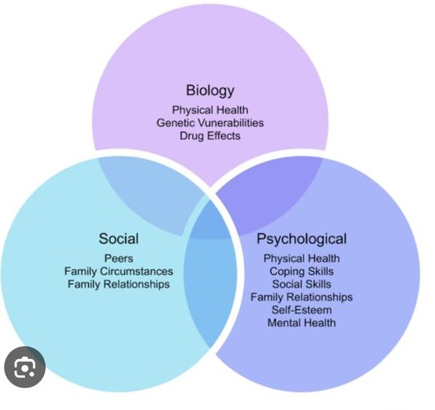
DISCUSSION BIOPSYCHOSOCIAL MODEL

Slide 7
FINDINGS
It was discovered that parents are victims of their family systems and patterns therefore finding it easy to cascade dysfunction to upcoming generations- Systems Approach
Substance abuse
Unfortunately as much as children are removed from such family systems, resistance in adjusting to good parenting skills causes repeated modelled behaviors during leave of absence.
Strength based perspective
Molo Mhlobo Wami campaign

Slide 8
What was Hard
Providing parenting skills to different race- two different languages
Attending different children’s homes meetings and having to face similar news about the misconduct of parents who faced removal. Genetic problems- can a leopard change its sports
Accepting that children from Warden area not allegeable to being taken to a less restrictive placement like foster care

Slide 9
MESSAGE
Children belong to their families and when engaging reunification processes the families can tend to be fragile since they will start to have awareness of the dysfunctions in their families. That can leave them vulnerable at times but continuing with the process strengthens the chances of change.
Reunification process is also a team work” alone we can do so little but together we can do so much” Helen Keller

Slide 10
Conclusion
In conclusion most children like to live with their parents despite their shortcomings. It is therefore essential to use findings depicted, as guides of addressing barriers of successful reunification to encourage raising children within family settings. Parents are Wardens of their children therefore as we focus more on offering parenting skills children are more likely to face speedy reunification services

