Slide 1

The Forgotten Link in Addiction Recovery
Service Users’ Experiences of Accessibility and Availability of Aftercare Services in the Western Cape
Danyschka Jacobs & Dr Ilze Slabbert
Stellenbosch University

Slide 2
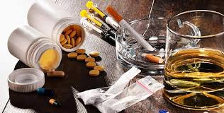
Substance abuse is a global pandemic
According to WHO over 275 million people use substances yearly
In 2024, over 3 million deaths were attributed to alcohol and drug use complications, this is 5% of all global deaths (WHO, 2024)

Slide 3
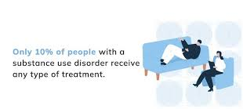
In South Africa, 13.3% of the population was affected by substance abuse and dependency (Kaswa et al., 2020)
In the Western Cape, there’s a significantly higher prevalence with 18.5% of the population affected
Western Cape has the highest rates of FASD in the country, and globally (May et al., 2016)
Substance abuse continues to fuel high rates of crime (Isobell et al., 2018), unemployment, is strongly associated with the spread of communicable disease (Myers et al., 2010), and family breakdown
Cannabis, Alcohol, and Methamphetamine (Tik) remains the most commonly used substances (SACENDU, 2018)

Slide 4

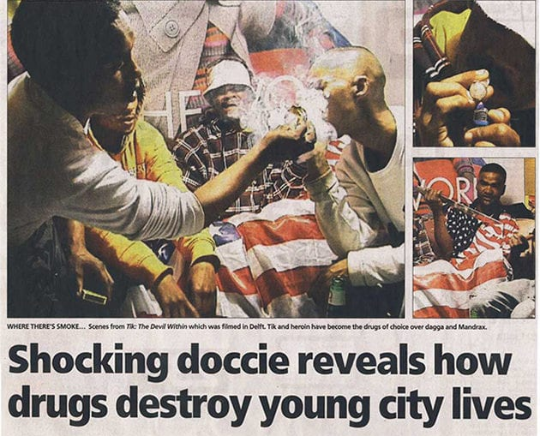
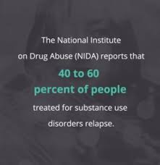
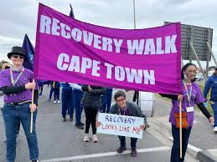

Slide 5
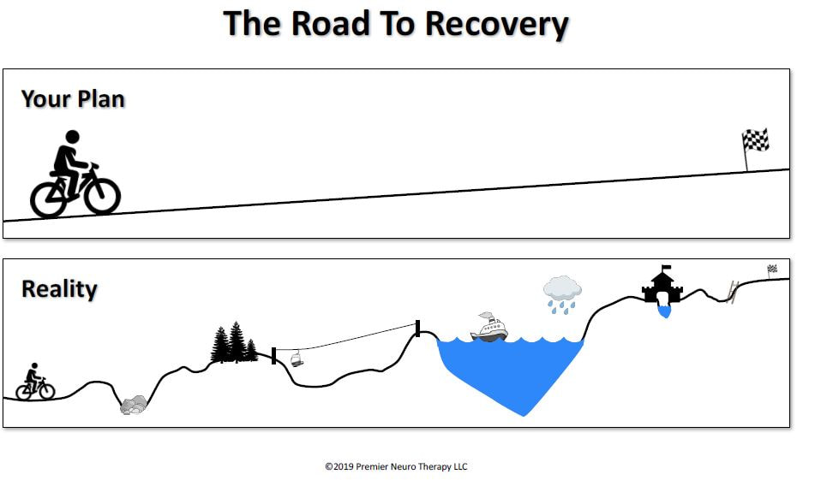
Why Aftercare Matters
Addiction is considered a chronic, relapsing disease (NIDA, 2020)
Aftercare = critical but the most overlooked service (Myers et al., 2010)
Sustains recovery beyond rehab (McKay, 2017)
Socioeconomic instability in our communities heightens the risk of relapse (Isobell et al., 2018)
Less than 30% of those in recovery access aftercare services, with gaps in referrals, and general awareness/ knowledge of these services (Bhana, 2007)

Slide 6

Research Aim
To explore accessibility & availability of aftercare services in the Western Cape
Focus: adult service users in recovery in the Western Cape

Slide 7

Methods
📝 Qualitative study using an exploratory and descriptive design
– Aimed to capture in-depth lived experiences of recovery
👥 👥 Semi-structured interviews with service users
– Allowed flexibility while focusing on aftercare experiences
🎯 Purposive sampling of individuals in recovery
– All had completed formal rehab and were expected to know about or have tried accessing aftercare services

Slide 8

Key Finding:
Aftercare = neglected link in continuum
Rehab centers lack follow-up capacity
Most services are inaccessible post-rehab

Slide 9

Key Finding: Barriers
Structural: limited funding, few programmes
Systemic: policy gaps, low prioritisation
Attitudinal: lack of awareness & info

Slide 10
Participant Voice
“In the past I did relapse because there was no structure of support groups, you see. You hear about them now and when you go there, there are none.”
“It is difficult to be here because if you are not busy, with nothing to do, there is a gap for relapse. You need to achieve your goals, figure out your goals and learn to see yourself somewhere in life. This community and the people in it need a lot more support.”

Slide 11
Participant Voice
“My friends are gang bangers, they use me, and I do not feel like I am being loved, it’s false. Because I know that real friends don’t give each other drugs, they would rather give support. I can’t say I’ve been supported by them, before, I thought they loved me and that they were my only family.”
“My main problem is that I am staying next to a merchant, a drug dealer. That is going to be a big problem for me because every time I must walk by his house”

Slide 12

Conclusion
Aftercare is essential for long-term recovery
Neglect undermines recovery outcomes
Urgent need to strengthen the continuum of care

Slide 13
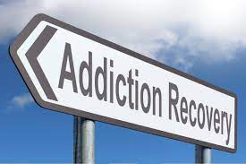

Recommendations
Increased investment in aftercare programmes
Expand accessible, community-based services, especially in rural areas
Raise community awareness & share information across rehab centers, hospitals, and other various access points

Slide 14
References:
World Health Organization. (2024, June 25). Over 3 million annual deaths due to alcohol and drug use: Majority among men. World Health Organization. https://www.who.int/news/item/25-06-2024-over-3-million-annual-deaths-due-to-alcohol-and-drug-use-majority-among-men
Kaswa, R., De Villiers, M., & Van der Merwe, T. (2020). Prevalence of substance use among adolescents in South Africa: A quantitative cross-sectional study. African Journal of Primary Health Care & Family Medicine, 12(1).
May, P. A., Marais, A. S., de Vries, M. M., Kalberg, W. O., Buckley, D., Hasken, J. M., Adnams, C. M., Barnard, R., Joubert, B., Cloete, M., Tabachnick, B., Robinson, L. K., Manning, M. A., Jones, K. L., Bezuidenhout, H., Seedat, S., Parry, C. D. H., & Hoyme, H. E. (2016). The continuum of fetal alcohol spectrum disorders in a community in South Africa: Prevalence and characteristics in a fifth sample. Drug and alcohol dependence, 168, 274–286. https://doi.org/10.1016/j.drugalcdep.2016.09.025
Isobell, D., Kamaloodien, K. & Savahl, S. 2018. Addiction treatment providers’ perceptions of publicly funded treatment services in the Western Cape, South Africa. Journal of Psychology in Africa, 28(1): 77-80.

Slide 15
References:
Myers, B., Pasche, S. & Adam, M. 2010. Correlates of substance abuse treatment completion among disadvantaged communities in Cape Town, South Africa. Substance Abuse Treatment, Prevention, and Policy, 5:3.
SACENDU. (2018). Alcohol Use and Other Drug Trends – 2018 Update. South African Community Epidemiology Network on Drug Use. (Report published June 1, 2017; circulated mid-2018.)
National Institute on Drug Abuse. (2020). The science of drug use and addiction: The basics. National Institutes of Health, U.S. Department of Health and Human Services
McKay J. R. (2017). Making the hard work of recovery more attractive for those with substance use disorders. Addiction (Abingdon, England), 112(5), 751–757. https://doi.org/10.1111/add.13502
Bhana, A. (2007). The prevalence of substance use and associated factors among adolescents in South Africa. African Journal of Drug and Alcohol Studies, 6(2).

