Slide 1

Presenter’s Biography
Seakamela Mokgoba Charles
BSW, Wits University
MBA, Regenesys Business School
14 years in Social Work practice
Roles: Medical SW, Deputy Director Allied (Acting), Substance Abuse & VEP Coordinator

Slide 2
Introduction
Topic: Mainstreaming digital and assessment tools in rural Social Work practice: insights from Lephalale Social Workers
Subtheme: Evaluating the effectiveness of digital tools in Social Work practice
Research question: What are the perceptions and preparedness of rural Social Workers in integrating digital and assessment tools into their practice?

Slide 3
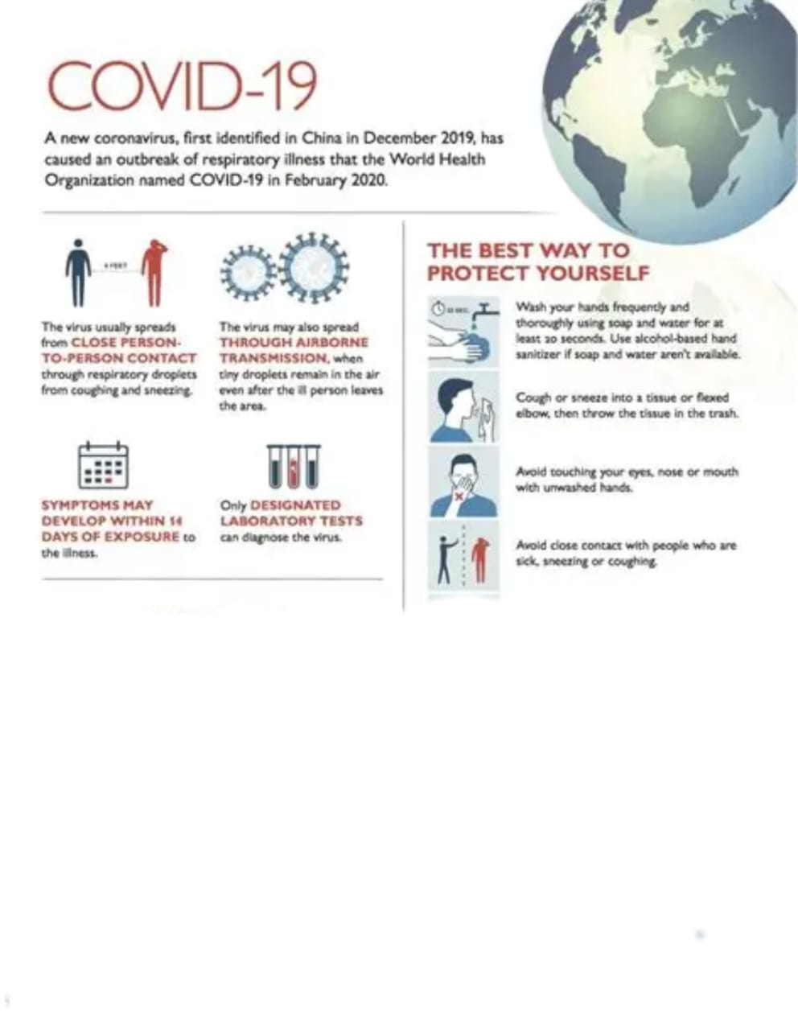
Background
80% of companies worldwide during Covid-19 adopted digital integration due to forced isolation
Johns Hopkins Medicine

Slide 4
Background Continue…
COVID-19 pandemic accelerated the adoption of remote work across professions, including Social Work
The situation prompted integration of digital and assessment tools into mainstreaming Social Work practice

Slide 5
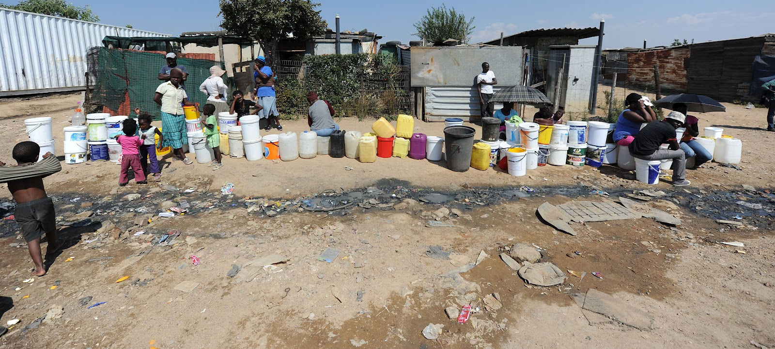
Research Approach
Rural life in lephalale

Slide 6
Research Approach Continue…
Qualitative approach was employed with open-ended and follow up questions
This approach helped with in-depth understanding of challenges related to lack of training of digital assessment tools by Social Workers
The study explored the experiences of twenty-nine (29) Social Workers participants from the Department of Social Development in Lephalale Municipality, Waterberg District, Limpopo province
Face to face interviews with Social Workers was scheduled for thirty ( 30) minutes each was conducted

Slide 7
Findings
Opportunities of Social Work digital assessment
The study reveal that majority of the participants are open to incorporate digital technologies for assessment of clients
Furthermore, the findings reveal that integration of digital assessment has potential to expand client reach
This means clients in farms, rural areas and squatter camps could easily be reached in number
Hence, this could feasibly improve and create effective and efficiency service delivery

Slide 8
Findings Continues…
Challenges of Employing Social Work digital assessment
Majority of places are rural with poor network coverage that is needed for digital devices
Insufficient training of Social Workers on digital platform e.g ( PCM= Probation Case Management ) to capture children in conflict with the law

Slide 9
Learnings
Digital assessment can improve work quality in Social Work practice
Digital tools can improve efficiency and save time
Concerns remain around data security and confidentiality
Workplace support and resources are essential

Slide 10

Recommendations
It is recommended that there be provision of digital devices such as:
Laptop
Wi-Fi modems
Cell phones

Slide 11

Recommendations continue…
Target training of Social Workers on digital assessment tools on various programmes
Always have Social Work forms on standby as a backup paper work incase network is unavailable

Slide 12
Conclusion
Like other professions, it is inevitable not to evolve with technology and adopt digital tools in daily interventions in Social Work practice
Practitioners must always safeguard clients' intergrity,dignity, respect and confidentiality as fundamental Social Work core values

Slide 13

End
Let technology be a bridge-not a barrier- to compassionate and effective Social Work

