Slide 1
GREEN SOCIAL WORK AND CLIMATE RESILIENCE: SUPPORTING VULNERABLE COMMUNITIES IN THE FACE OF ENVIRONMENTAL CRISES.
TOPIC: ThE ROLE OF SOCIAL WORKERS IN SUPPORTING THE RESILIENCE, ADAPTATION AND RECOVERY IN AFFECTED COMMUNITIES.
PRESENTER: MS k.S LEGEGERU
DATE: 10- 12 SEPTEMBER 2025
2025 asaswei international conference

Slide 2
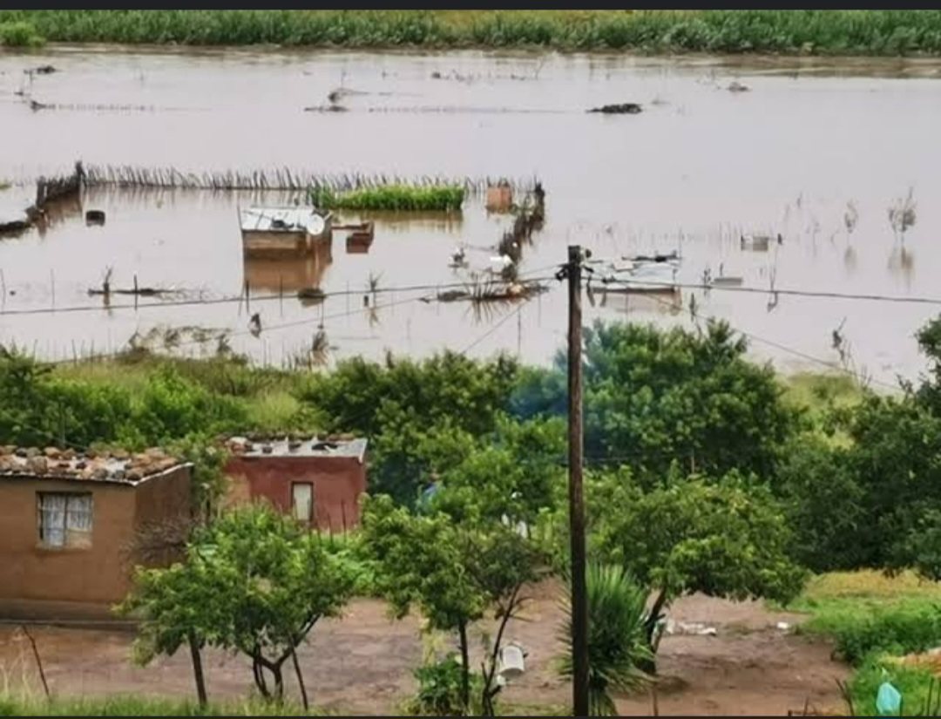
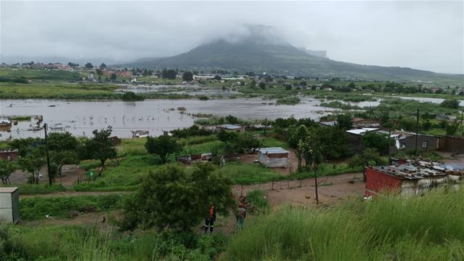
INTRODUCTION
The world, SA and QwaQwa grappling with Environmental crises, climate impacts & disasters.
Increase in frequency & intensity.
QwaQwa (Study location) also not immune from these E-Crises.

Slide 3
BACKGROUND
Literature Review done on the Study to understand the resilience & risks to climate-related impacts in the QwaQwa( Muyambo et al,2025).
They found that Multiple Factors contributes to high vulnerability and low resilience in the area.
Thus causing long-term impacts, as well as adaptation & recovery struggles.
Social Work with its declared dedication to supporting the most vulnerable; remains best suited to ensure Social Response, Resilience Building, & Recovery initiatives.
HENCE THE GOAL OF THIS STUDY

Slide 4
METHODOLOGY
Qualitative research approach & descriptive design.
Non- Probability purposive sampling method to select participants.
Data collection through semi-structured interviews.
Data analysed thematically by developing themes from research findings
Ethical considerations
Permission to conduct the study.
Principles to promote integrity of the study.

Slide 5
PRE-DETERMINED QUESTIONS GUIDING THE RESEARCHER
What is your understanding of Environmental Crises & possible impacts ?
Prevalent environmental crises in the communities served ?
How Social Workers support the resilience, adaptation and recovery of affected communities ?
What challenges do Social Workers encounter in response efforts ?

Slide 6
FINDINGS & DISCUSSIONS
PARTICIPANTS AWARENESS & UNDERSTANDING OF E- CRISES & POSSIBLE IMPACTS
Limited awareness of prevalent E-Crises and impacts thereof.
Partial understanding of effects on vulnerable populations; often attributed to low involvement & exposure to Climate-related contexts.
Limited insights on how Pre-existing vulnerabilities influence adaptation & Recovery prospects.
ROLES & SERVICES PROVIDED BY SWs IN THE FACE OF E-CRISES
The Under-Developed competencies in climate-related contexts result in SW’s unpreparedness to respond to Environmental issues.
SWs are solely involved in the reactive mitigation of impacts. Neglecting Long-term sustainable & recovery efforts.

Slide 7
FINDINGS & DISCUSSIONS con….
Existing Departmental Procedure Manuals for Generic Intervention Processes (GIP) have not incorporated interventions responding to Environmental & Climate-Related Issues. Therefore, SWs remain confined to generic SW services & Programmes. While Disaster Practice remains peripheral in Practice.
SWs are only involved in providing preliminary Material Assistance, PSS & Linkage to Social Assistance Programmes But Not long-term Reconstruction & Developmental Programmes that ensures Community resilience & recovery.

Slide 8
FINDINGS & DISCUSSIONS con….
CHALLENGES ENCOUNTERED IN SUPPORTING RESILIENCE, ADAPTATION & RECOVERY.
Lack of training & CPD in Climate-related contexts .
Subsequently, these under-developed Competencies result in Compromised efficiency in SWs
Lack of Professional guidelines for SW in this emerging field.
Staff shortage & high generic workloads. ( Other generic incidents are prioritized – limiting capacity to also support the Resilience Building in affected communities).

Slide 9
CONCLUSION
The threats & effects of E-Crises are too dire to ignore.
Human consequences of these, are a Social Justice & Human Rights issues.
there’s an emergent need for SWs to join inter-disciplinary efforts to tackle E threats & impacts.
With Vulnerable populations hardly hit Lack of involvement in Adaptive & Recovery efforts may be perpetuating social injustices & harmful to the very vulnerable population the profession so seeks to protect.
If long-term resilience, adaptation & recovery is to be achieved SW (with its rich Skill-Sets, Perspectives & Modalities) needs to extend beyond Immediate Case management but ongoing Community Development & Empowerment.

Slide 10
RECOMMENDATIONS
Mainstreaming of GSW & Climate Resilience to Social Work Curricula in Academic institutions & Continuous Professional Development Efforts.
Integration of GSW and Climate Resilience needs to gain momentum in SW Education, Policy Making, Practice & Research.
GSW Practice to be located within the generic domain rather than on the peripherals of the profession. & such to be incorporated in to SWs Work Plans.
Optimization of SW efficiency, by ensuring that SWs are well- supported, adequately trained and capacitated to provide required Support in the face of Environmental Crises.
For adequate staffing to maximise the Capacity of SWs in supporting the Resilience, Adaptation & Recovery of Affected Communities.

Slide 11

LESSONS LEARNT
The delay of the Profession to engage in Ecological SW has contributed to the Social & Environmental Injustice to the Most Vulnerable Populations. Adaptive strategies & Resilience Building remains the only path forward to sustainable livelihoods.

Slide 12


