Slide 1

Social Work Practitioner Presentation
Hello,
Bonjour,
Molweni,
Dumelang

Slide 2
Who I Am
“My name is Mthakathi Kwini Radebe. I’m currently permanently employed at the Department of Social Development Lejweleputswa District office in the Free State. I’ve been a social worker for the department for 11 years.
Today, I'm sharing on how
Social Work Interventions have contributed to the protection of the rights of older persons in communities and the limitation to attaining equity and sustainable communities.

Slide 3
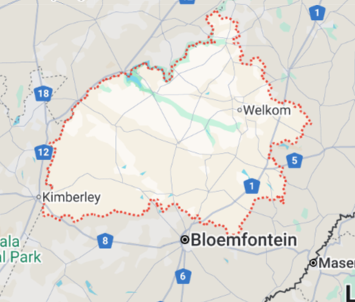
The community I served
60+ years of age as described by the Older Persons Act 13 of 2006.
Challenged they are faced with:
Healthcare services →poor transport →long waiting times.
Financial insecurity stemming from low pensions and poverty.
Lack of social support, unfavourable perceptions ► Abuse, neglect, and social isolation
Lack of affordable care infrastructure and social programs in rural locations perpetuates the social ills.
Why this topic matters
Despite considerable decreases in physical and mental capacity, elderly adults maintain ambitions for well-being and respect.
Long-term-care systems ► Support elderly with declining capacities ► basic rights, freedoms, and human dignity are upheld.

Slide 4
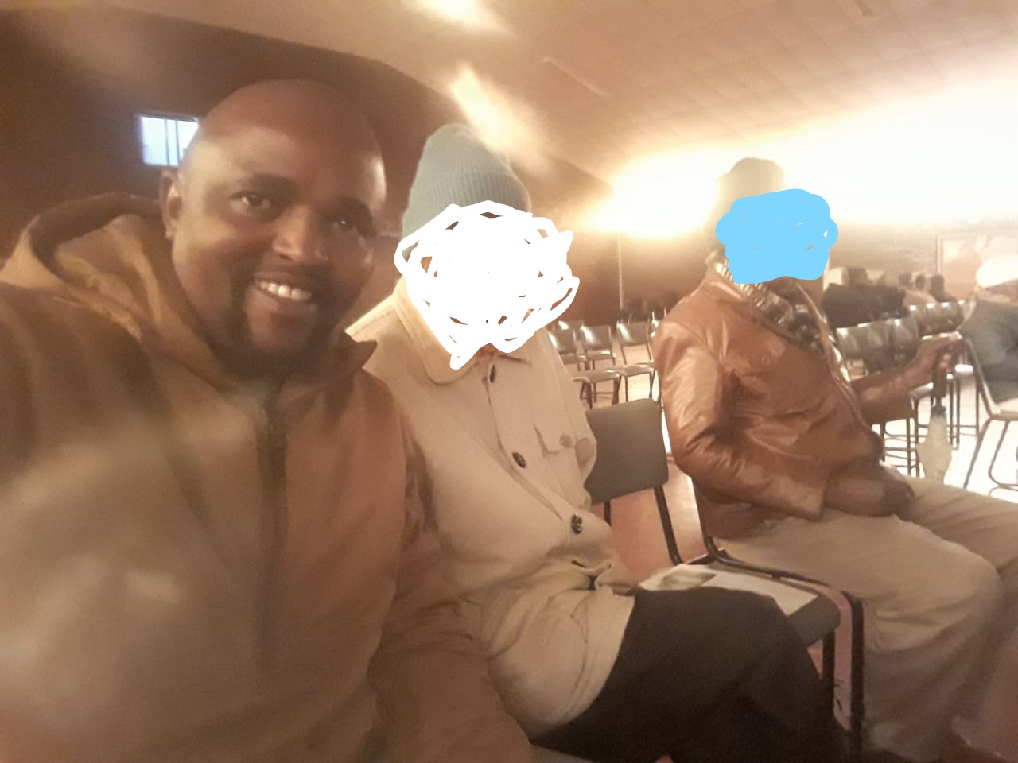

Methodology
Case Study Methodology
Case Work files assessments and interviews with NPOs and service users → Data Collection and Analysis.

Slide 5
Finding:
Semi frail older persons are breadwinners in a household of more than five members, which puts financial strain to their limited Social grant.
Unemployment and poverty is the contributing factor to financial/mismanagement of Older Person’s Grant, physical and mental abuse
Community Based Care and Support Services = Centre based for the able not home based.
Semi Frail Eelders are mostly place in Old Age Home >>Broken Family life and Belonging.

Slide 6
Discussion
Old Age Home/Residential Care Facility
Community/Home Based Care
18/20 Semi frail older persons investigated refused to go to old age home.
12/20 threatened to self harm if removed.
20/20 claims that OAH are not affordable (Top-up).
18/20 preferred to be taken care off at home (Relative or Not).
10/20 prefer to relocate to a caring relative.
15/20 preferred a local community OAH (Registered/Not).

Slide 7
Conclusion of the review
Majority of older persons and their family member cannot afford the top-up that is requested to meet the required amount by other registered OAH.
Semi frail and able older person prefers Home Based Care and Support Service for Respect and Dignity. Reinforcement of HBCSS be prioritised to promote family preservation.
HBCSS will minimize the hidden and unreported incidents of abuse and maltreatment of older persons.

Slide 8
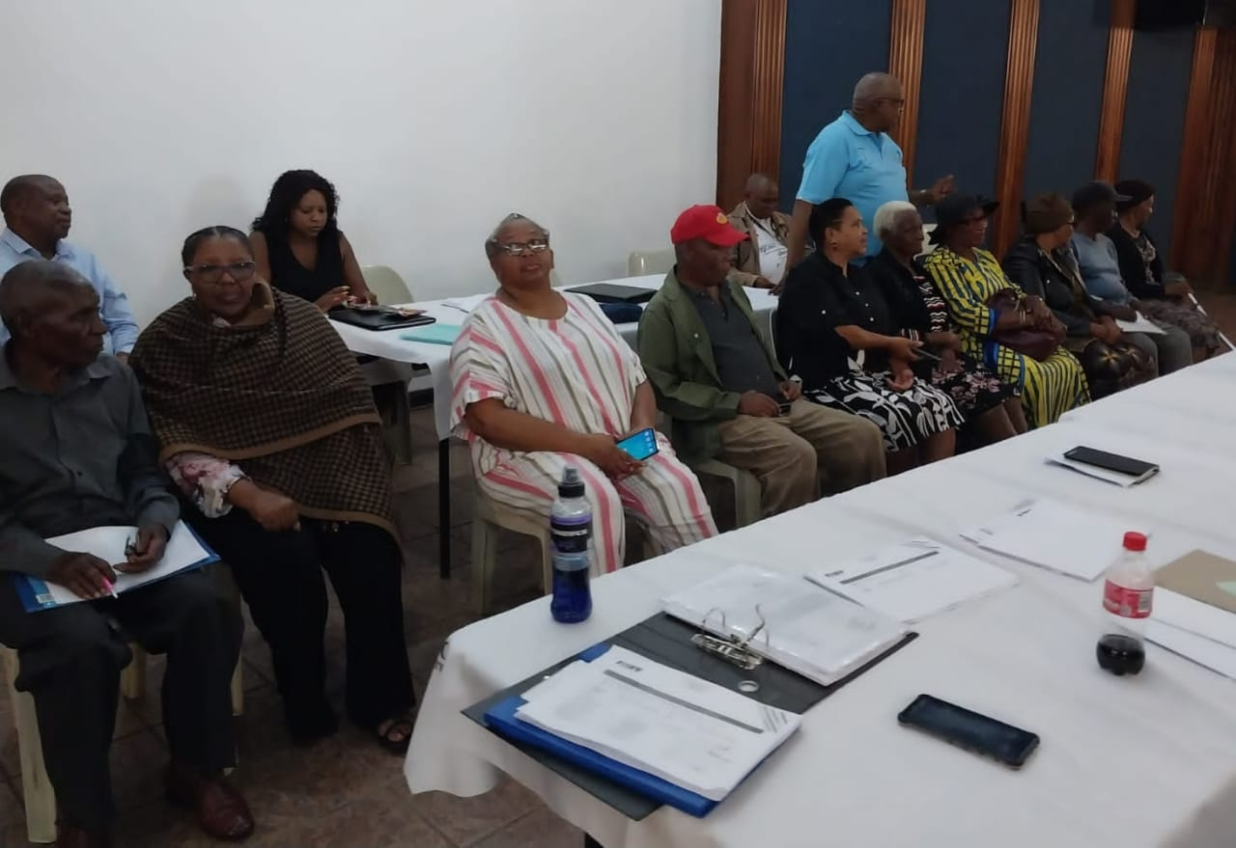

Lesson Learned while working with older Persons;
To Maintaining physical, mental, and social well-being to live a full and meaningful life, regardless of age and they need support. (Active Aging).
Never assume the older person to be needy as they posses resilience to choose happiness over comfort.
Familiarity of environment or objects in Alzheimer/Dementia patients is key to calmness.

Slide 9
Recommendations
Restructure the funding model of NPOs to be aligned with that of Government owned Residential facilities.
Ensure that the cost of access to residential facility is accessible for majority of poverty stricken older persons.
Reintroduction of Community Home Based Care Giver to assist the semi frail elders with care and support to avoid placement in residential facility and promote family and community life.
Reinforce the Older Persons Act and promote care and protection of the rights of the older persons
Foster for sustainable communities that encourages equal rights to all member in the community by ensuring equal access to services.

Slide 10

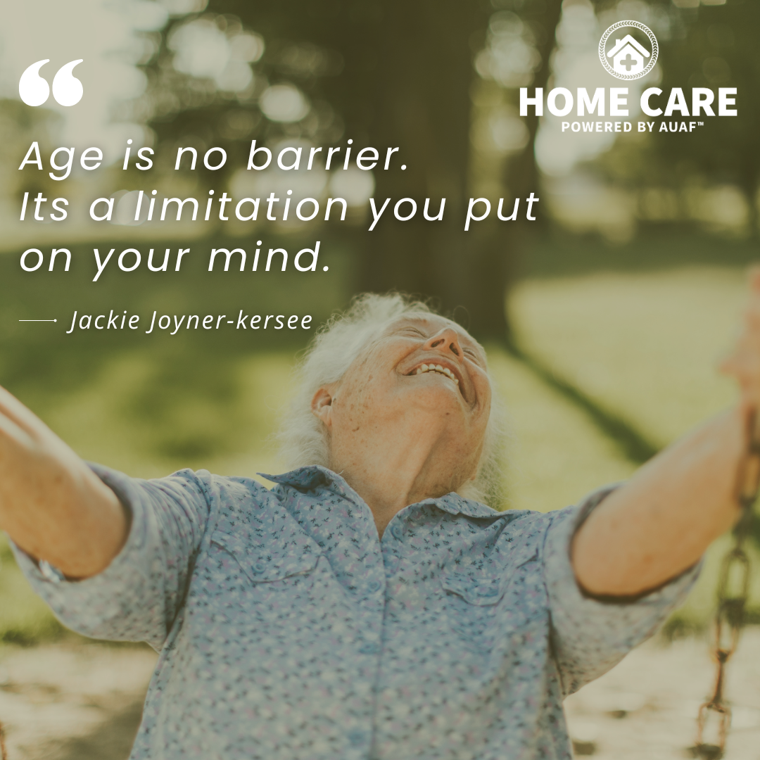

061 794 3423
Mthakathi.Radebe@fssocdev.gov.za
Aging
To Social Worker:
Thank you for the opportunity!!

