Slide 1


GREETINGS

Slide 2
A LITTLE BIT ABOUT MYSELF
MY NAME IS LEABA
MY SURNAME IS MOLOI
I AM A SOCIAL WORKER
EMPLOYED AT THE FREE STATE DEPARTMENT OF SOCIAL DEVELOPMENT
FROM THABO MOFUTSANYANA DISTRICT; BASED IN QWAQWA OFFICE
I WORK AT CHILD CARE AND PROTECTION UNIT
I HAVE BEEN PRACTICING AS SOCIAL WORKER FOR THE 10 YEARS NOW.

Slide 3
CONTENT OF THE PRESENTATION
TOPIC
THE COMMUNITY I SERVE
MY INTERVENTION CASE
FINDINGS
INTERVENTION
LESSONS AND MESSAGE

Slide 4
TOPIC
Social work and the achievement of sustainable development goals: A case study of working with special and vulnerable population (Children).

Slide 5
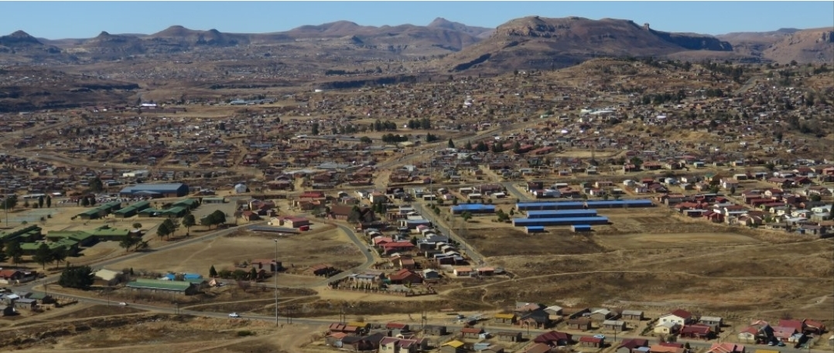
THE COMMUNITY I SERVE

Slide 6
THE COMMUNITY I SERVE
QWAQWA IS A FORMER HOME LAND FOR THE BASOTHO PEOPLE
IT IS LOCATED IN THE NORTHEAST OF THE FREE STATE PROVINCE, IN THE FOOTHILLS OF THE DRANKENSBERG MOUNTAINS.
THE NAME QWAQWA COMES FROM KHOISAN MEANING WHITHER THAN WHITE
IT IS KNOWN FOR ITS COLD WHEATHER AND SNOW ON THE MOUNTIANS DURING WINTER.
QWAQWA IS A RURAL AREA WITH A LOT OF CHALLENGES, INCLUDING AMONST OTHERS, HIGH UNEMPLOYEMENT, HIGH CRIME RATE, GENDER BASED VIOLENCE, CHILD ABUSE AND NEGLECT, AND SUBSTANCE ABUSE.
LOCAL MANUCIPALITY IS CALLED MALUTI A PHOFUNG.

Slide 7
MY INTERVENTION CASE
Rele (not her real name) is a 16 years old girl from Bolata village in QwaQwa. She was brought to the social worker’s office by a community member, who was extremely concerned about her wellbeing. Rele’s biological parents are still alive, but they never married nor stayed together. Her mother abandoned her when she was 7 years old; after she had differences with the biological father. She subsequently took a decision to relocate to Gauteng province and never came to visit Rele. The father on the other hand left Rele with her paternal grandmother, and started another family with another lady.
Rele was not properly cared for by the paternal family, and started meeting wrong friends at school, and a wrong boyfriend, who was allegedly very dangerous member of a certain gang. Rele became pregnant of this boyfriend’s child who is 6 months old, dropped out of school while in grade 9 and moved in with him. He started physically and sexually abusing her while she was pregnant and even after pregnancy.

Slide 8
FINDINGS
Rele and her 6 months old child are minors according to the south African constitution and Children’s Act.
Rele does not have the mental, emotional, and financial capacity to meet the needs of her child.
It will be a painful thing to only help the 6 months old child and separate him with his mother; both of them need care and protection in terms of section 150 of children’s Act 38 of 2005.
Rele is abandoned by her biological parents, and the paternal family; she does not have a relationship with them. Her family is has given up on her.
Rele was in an abusive relationship, and needed to be rescued.
Rele needs trauma counselling and psychosocial support

Slide 9
FINDINGS continued…..
Rele and her child growth and wellbeing are compromised
Rele must be assisted to go back to school and her child to also be enrolled at early childhood development centre.

Slide 10
INTERVENTION
The social worker intervewed the reporter and Rele, and conducted a home visit to Rele’s family.
The social worker compiled a section 155 report to children’s court, outlining the social circumstances of Rele and her child; and requested the presiding officer to find both them in need of care and protection in terms of section 150, and place them in temporary safe care in terms of section 167 of children’s Act.
Children’s court found both of them in need of care and protection, and were placed in temporary safe care for 90 days, with a safe care parent. Unfortunately after few weeks, Rele took her child and absconded from the placement, and went back to the abusive boyfriend. The social worker went to the boyfriend’s place and removed Rele and the child to a more secure place at CYCC.

Slide 11
INTERVENTION continued…..
Both Rele and her child were taken to the doctor for medical check up. Rele was found to have serious bruises all over her body; and the child had malnutrition. They both received medical attention
The social worker as a case manager and the social worker at the CYCC were working together to provide counselling to Rele, and empower her to break free from any abusive relationship.
Rele was immediately enrolled at a school while in the CYCC, so that she can finish her grade 9 and go to high school. Her child was well taken care of by child and youth care giver.
The social worker managed to find Rele’s mother contact details; and she called her for reunification purposes. The mother has been looking forward to stay with Rele one day, and pleaded for her release from the CYCC.

Slide 12
INTERVENTION continued…..
The social worker and the CYCC arranged transport and one of the social workers to take Rele to her mother in Pretoria, Gauteng province.
The social worker has been doing a follow up on Rele, the child and the mother, and they reported to be adjusting very well.

Slide 13
LESSONS AND MESSAGE
Family dysfunction negatively impact on the children’s growth and wellbeing.
It is always important to work with a client within their environment, and look for resources within their own environment.
Try be all means as a professional to keep the client within their family; and do your best to reunify them as soon as possible in cases of removal.
Acts and policies assist us to be deliver our services to our clients
Victims of domestic violence have a tendency of returning to their abusers, do not give up on them.
As a social worker we play a vital role in actualizing the sustainable development goals; and in my case 3, 4, and 5 we achieved.
Sustainable Development Goals are achievable, and can be integrated in to the daily work of a social worker.

Slide 14
When it comes to your GO-AL, you must GO-ALL out. (Leaba Moloi)

Slide 15

THANK YOU SO MUCH

