Slide 1


SUPPORTING VULNERABLE COMMUNITIES IN THE FACE OF
ENVIRONMENTAL CRISES

Slide 2
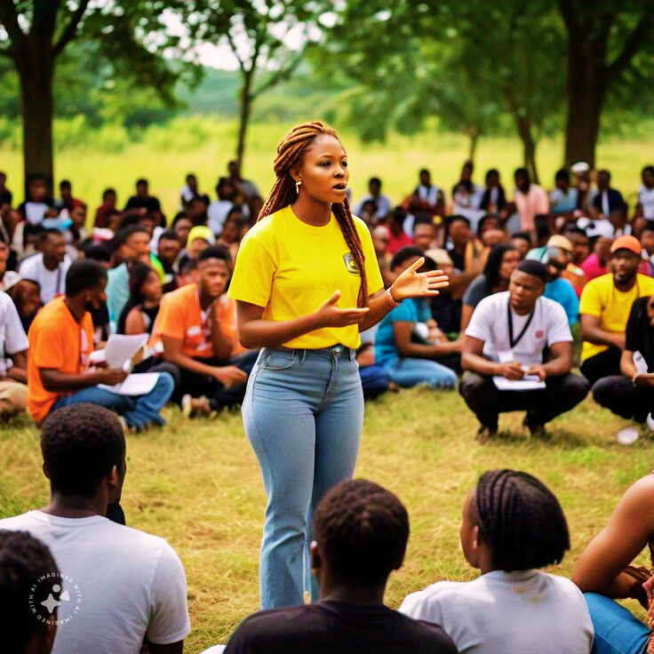
EXPLORING GREEN SOCIAL WORK IN LIMPOPO PROVINCE
Name: Phuluwa Andisa Goodhope
Date: 11 September 2025
Venue: Freestate University (LCTA)
Time: 13H40-15H30

Slide 3
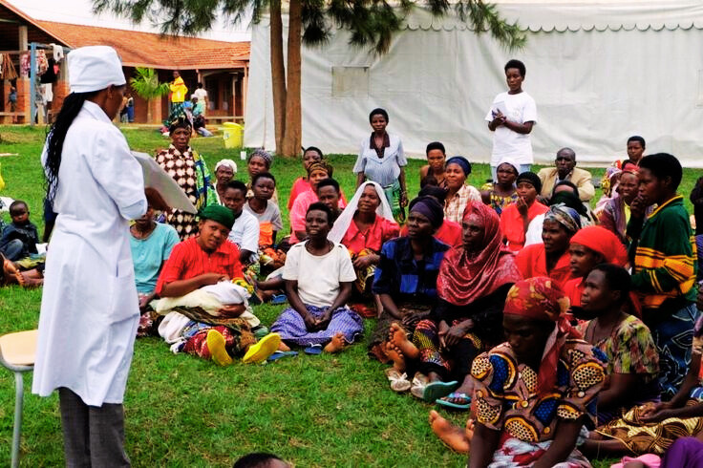
INTRODUCTION TO GREEN SOCIAL WORK
Emerging field integrating social work with:
Environmental sustainability
Social justice
Aligns with social work principles, norms, and ethics
Responds to environmental crises with community support

Slide 4
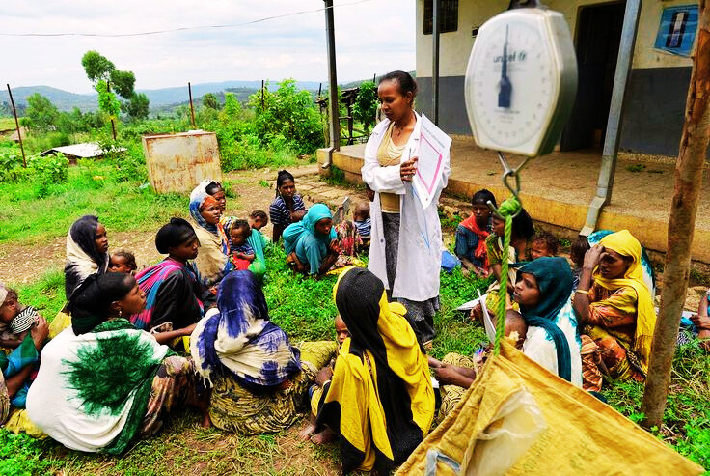
RESEARCH FOCUS
Study conducted in Limpopo Province, Mopani District
Methods:
Mixed research
Observational data
Social work practice focus on trauma-informed practices:
Counseling
Social relief during environmental disasters

Slide 5
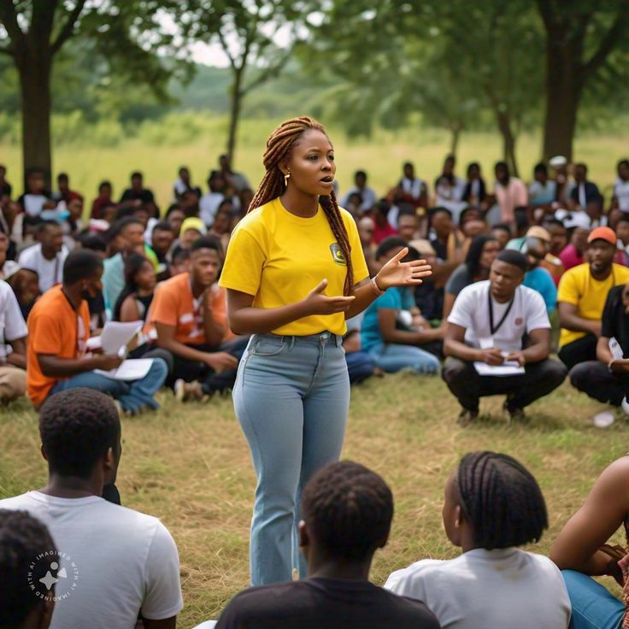
INDIGENOUS KNOWLEDGE & AFROCENTRIC THEORY
Communities hold deep environmental knowledge
Afrocentric Theory:
Links culture, beliefs, behavior with the environment
Supports holistic social work approaches:
Counseling
Therapy
Localized support

Slide 6
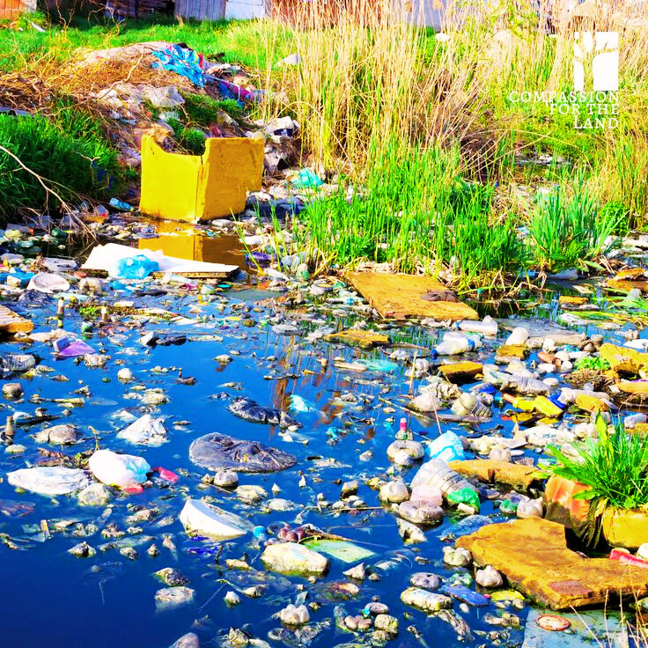
ENVIRONMENTAL CHALLENGES IN LIMPOPO
Recurring issues:
Drought
Natural fires
High temperatures
Neglected agricultural lands
Disproportionate impact on rural communities

Slide 7
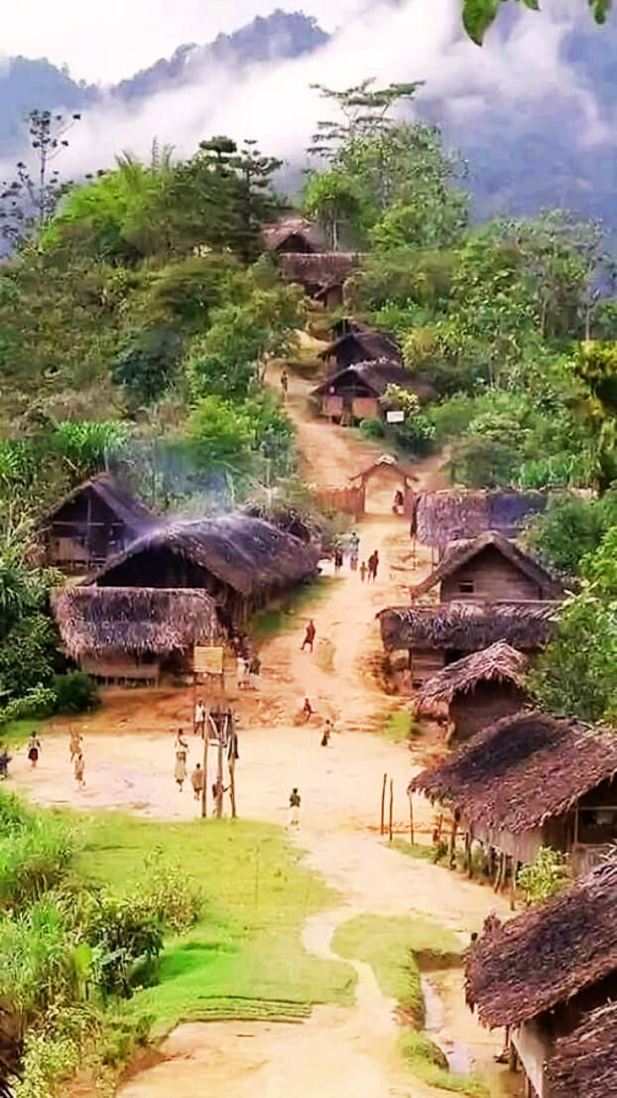
VULNERABLE LIVING CONDITIONS
Families in wood/plastic homes on farms
Overcrowded, unsafe environments
Systemic challenges:
Environmental racism
Classism & sexism
Environmental homophobia

Slide 8
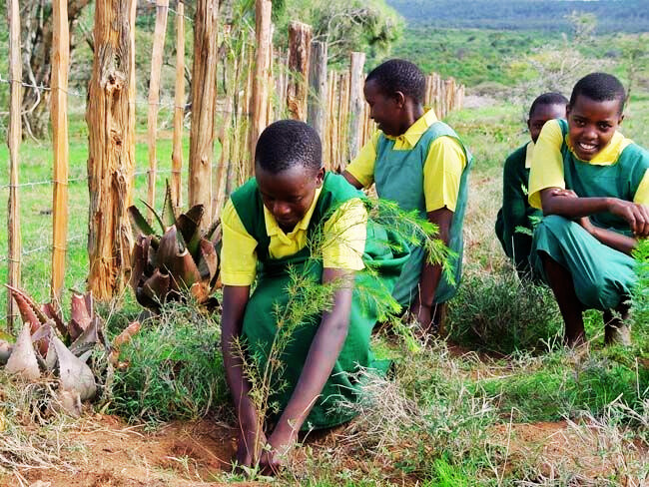
PATHWAYS FOR GREEN SOCIAL WORK IMPLEMENTATION
Community organization & advocacy
Environmental education
Capacity building
Collaboration with environmental departments

Slide 9
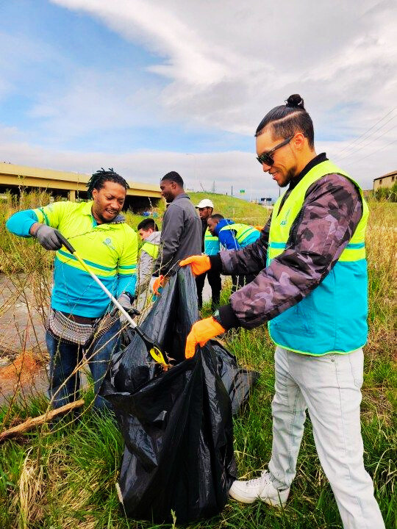
ROLE OF ENVIRONMENTAL JUSTICE
Integrating sustainability into:
Community-based initiatives
Disaster response & recovery
Policy development
Promotes innovation in social work practices

Slide 10
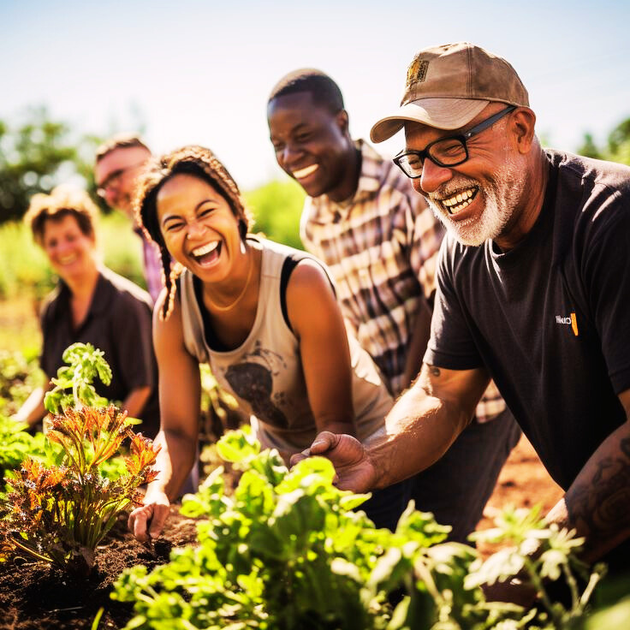
EMBRACING INDIGENOUS PRACTICES
Culturally responsive & sustainable solutions
Key components:
Community-led initiatives
Cultural revitalization
Traditional ecological knowledge
Holistic land management

Slide 11

CONCLUSION
Green social work bridges culture, community, and sustainability
Empowering vulnerable communities through:
Environmental justice
Indigenous wisdom
Holistic, inclusive social work approaches

Slide 12


THANK
YOU

