Slide 1


Reimagining Ecological Systems Theory for Environmental Justice:
Integrating the Natural Environment into Bronfenbrenner’s Framework
Presented By:
Prof Zoleka Soji and Ms Anelisa Pezisa

Slide 2
Introduction
What role do social workers play in responding to disasters and pandemics?
To what extent are social workers prepared to address environmental issues that shape individual and community well-being?

Slide 3

Introduction
Environmental justice is rooted in the principle that all people deserve equal protection from environmental hazards and equal access to decision-making processes concerning environmental health (Bullard, 1996).
Yet, environmental injustice continues to manifest as the unequal and disproportionate distribution of risks and hazards.
Marginalized communities, particularly in the Global South, experience a double burden: suffering the consequences of environmental degradation while also, out of necessity, contributing to it due to inadequate services and infrastructure (Lombard, 2019).
Social workers, traditionally concerned with the promotion of human rights and social justice, are primed to be strong partners in responding to environmental injustice and supporting environmental justice movements (Kemp, 2011: Teixeira & Krings, 2015)

Slide 4
Background: Climate Change & Marginalization
South Africa’s floods in KwaZulu-Natal and the Eastern Cape revealed infrastructural weaknesses, historical injustices, and long-term trauma. Without integrating ecological realities, social workers risk missing critical dimensions in assessment, intervention, and policy influence.
Rothery (2016) identifies the omission of natural environments from EST as a disciplinary blind spot. Continuing to teach EST as a purely social construct overlooks how environmental degradation interacts with poverty, inequality, and trauma.
Climate change exacerbates existing inequalities, disproportionately affecting vulnerable populations (Ahmed et al., 2009; World Bank, 2022).

Slide 5
Why this Gap?
Without integrating ecological realities, EST risks:
01
Missing environmental justice issues in assessments (Mason et al., n.d.).
02
Overlooking how environmental hazards intersect with poverty and inequality- which affects ones development.
03
Limiting social workers’ preparedness to respond to climate-induced disasters.
04
This omission is a disciplinary blind spot (Kemp, 2011; Teixeira & Krings, 2015).

Slide 6
Theoretical Framework
01
Critical Ecological Systems Theory: emphasizing the interconnectedness of human and natural systems (Rothery, 2016).
02
Environmental Justice Theory: highlights structural inequalities and power dynamics that shape environmental exposure and risk (Bullard, 1996).
03
Eco-social work: human–nature interdependence (Wang & Altanbulag, 2022).

Slide 7
Case studies: Floods in SA
(KwaZulu-Natal Floods (April–May 2022)
One of South Africa’s deadliest natural disasters.
Impact:
443 lives lost (Government of South Africa, 2022).
40,000+ displaced; 128,000 people affected (Presidential Climate Commission, 2022).
4,000 homes destroyed; 8,300 damaged (Wikipedia, 2022).
R17 billion in infrastructure losses.
300 schools disrupted across rural and urban areas.
Highlights how fragile infrastructure, historical marginalisation, and environmental vulnerability converge, exposing the limits of ecological systems theory when natural systems are overlooked.

Slide 8
Case studies: Floods in SA
(Eastern Cape Floods-Umtata (June 2025)
Severe flooding caused by a cold front.
Impact:
75–92 fatalities (News24, 2025; Associated Press, 2025).
1,000 residents displaced into emergency shelters.
127 schools and 20 health facilities damaged.
A school bus tragedy killed eight children, three survived (Reuters, 2025).
Government Response: Initiated phased resettlement; 25 families relocated to Temporary Residential Units (Government of South Africa, 2025).
Demonstrates how climate shocks intersect with inequality and under-resourced governance, reinforcing the need to embed ecological considerations in social work practice.

Slide 9
Bronfenbrenner’s Ecological Systems
Bronfenbrenner’s ecological systems theory explains that an individual’s development is shaped by interconnected environmental systems, from immediate surroundings like family to broader societal structures like culture.
Micro: Family, peers, school.
Meso: Interactions between the microsystems.
Exo: External environments (e.g., parent workplace).
Macro: Culture, policies, values.
Chrono: Time and life-course events.
Critique: The natural environments is only implicit, not explicitly considered.

Slide 10
Ecological Systems (Reimagined)
We propose a reimagined ecological systems framework that explicitly incorporates environmental justice principles into each level of the theory; micro, meso, exo, macro, and chrono- providing a more comprehensive tool for social work education and practice.

Slide 11
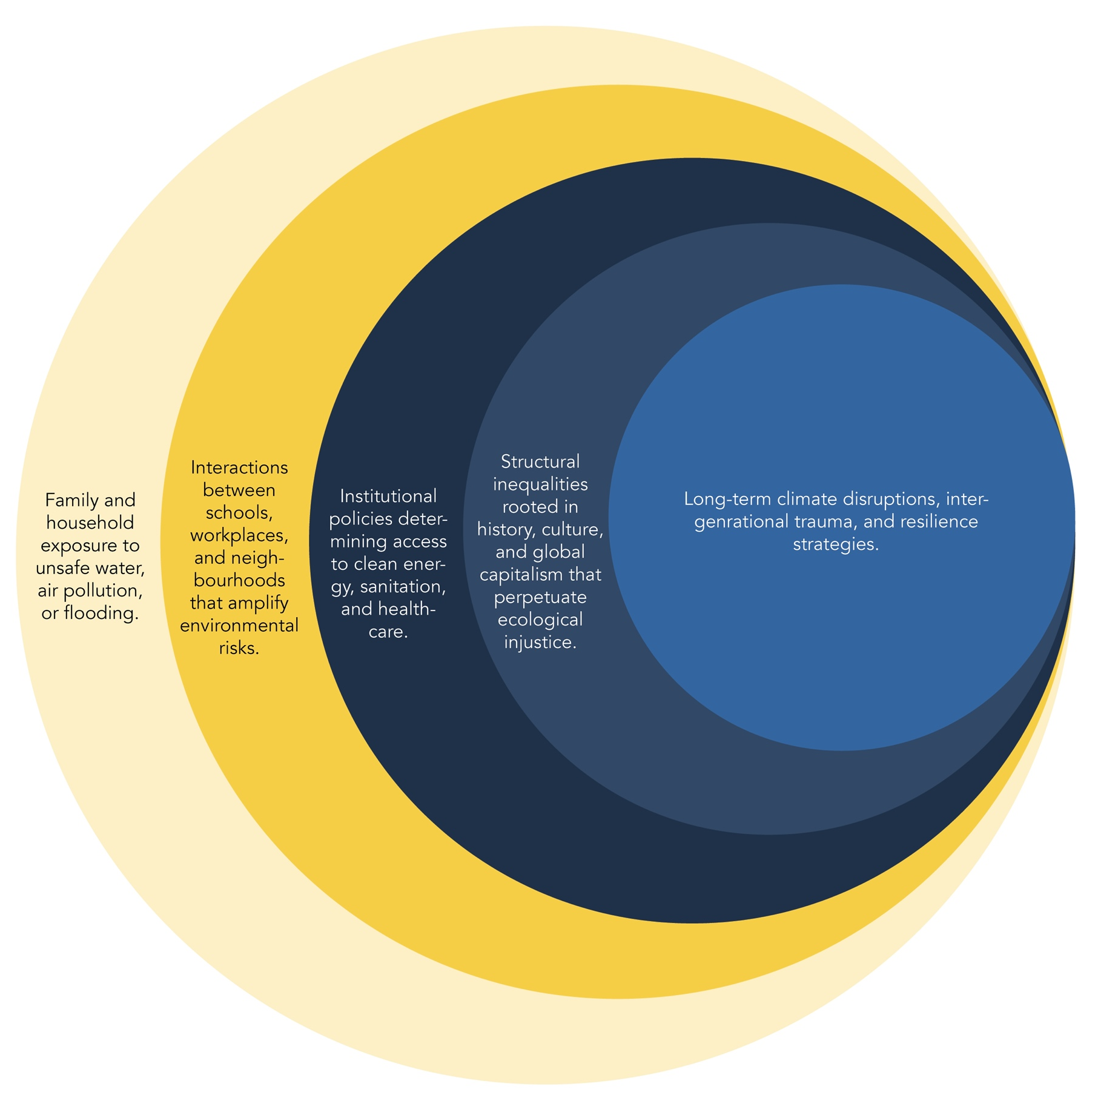
Ecological Systems (Reimagined)
Micro: Family and household exposure to unsafe water, air pollution, or flooding.
Meso: Interactions between schools, workplaces, and neighbourhoods that amplify environmental risks.
Exo: Institutional policies determining access to clean energy, sanitation, and healthcare.
Macro: Structural inequalities rooted in history, culture, and global capitalism that perpetuate ecological injustice.
Chrono: Long-term climate disruptions, intergenerational trauma, and resilience strategies.

Slide 12
Implications for Social Work Education
1
2
3
Deepening ecological literacy
A need identified by Nesmith and Smyth (2015). Not just teaching EST as “social context,” but training students to recognise how natural environments interact with and shape human well-being.
Holistic assessment skills
Social work students would learn to assess clients not only in terms of family, community, and policy but also their exposure to environmental risks.
Equip future social workers as both social and ecological justice advocates (Stamm, 2023; Mathias et al., 2023).

Slide 13
Practice Applications
Policy advocacy linking environmental justice with social justice.
Supporting policies that advance green jobs and sustainable development (World Bank, 2022).
Community disaster preparedness and resilience planning.
Partnerships with environmental NGOs and municipal planners.

Slide 14

Conclusion
Climate change is reshaping social work realities- EST must evolve to reflect this.
A reimagined EST makes the natural environment a visible, active determinant of well-being.
This paradigm shift positions social workers to contribute to both social and ecological justice, aligning the profession with global calls for sustainability and resilience.

Slide 15
Reference list
Ahmed, S. A., Diffenbaugh, N. S., Hertel, T. W., Lobell, D. B., Ramankutty, N., Rios, A. R., & Rowhani, P. (2009). Climate volatility and poverty vulnerability in Tanzania. Global Environmental Change, 19(3), 314–325.
Bullard, R. D. (1996). Environmental justice: It’s more than waste facility siting. Social Science Quarterly, 77(3), 493–499.
Associated Press. (2025, June 12). Eastern Cape floods kill at least 75, displace thousands. AP News.
Government of South Africa. (2022, April 18). National state of disaster: KwaZulu-Natal floods update. Pretoria.
Government of South Africa. (2025, August 26). Eastern Cape relocation of Mthatha flood victims. Pretoria.
Kemp, S. P. (2011). Re-centering environment in social work practice: Necessity, opportunity, challenge. British Journal of Social Work, 41(6), 1198–1210.
Lombard, A. (2019). Social workers’ role in addressing environmental challenges. SACSSP Conference Proceedings.
Mason, L. R., Shires, M. K., Arwood, T. J., & Wilson, G. (n.d.). Environmental justice in social work: Integrating ecological perspectives in practice. [Unpublished manuscript].
Mathias, J., Stamm, I., & Mäkelä, J. (2023). Social work in the climate crisis: Emerging roles and responsibilities. International Social Work, 66(4), 543–558.

Slide 16
Reference list
Nesmith, A., & Smyth, N. (2015). Environmental justice and social work education: A content analysis. Journal of Social Work Education, 51(3), 414–431.
News24. (2025, June 12). The water was around my neck: Eastern Cape residents recount floods.
Presidential Climate Commission. (2022). Briefing on KwaZulu-Natal floods. Pretoria.
Reuters. (2025, June 11). Eight bodies recovered after South African school bus swept away by floods. Reuters News.
Rothery, M. (2016). Critical ecological systems theory: A framework for social work. Journal of Critical Social Work, 17(2), 45–60.
Stamm, I. (2023). Social workers as ecological justice advocates. Journal of Social Work, 23(2), 115–129.
Teixeira, S., & Krings, A. (2015). Sustainable social work: An environmental justice framework for practice. Social Work, 60(3), 245–253.
Wang, Y., & Altanbulag, B. (2022). Eco-social work: Human–nature interdependence in practice and policy. International Journal of Social Welfare, 31(2), 145–156.
World Bank. (2022). Climate change and inequality: A global perspective. World Bank Publications.

Slide 17

Comments and Questions?

Slide 18

Change the World
mandela.ac.za

