Slide 1
GREEN SOCIAL WORK AND CLIMATE RESILIENCE: SUPPORTING VULNERABLE COMMUNITIES IN THE FACE OF ENVIRONMENTAL CRISES.
TOPIC: ThE ROLE OF SOCIAL WORKERS IN SUPPORTING THE RESILIENCE, ADAPTATION AND RECOVERY IN AFFECTED COMMUNITIES.
PRESENTER: MS k.S LEGEGERU
DATE: 10- 12 SEPTEMBER 2025
2025 asaswei international conference

Slide 2
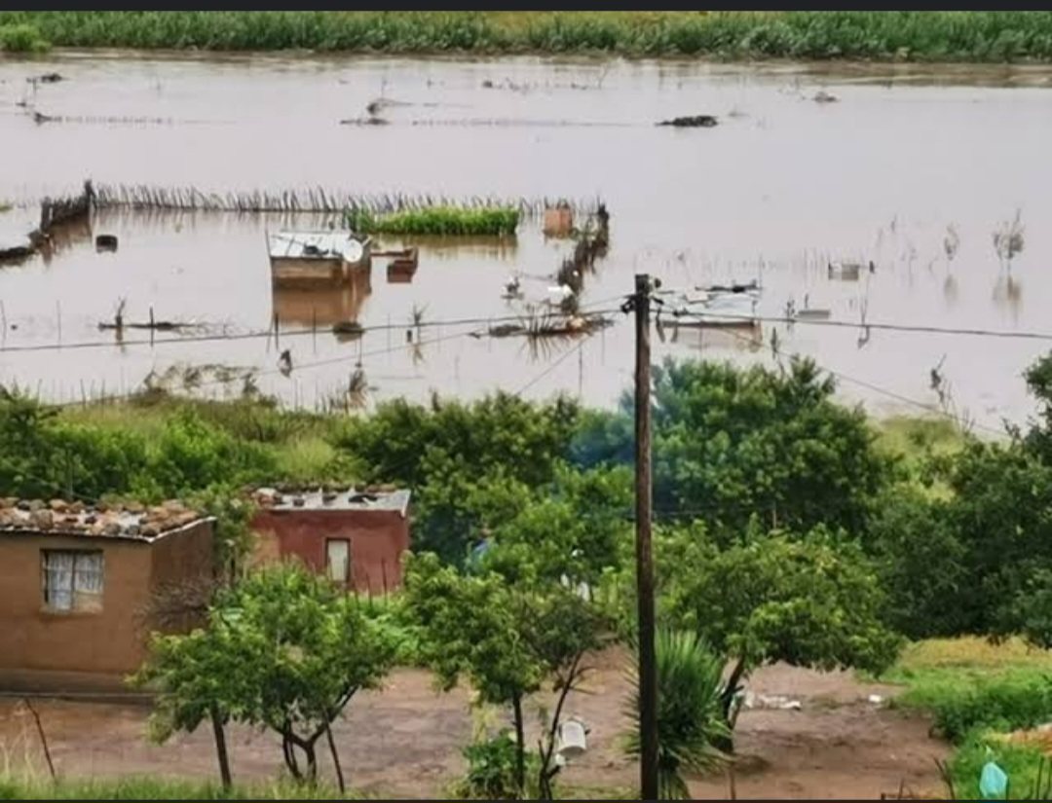
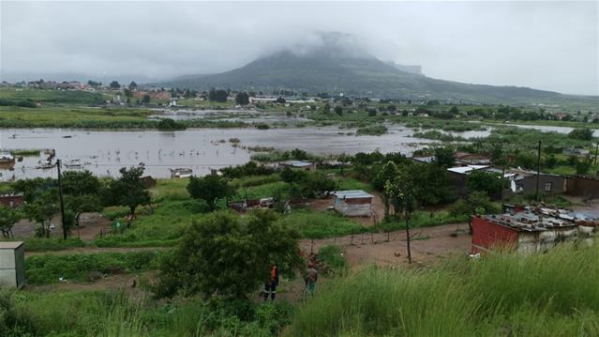
INTRODUCTION
The world, SA and QwaQwa grappling with Environmental crises, climate impacts & disasters.
Increase in frequency & intensity.
QwaQwa (Study location) also not immune from these E-Crises

Slide 3
BACKGROUND
Literature Review done on the Study to understand the resilience & risks to climate-related impacts in the QwaQwa( Muyambo et al,2025).
Multiple Factors contributing to high vulnerability and low resilience rates.
The area is more likely to suffer long-term impacts resulting in adaptation & recovery struggle.
Social Work with declared dedication to supporting the most vulnerable; remains best suited to ensure Social Response, Resilience Building, & Recovery initiatives.
HENCE THE GOAL OF THIS STUDY

Slide 4
METHODOLOGY
Qualitative research approach & descriptive design.
Non- Probability purposive sampling method to select participants.
Data collection through semi-structured interviews.
Data analysed thematically by developing themes from research findings
Ethical considerations
Permission to conduct the study.
Principles to promote integrity of the study.

Slide 5
PRE-DETERMINED QUESTIONS GUIDING THE RESEARCHER
What is your understanding of Environmental Crises & possible impacts?
Which environmental crises are prevalent in the communities you serve?
Capacity to provide services in response to these environmental crises?
What challenges do Social Workers encounter in response efforts?

Slide 6
FINDINGS & DISCUSSIONS
PARTICIPANTS AWARENESS & UNDERSTANDING OF E- CRISES & POSSIBLE IMPACTS
Shown awareness of prevalent E-Crises and impacts thereof.
Partial understanding of effects on vulnerable & at-risk populations; often attributed to low involvement in Climate-related contexts.
Limited insights on how Pre-existing vulnerabilities influence adaptation & Recovery prospects.
ROLES & SERVICES PROVIDED BY SWs IN THE FACE OF E-CRISES
Under-developed competencies in climate-related contexts resulted in: lack of recognition as role players.
Late involvement in inter-professional response efforts result in SWs being solely involved in the reactive mitigation of E-Crises impacts, rather than the overall proactive risk identification, reduction & recovery efforts.

Slide 7
FINDINGS & DISCUSSIONS con….
Limited roles as second responders not key contributors to risk identification, reduction, recovery & reconstruction as well.
An expressed high sense of role ambiguity as there are no clearly defined frameworks & guidelines guiding the role of SW in the face of E-C.
While their role in preliminary humanitarian, Social Assistance Programmes & PSS have been helpful No long-term Reconstruction & Developmental Programmes to build Adaptation & recovery.
Plans, Programmes & services not incorporated into SWs Work Plans but on the peripheries of practice. Hence Role in Climate Resilience is negated.

Slide 8
FINDINGS & DISCUSSIONS con….
CHALLENGES IN GSW IMPLEMENTATION
Lack of training & CPD in Climate-related contexts to enable SWs prevention, response & re-construction services.
Sub-sequent under-developed Competencies efficiency compromised.
Lack of recognition in Climate-related contexts.
Lack of Professional guidelines for SW in this emerging field.
Lack of recognition of GSW like other Advanced SW Practice.
Staff shortage & high generic workloads. ( Other generic incidents are focal points).

Slide 9
CONCLUSION
The threats & effects of E-Crises are too dire to ignore.
Human consequences of these, are a Social Justice & Human Rights issues.
there’s an emergent need for SWs to join inter-disciplinary efforts to tackle E threats & impacts.
With Vulnerable populations hardly hit Lack of involvement in response efforts may be perpetuating social injustices & harmful to the very vulnerable population the profession so seeks to protect.
If long-term resilience, adaptation & recovery is to be achieved SW (with its rich Skill Sets, Perspectives & theories) remains the missing Key- Discipline in Climate-related contexts.
GO GREEN & ENSURE CLIMATE RESILIENCE

Slide 10
RECOMMENDATIONS
Mainstreaming of GSW & Climate Resilience Building to Social Work Curricula in Academic institution & Continuous Professional Development Efforts.
Integration of GSW and Climate Resilience needs to gain momentum in SW Education, Policy Making, Practice & Research.
GSW Practice to be located within the generic domain rather than on the peripherals of the profession. & such to be incorporated in to SWs Work Plans.
To maximise their impact, it is NB that SWs are well- supported, adequately trained and timeously involved in the Prevention, Planning & Response to E-C.
For adequate staffing to amplify the Capacity of SWs in supporting the Resilience, Adaptation & Recovery of Affected Communities.

Slide 11

LESSONS LEARNT
The delay of the Profession to engage in Ecological SW has contributed to the Social & Environmental Injustice to the Most Vulnerable Populations. SW remains the only Discipline/ Profession Where Immediate Crisis Response & inter-Professional Efforts ends.
SW prevails not as the frontline, nor backline But a Lifeline

