Slide 1
An Optimistic Psychological Viewpoint on Resilience in the Face of Disasters
ASASWEI 2025
Dr Sandra Bredell
Hugenote Kollege
Email: sr13@hugenote.ac.za

Slide 2
Research Question & Methodology
Research Question: How can resilience and positive psychology transform African communities’ response to natural and hybrid disasters?
Methodology: Scoping Review
Keywords: resilience, community resilience, disasters, positive psychology
Literature review
Thematic analysis
Key findings

Slide 3
Climate Change & Health
Climate change impacts public health
Continuous health risk assessments are essential
Disaster strategies must support long-term recovery

Slide 4
Indigenous Knowledge & Cultural Strategies
Strategy Type | Example from Literature | Impact on Resilience
Indigenous Rituals | Durban flood recovery | Strengthens identity
Community Storytelling | Healing circles | Builds cohesion

Slide 5
Building Individual & Community
Resilience, Social Capital & Networks
Resilience operates at multiple levels
Key to recovery and psychological safeguarding
Trust, customs, and networks enhance resilience
Communities with strong social capital recover faster
Identify strengths
Foster connectedness and problem-solving

Slide 6
Key Findings
Mental health and resilience linked to social capital
Vulnerable groups need targeted interventions
Optimism and coping mechanisms are essential

Slide 7
Positive Psychology & Learned Optimism
Positive psychology focuses on human thriving
Learned optimism helps reframe adversity
“Optimism is a learned skill that can transform adversity into growth.”
– Martin Seligman

Slide 8
Seligman’s 3 P’s Model
Pillar | Description
Personalization | Not blaming oneself
Pervasiveness | Limiting the scope of adversity
Permanence | Believing change is possible

Slide 9
Applying the 3 P’s
Resilience process
Personalisation
Pervasiveness
Permanence
“It’s not my fault”
“This too shall pass”
“It’s not affecting everything”

Slide 10
Conclusion
Resilience
is shaped by thought patterns
Positive
psychology offers tools for recovery
thrive when optimism is cultivated
Communities

Slide 11
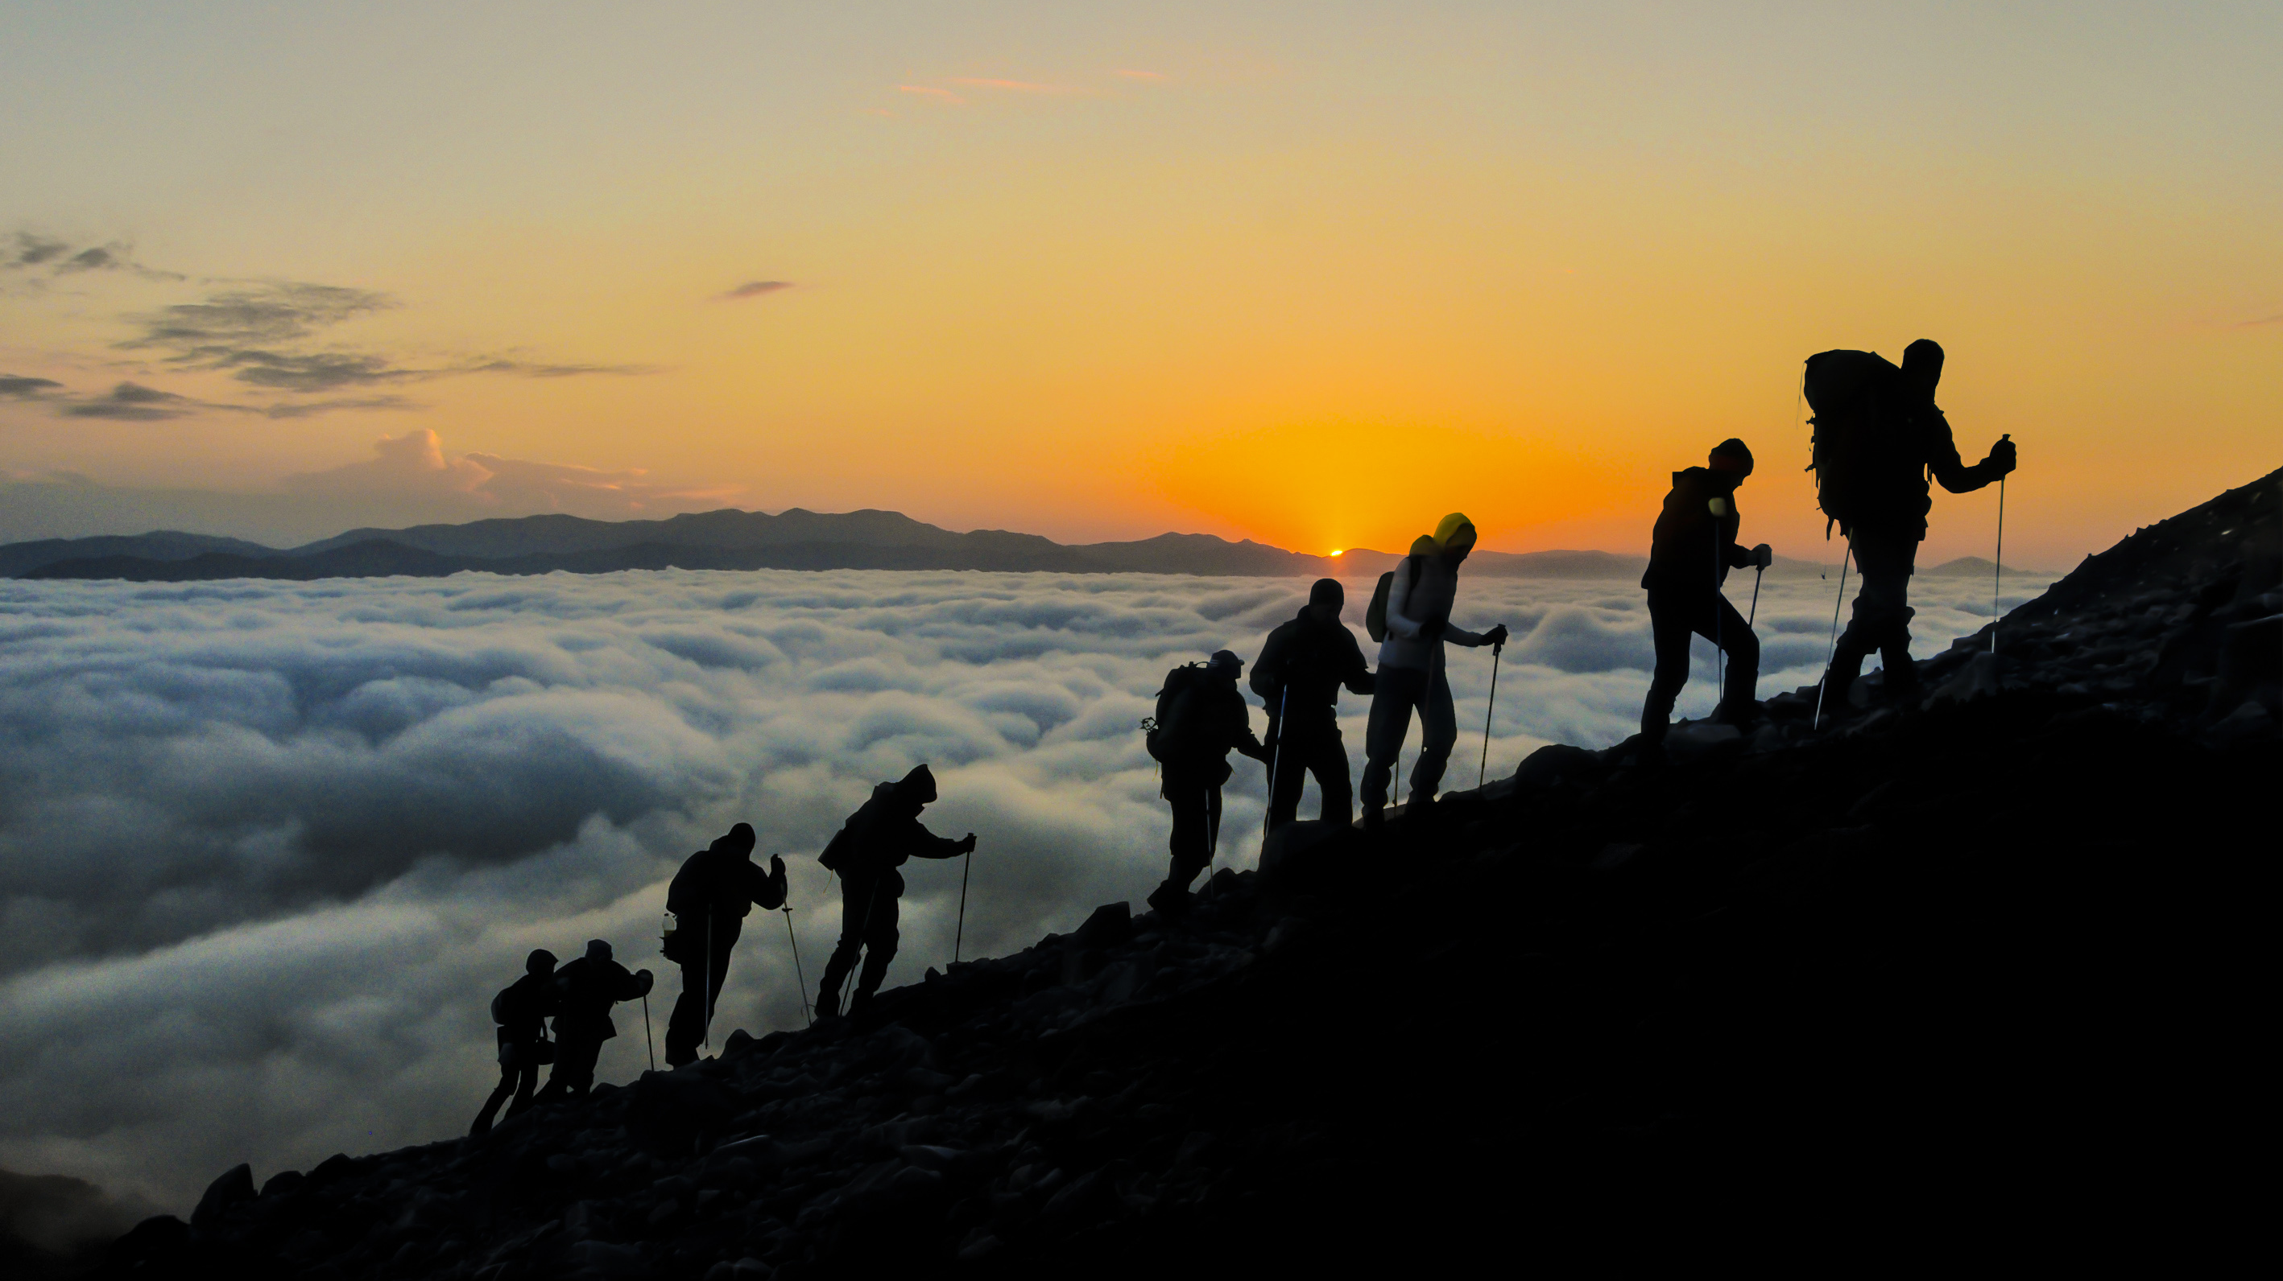
Reflective Quote
“Do not judge me by my success, judge me by how many times I fell down and got back up again.”
— Nelson Mandela

Slide 12
References
Berkes, F. and Ross, H. (2012) ‘Community Resilience: Toward an Integrated Approach’, Society & Natural Resources, 26(1), pp. 5–20. doi: 10.1080/08941920.2012.736605.
Buikstra, E. et al. (2010).JOURNAL OF COMMUNITY PSYCHOLOGY, Vol. 38, No. 8, 975–991 Published online in Wiley Online Library (wileyonlinelibrary.com).
& 2010 Wiley Periodicals, Inc. DOI: 10.1002/jcop.20409
Carro, J., Rojas, J., & Benavides, C. (2019). The role of resilience in disaster recovery: A psychological perspective. Journal of Trauma & Dissociation, 20(5), pp. 536-549.
Chersich, M.F., Wright, C.Y., Venter, F., Rees, H., Scorgie, F., & Erasmus, B. (2018). Impacts of climate change on health and wellbeing in South Africa. International Journal of Environmental Research and Public Health, 15(9), 1884.
Ebhuoma, E., Nene, L., & Leonard, L. (2024). Enhancing resilience to flood disasters in Durban, South Africa: A synergistic approach between indigenous and modern strategies. Environmental and Sustainability Indicators, 100454. https://doi.org/10.1016/j.indic.2024.100454.
Edoun, E.I., Balgah, R.A., & Mbohwa, C. (2015). The impact of effective management of natural disasters for Africa’s development. Economic Research-Ekonomska Istrazivanja, 28(1), pp. 924-938.
Examining the Role of Community Resilience (2022). Resilient communities in times of crisis: A review of the literature. Disaster Management Review, 14(3), pp. 125-139.

Slide 13
References
Hall, M., Ostrom, E., & Manson, S. (2023). Social capital and community resilience: A framework for analysis. International Journal of Disaster Risk Reduction, 65, pp. 102-117.
Ho, H.C., Yeung, D.Y., & Kwok, S.Y.C.L. (2014). Development and evaluation of the Positive Psychology Intervention for Older Adults. The Journal of Positive Psychology, 9(3), pp. 187-197. https://doi.org/10.1080/17439760.2014.888579.
Kwan, M., & Walsh, K. (2017). Resilience of older adults in disaster situations: A scoping review. Aging & Mental Health, 21(5), pp. 465-475.
Luthar, S.S., Lyman, E.L., & Crossman, E.J. (2014). Resilience and positive psychology. In Lewis, M. & Rudolph, K.D. (eds), Handbook of developmental psychopathology. 3rd edn. New York, NY: Springer, pp. 125-140. https://doi.org/10.1007/978-1-4614-9608-3_7.
Makleff, S., Greene, J., & Tan, D. (2022). Vulnerability and resilience in the face of natural disasters: Understanding the psychological impacts. Environmental Psychology, 43, pp. 78-85.
Seligman, M.E.P. (1990) Learned Optimism: How to Change Your Mindset and Embrace the Power of Positive Thinking. New York: Pocket Books.
Seligman, M.E.P. (2006). Learned optimism: How to change your mind and your life Rev. edn. New York: Vintage.

