Slide 1
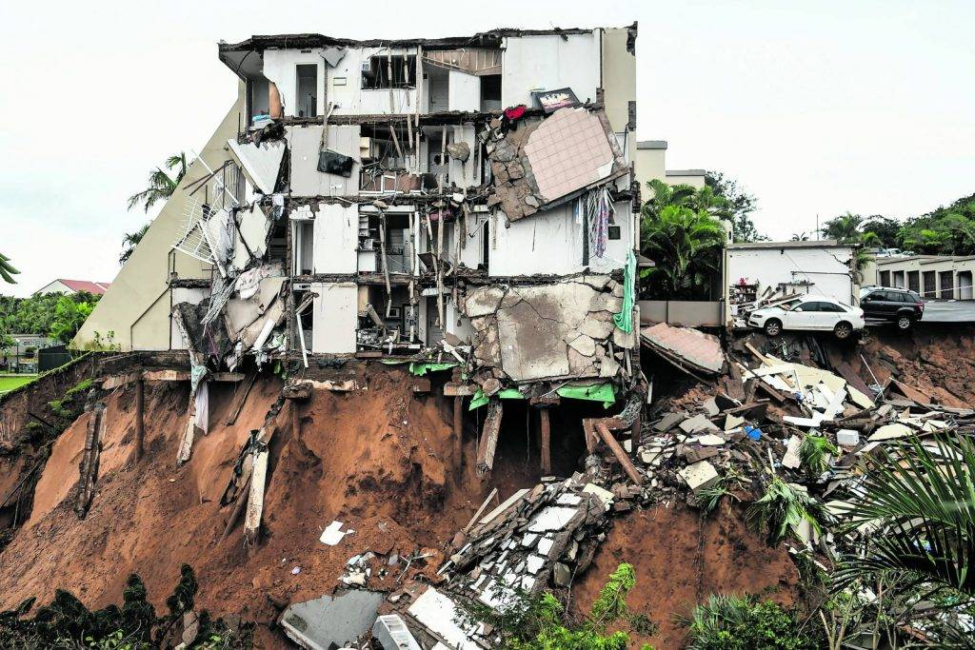

The Discourse of Climate Change Disasters and the Implications for Green Social Work: The Lived Experience of Flood Survivors in KwaZulu-Natal and Eastern Cape, South Africa

Slide 2


Presentation Facilitators
Thembelihle Makhanya
Thembelihle.Makanya@ump.ac.za
Santham Ajodhia
Sajodhia@ufh.ac.za

Slide 3
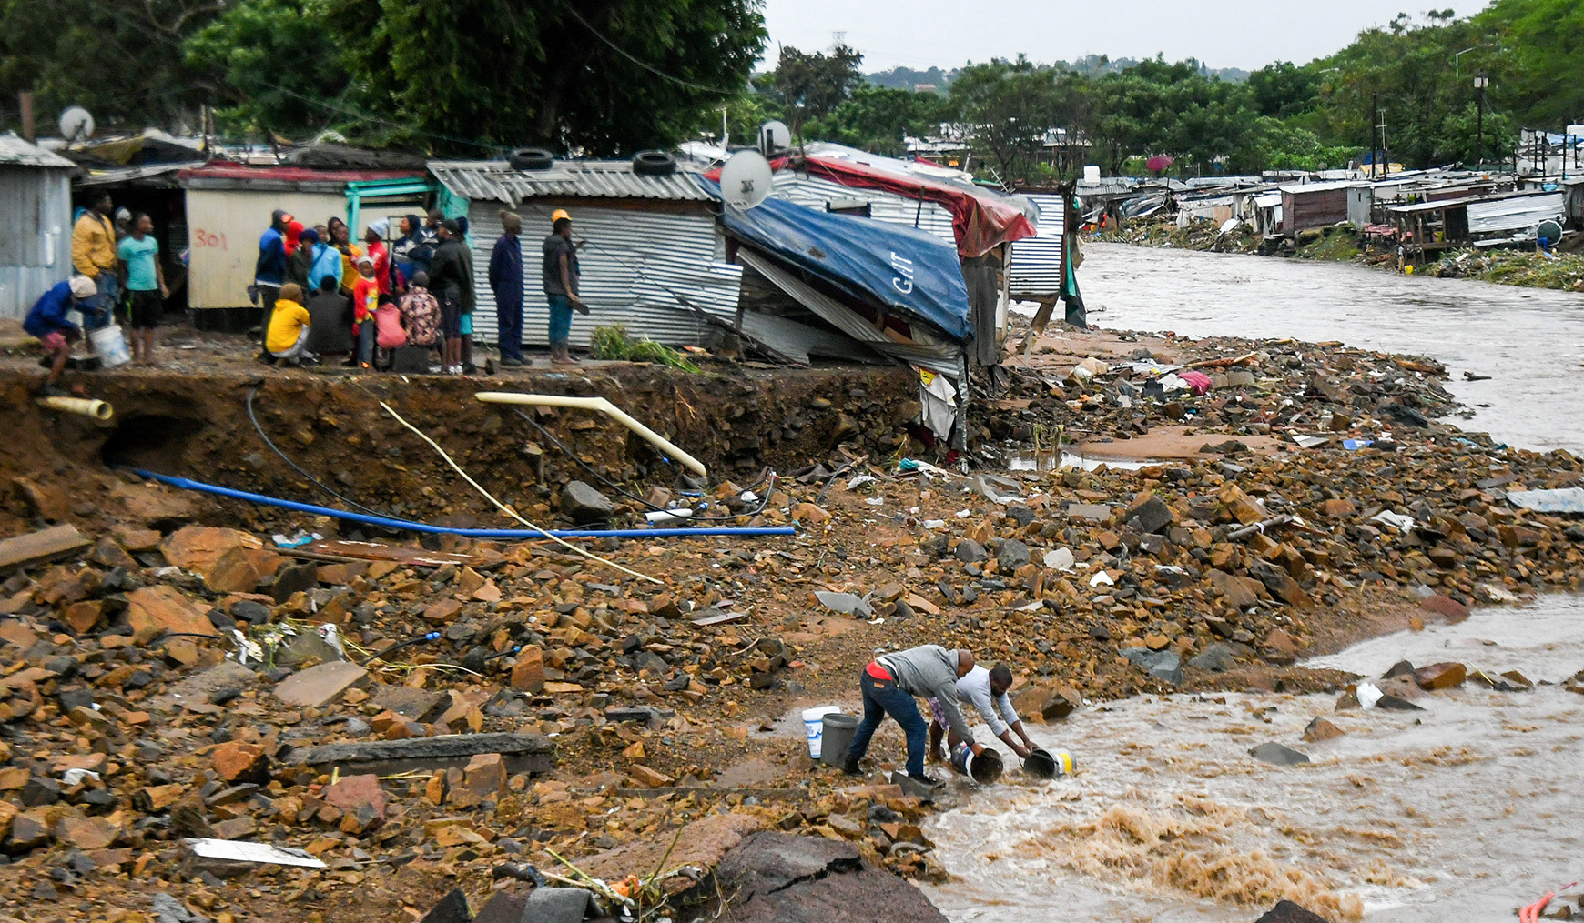
Introduction
  Climate-related disasters are increasing in frequency and severity, with water-related events causing 90% of all disasters (Ngcamu, 2023).
  The April 2022 floods in KwaZulu-Natal alone resulted in:
  Over 500 fatalities
  40,000+ people displaced
  12,000+ homes annihilated
  (Mudefi, 2023)

Slide 4
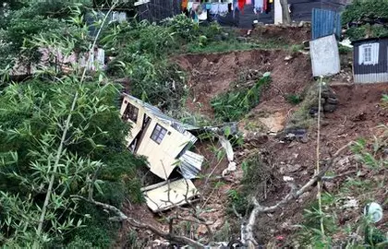
  The core problem: These disasters disproportionately impact impoverished communities in vulnerable areas, while the social work response has yet to fully integrate an environmental justice framework (Shokane, 2019).
  Purpose of the study: To explore the lived experiences of flood survivors and advocate for a reorientation of social work towards a “green” climate - sensitive practice.

Slide 5


A paradigm shift
Background: The Need for Green Social Work
An emerging framework that integrates environmental justice, sustainability, and human rights
Key theoretical lenses
Green social work: Environmental justice and community resilience.
Sustainable livelihoods framework
Communities using their assets (social, human, natural) to survive and recover from shocks

Slide 6
Research Methodology
  Project: A Comparative Study on the Lived Experiences of Floods Survivors in KwaZulu-Natal and Eastern Cape Province: Exploring the Discourse of Climate Change Disasters and the Implications for Green Social work.
  Research Design: A qualitative, exploratory design
  Participants: 23 Participants
  (11 from KwaZulu- Natal and 12 from Eastern Cape)
  Data Collection: In-depth, semi structured interviews
  Data Analysis: Thematic analysis
  Ethics: Ethical clearance from the University of Mpumalanga
  Informed consent, anonymity and confidentiality

Slide 7
Findings
The Immediate Impact: Loss & Systemic Failure
  Overwhelming Loss: Survivors reported the sudden and shocking loss of homes, property, and essential documents.
"I watched as my home was swept away."
(Participant G, KZN)
"I lost all my personal belongings, including my identity card and my children’s birth certificates…everything was swept away." (Participant H, EC)

Slide 8
Inadequate Infrastructure
  Homes were poorly built and located in flood-prone areas, with no proper drainage, leading to recurring damage.
"The infrastructure here is poor. The roads are always flooded, and there’s no proper drainage." (Participant C, KZN)
  Slow & Insufficient Response: Participants expressed feelings of neglect and abandonment due to slow and uncoordinated government aid.
"The government is very slow to respond. We need assistance fast, but instead, we are left waiting, and then the damage is done."
(Participant B, KZN)

Slide 9
Trauma & Mental Health
  Pervasive Psychological Distress: Survivors experienced severe anxiety, shock, and cognitive disturbance. The trauma persisted long after the floods.
"After the flood, I couldn’t sleep for days… Every time it rains now, I’m filled with anxiety." (Participant C, KZN)
  A Constant State of Threat: The emotional toll of loss and poor living conditions created a feeling of helplessness and constant stress.
"I feel helpless… every time it rains, I just want to leave the house because the house is always damaged… its draining mentally and physically." (Participant N, KZN)

Slide 10
Agency & Resilience: Community Coping
  Community Solidarity as a Lifeline: In the absence of formal aid, survivors relied heavily on mutual support and collective action.
"Our resilience comes from unity. When one person is struggling, others step in to help." (Participant G, KZN)
  The Power of Social Networks (Ubuntu): Relational support was a primary coping mechanism, with neighbors helping with clean-ups, shelter, and sharing resources.

Slide 11
  Culturally-Rooted Coping: Communities engaged in symbolic rituals (e.g., "pot-hitting") to ward off future disasters.
"We hit the tins and shout to scare the danger away."
(Participant Z, KZN)
These practices represent an attempt to reclaim a sense of agency and psychological control in a threatening environment.

Slide 12
The Role of Social Work
  A Call for Proactive Intervention: Survivors expressed a clear need for social work support that was largely unmet.
"We need people to talk to us about the trauma." (Participant N, EC)
  Support Perceived as Absent or Inadequate: Participants reported that social workers were not visible or were focused on other issues.
"There’s no social worker support here, and when we try to reach out, no one listens. People are struggling mentally, but we have no one to turn to." (Participant B, KZN)

Slide 13
Recommendations for the Profession:
  Integrate Climate Change into Social Work Education: Curriculums must include environmental justice, disaster risk reduction, and green social work principles.
  Develop Trauma-Informed, Community-Based Interventions: Train social workers in culturally sensitive mental health support for disaster contexts.
  Promote Community Resilience: Collaborate with communities to build on their existing strengths, local knowledge, and cultural coping strategies.

Slide 14
  Promote Community Resilience: Collaborate with communities to build on their existing strengths, local knowledge, and cultural coping strategies.
  Advocate for Policy Reform: Engage in advocacy to improve infrastructure, ensure equitable disaster response, and hold government accountable.
  Strengthen Institutional Presence: Ensure social workers are resourced and embedded within official emergency response teams.

Slide 15
Conclusion
The profound impacts on survivors, coupled with their resilience, reveal a critical need for a paradigm shift in social work. We must move toward a socially and ecologically responsive practice that actively builds disaster resilience and promotes environmental justice.

Slide 16
Dissemination of Findings:
Article submitted to the British Journal of Social Work
Article submitted to the Feminist Inquiry in Social Work Journal
Call for Book Chapters: Climate Change Disasters: Indigenous Practices for Enhancing Sustainable Community Resilience and Interventions. To be published by the International Federation of Social Workers (IFSW). Editors: Thembelihle B. Makhanya (University of Mpumalanga), Ndwakhulu S. Tshishonga (University of KwaZulu-Natal), and Santham Ajodhia (University of Fort Hare).Abstracts closing date: 30 September 2025. Submission email: climatedisastersresiliences@gmail.com.

Slide 17
References:
Ajodhia, S., and Makhanya, T. B. (2024). The lived experiences of displaced African single mothers in the aftermath of floods in Kwazulu-Natal, Social Work/Maatskaplike Werk, 60(3), pp. 602-621.
Alston, M. (2015). Social work, climate change and global cooperation, International social work, 58(3), pp. 355-363.
Arkert, L. and Jacobs, I. (2021) ‘Ecological social work in South Africa and the way forward’, in Practical and Political Approaches to Recontextualizing Social Work, pp. 151–174. IGI Global. doi:10.4018/978-1-7998-6784-5.ch008.
Babbie, E. R. and Mouton, J. (2011) The Practice of Social Research (South African edn). Cape Town: Oxford University Press Southern Africa.
Bradshaw, S. (2015). Engendering development and disasters, in E. Enarson and P.G. Dhar Chakrabarti (eds.), Women, Gender and Disaster, Global Issues and Initiatives, SAGE.
Chiwara, P. and Lombard, A. (2020) ‘Multidimensional poverty in informal settlements in Windhoek, Namibia, and Orange Farm, South Africa’, Social Development Issues, 42(1), pp. 31–43. doi:10.3998/sdi.17872073.0042.104

Slide 18
References:
Dominelli, L. (2018) The role of social workers in climate change adaptation. International Social Work, 61(4), pp. 488–494.
Lombard, A., and Viviers, A. (2020). Green social work practice in South Africa: A framework for a climate-just profession, International Social Work, 63(2), pp. 213–228.
Makhanya, T. B., and Mzinyane, B. M. (2024). Mazibuyele emasisweni: the nexus of Ubuntu philosophy, climate change and green social work, Critical and Radical Social Work, 1(aop), pp. 1-18.
Mudefi, E. (2023), Disaster management ‘deeds’ in the context of April 2022 KwaZulu-Natal floods: A scoping review. International Journal of Disaster Risk Reduction, 98, pp. 104122.
Shokane, A. L. (2019) Social work assessment of climate change: Case of disasters in greater Tzaneen municipality, Jàmbá: Journal of Disaster Risk Studies, 11(3),pp. 1-7.

Slide 19
