Slide 1


Engaging Men to Pioneer the Prevention of Gender Based Violence and Femicide as well as HIV through Social and Behaviour Change Programme - Men Championing Change
ASASWEI CONFERENCE
10-12 SEPTEMBER 2025
Ms. Mookho Shikwambana

Slide 2
PRESENTATION OUTLINE
INTRODUCTION
BACKGROUND
RATIONALE
MEN CHAMPIONING CHANGE PROGRAMME
IMPLEMENTATION OUTCOME (FINDINGS)
ANALYSIS
CONCLUSION
RECOMMENDATIONS
REFERENCE LIST

Slide 3
INTRODUCTION
According to South African National AIDS Council 2022 Stastics there are 8 million people living with HIV in South Africa.
The prevalence of HIV infection among women in South Africa remains significantly higher than among men with an estimation of 5,2 million of the 8 million being women by the end of 2024 to early 2025.
While sexual intercourse is a widely recognized as a primary mode of HIV transmission, the discourse often overlooks the social and structural drivers that are the root causes of infection.

Slide 4
INTRODUCTION
Research consistently shows that there is a strong and complex link between Gender-Based Violence and high rates of HIV infection, particularly among women and girls.
According to the First South African National Gender-Based Violence Study, 2022, conducted by the Human Sciences Research Council (HSRC), an estimated 2,150,342 women aged 18 and older in South Africa have experienced sexual violence in their lifetime
The Sexual Offences and Related Matters Amendment Act No. 32 of 2007 categorised sexual violence offences as rape, sexual assault, compelled sexual acts, sexual grooming, incest and dissemination of child pornography.

Slide 5
BACKGROUND
The National Strategic Plan (NSP) on HIV, TB and STIs, 2017-2022, called on social scientists to conceive a pathway to address the social and structural drivers of the epidemics. These drivers are not individual behaviours but rather the broader societal conditions that create an environment where HIV thrives.
This amongst many reasons led to the development and later implementation of the Department of Social Development’s Social and Behaviour Change Compendium of Programmes.
At its core the Compendium aims to challenge behaviour, social norms, cultural practises and beliefs that promote risky behaviours, women demeaning practises and men isolating ideas thereby promoting positive behaviour.

Slide 6
BACKGROUND
The Social and Behaviour Change Programmes are HIV, Gender Based Violence and other social ills prevention and intervention Programmes of the Department.
Men Championing Change Programme is one of the SBC Programmes which targets men nineteen years upwards.
The aim of the Programme is to create an enabling environment in which men can dialogue HIV and GBV prevention, and to inspire positive values related to sex and sexuality.

Slide 7
RATIONALE
Men as members of society face various challenges which affect their mental well being.
When faced with adversity or immense pressure some men become violent and harmful to themselves and those around them.
Their reaction to pressure and adversity is exarcebated by the socio structural aspects such as traditional gender norms assigned to men and women.

Slide 8
MEN CHAMPIONING CHANGE PROGRAMME
Men Championing Change Programme though not a panacea to all men and the challenges they face, it affords men their high need of conducive environment to engage meaningfully with other men, addressing matters such as men’s mental well being.
Through these engagements men also map out plans to actively take responsibility in dealing with social ills (HIV and GBVF) as well as influencing one another towards active citizenry .
They share with one another on harnessing their power to mitigate the outcomes of Gender Based Violence and HIV.

Slide 9
MCC IMPLEMENTATION AND OUTCOME (FINDINGS )
This presentation outlines the impact of the Men Championing Change (MCC) programme, which has been implemented in South Africa since 2018, with a particular focus on the Free State province.
A survey was conducted to assess the impact of the MCC programme, and this presentation will share the key findings from that study.
A sample was deduced from 40 men from Fezile Dabi and Mangaung Metro Districts who have attended either dialogue or workshop on MCC.
Random selection was utilized to select participants.

Slide 10
MCC IMPLEMENTATION AND OUTCOME (FINDINGS )
Most of the men who attended the Programme reported to have received sense of belonging and relief by just being part of the discussions with other men.
More than 90% (36) of the men experienced the topics discussed as being relevant matters of what men go through.
While 40% (16) felt that their approach in dealing with conflict will change wherein they will consider hearing their partner’s side of the story before taking their own decisions.
More than 97.5% was relieved to find out that there are commonalities amongst all men of the things they go through.

Slide 11
ANALYSIS
Both dialogue-based sessions and workshops, along with questionnaire responses, provided clear evidence that men are capable of openly discussing and expressing their emotions in the company of other men.
Creating a conducive environment seems to communicate non judgemental atmosphere which inspire men to meaningfully participate in group sessions.
Responses from the questionnaire indicated that men are prepared to use condoms when engaging in sexual intercourse.
Men that participated in the evaluation showed willingness to resolve conflict amicably with their partners without being violent.

Slide 12
CONCLUSION
Increasing men’s involvement in addressing HIV and GBVF can be achieved through strategic planning and intentional actions.
This approach encourages men to act not just as individuals, but to work collaboratively and to mobilize women as active partners in their efforts in dealing with HIV and GBVF,
The approach highly confirms that collaborative effort work better for men in dealing with the two scourges than working as individuals.

Slide 13
RECOMMENDATIONS
Men should be invited to be equal partakers in the fight against new HIV infections and the fight against Gender Based Violence and Femicide.
Programmes that targets men’s well being should receive precedence.
Social and Behaviour Change Programme in particular Men Championing Change Programme be one of the main intervention Programmes meant for services towards men.

Slide 14
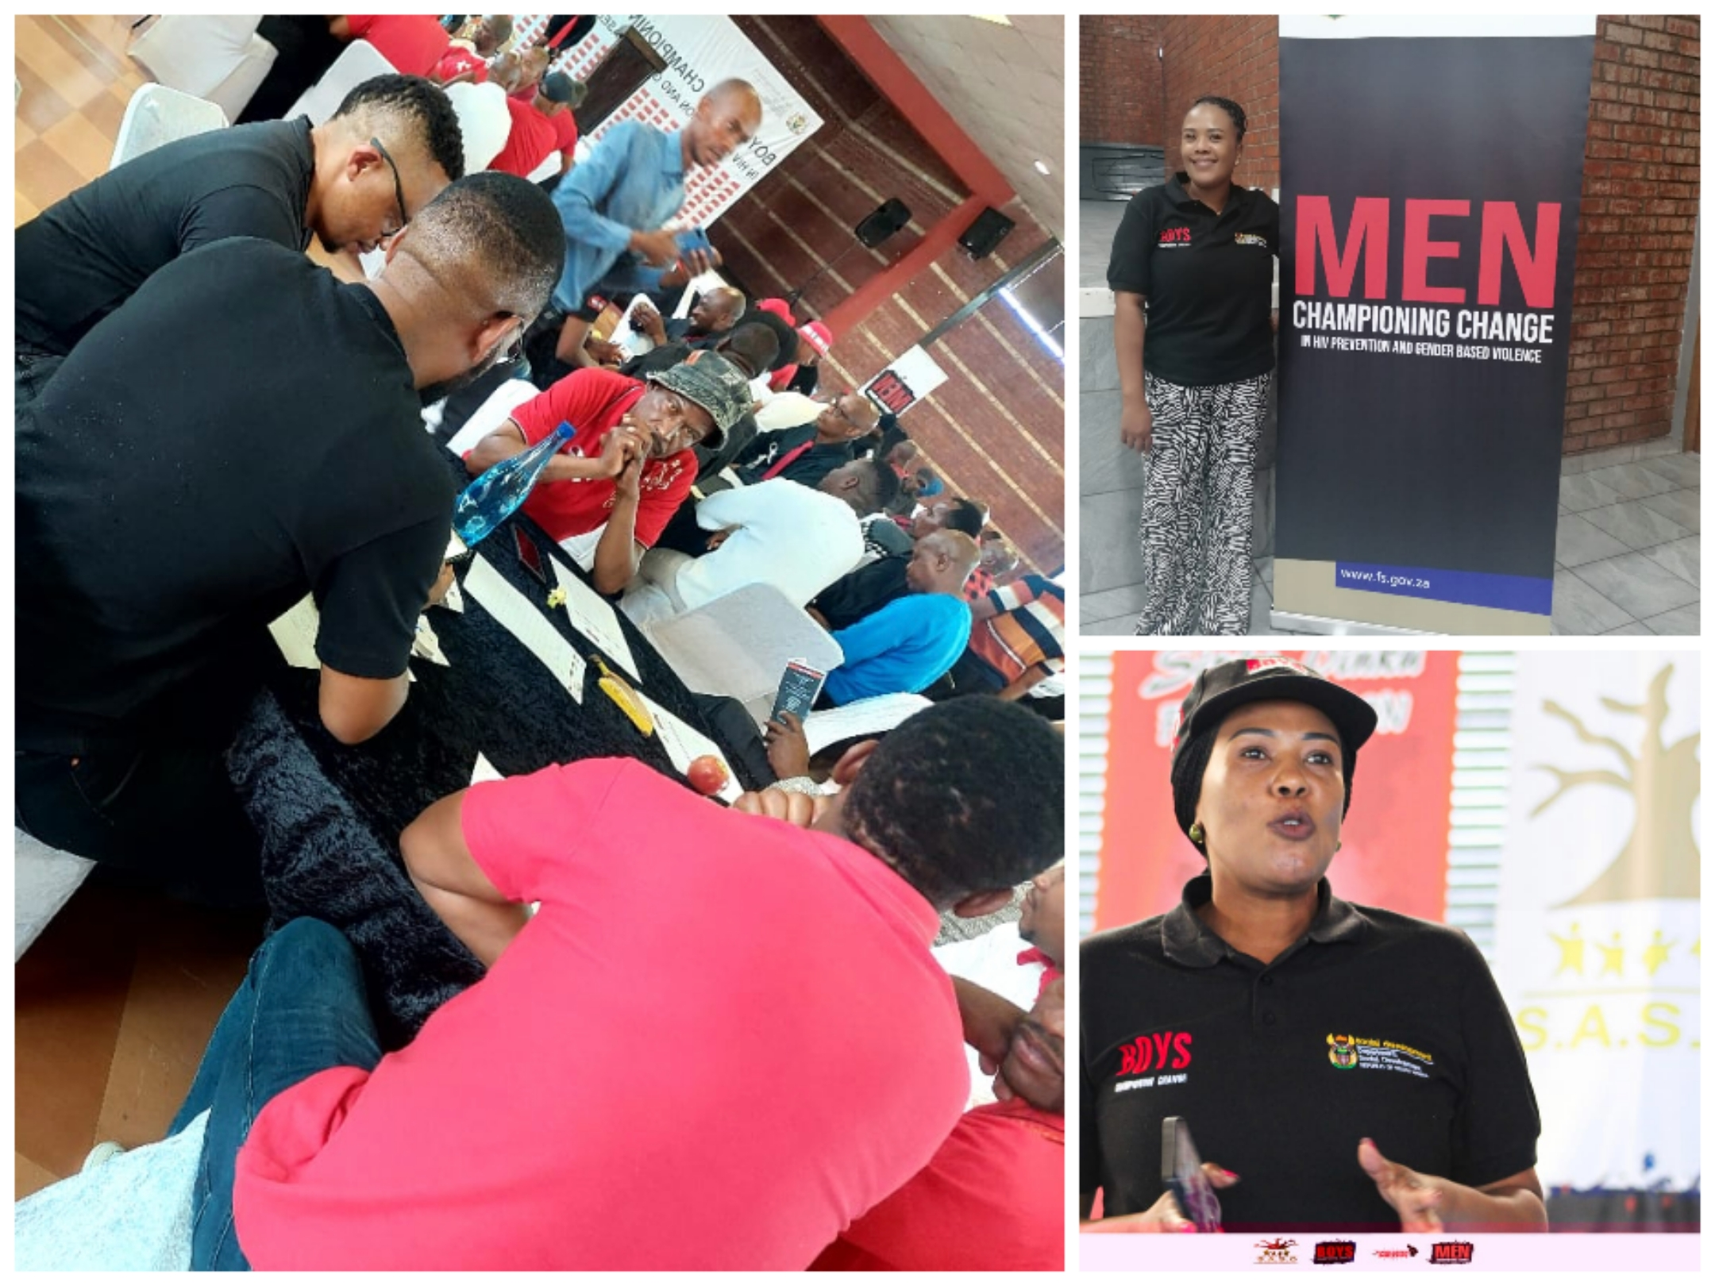

Slide 15
REFERENCE LIST
South Africa. Department of Social Development. (2020)A Toolkit for Primary Prevention of Social and Structural Drivers of HIV.
South African National AIDS Council. (2016).National Strategic Plan for HIV,TB and STI’s - Let our Actions Count 2017 -2022. Available from http//www.sanac.org.za
Zungu,N.P et. al. (2022). The First South African National Gender-Based Violence Study. (Report No. 1). Cape Town. Human Science Research Council

Slide 16

HA KHENSA

