Slide 1
Social Work Practitioner Presentation on Theme: Green Social Work and Climate Resilience: Supporting Vulnerable Communities in the Face of Environmental Crises Title: Green Social Work: Integrating Environmental Justice into Social Work Practice
ASASWEI 2025

Slide 2
I Am
Example:
“I am Pharryl Douw, currently working within The Department of Social Development at Lejweleputswa District in the Freestate, Welkom office. I am a social work coordinator working with Older Persons, whether in communities or Residential Facilities. I’ve been within the Department since 2014, which constitutes 11 years of experience. We serve vulnerable communities, with a focus on specific demographics e.g. Older Persons
I will be presenting on the tittle: Integrating Environmental Justice into Social Work Practice. Subtitle: A Green Social Work Approach

Slide 3
I Am
“My name is Kelebogile Kwena. I work at The Department of Social Development, Lejweleputswa District in the Free State Welkom Office. I’ve been a social worker for 7 years. Today, I will be presenting on the tittle: Integrating Environmental Justice into Social Work Practice. Subtitle: A Green Social Work Approach

Slide 4
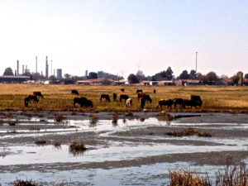
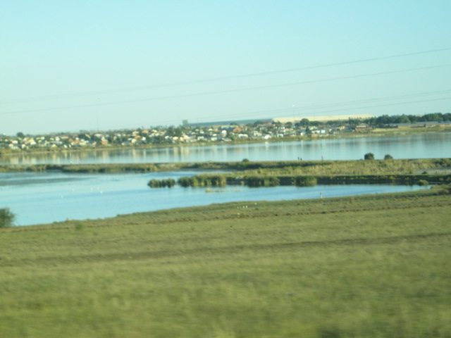
Allanrigde (Nyakallong)
A few points about your community
The community is semi urban and rural community
The community of Allanriidge with an estimated population 18, 879 as of 2025, with estimated 10% disability and 14,31 % of Older persons which forms part of the community).
Key challenges faced
Abandoned Mining Plant
Sewage Plant not maintained
No proper drainage systems in place
Why this topic matters
from observations through community work-Sewage dam flows into Silt dam which is practically within the community.
The above-mentioned dam emits sewage gas which contains ammonia, methane and hydrogen sulphate which is inhaled by the entire community and high concentrations can result in asphyxiation, miscarriages and gal bladder problems, which is exacerbated within vulnerable groups.
The community regularly floods during rainy seasons which displaces community members (cause of the dams and lack of drainage systems), and the vulnerable groups gets the worse of it.
There is a Silt dam (From Abondoned Mine) and Sewage dam right next to the community, and various other pans and/or dams within and outside the community caused by rain water, giving an indication that the community was build in a swamp area or possibly an old river bed. This adversely affects the entire community, and is exacerbated within vulnerable groups. As together our work focus on partial care and Older persons respectively, social workers had to be cognisant of the environment and its effects on the focus groups. Other resources like public transportation, Banks, etc. are currently a challenge within this community.

Slide 5
What We Did (Part 1)
What problem did you tackle?
Enrollment of children with disabilities in partial care day centers.
Parenting skills to parents of children with disabilities within the community.
Placement within residential facility for older persons.
Monitoring of CBCSS and residential facility of older persons.
Rendering care and psychosocial support services to the vulnerable groups.
What actions did you or your team take?
Screening
Interviews
Assessments
Report Writing
Registration of Facilities
Who was involved?
Social workers
Community members
Other stake holders e.g SAPS, DOE, DOH
NPO’s
Any creative or local knowledge used?
Community forums
Gardening as daily activity in the CBCSS
Stokvel's
l

Slide 6
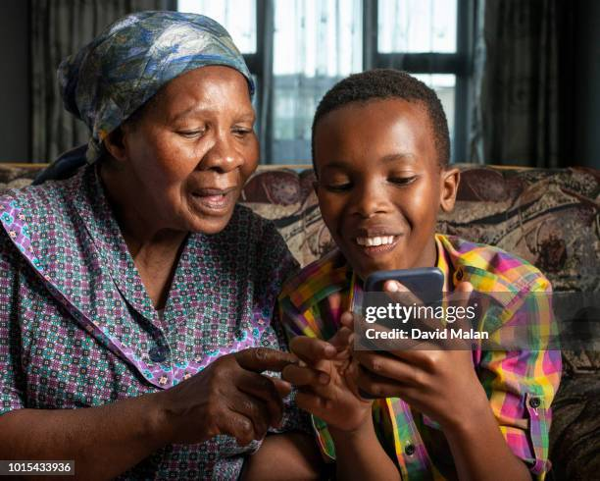
Case study
Case story of Ouma Mohapi and Thabo Sewe (privacy protected).
We have the case of Ouma Mohapi (83years) who is currently the sole care-giver of Thabo Sewe (9years), who is her grand child. This responsibility was taken when the mother Confidence passed on in 2019 due to natural causes. Ouma Mohapi constantly complaints of chest pains and only approached Social worker in January 2020. Social worker did screening during intake (which revealed that Thabo Sewe is a child with disability and Ouma Mohapi might have underlying health concerns, Building Rapport with the family, to serve as catalyst during preliminary assessment and intervention with the family. Ouma Mohapi was referred to the Primary Health facility, to get an indication as to what health challenges she might be facing. Thabo was also referred to Primary Health Facility so as to gain an understanding of his disability. As the client-social worker relationship is an ongoing relationship. Social worker assisted in enrolling Thabo within a Thuso Day Care (Temporary Respite Care) and linked Ouma Mohapi with the Luncheon Clubs within the community (Community Based Care and Support Services). This was done to ensure that whilst the family is being assisted with Disability Grants and Old Age Grant, they have functioning support systems and networks within the community (Which is monitored by Social workers). Ouma Mohapi was said to have respiratory challenges and advanced heart challenges, apart from the many Physical ailments that comes with old age. She is currently very active, maintains a vegetable garden and is enrolled within the Older persons Active Aging program. Thabo’s well-being is also improved, as he is enrolled within the TRC. He is now very talkative ,active as he engages in various mental stimulating programs within the TRC and physical activity. The only concern is that Ouma Mohapi still resides next to the toxic dam which is not helping matters. Social worker, engaged municipality, local councilor, to possibly seek a new site in the current newer extensions within the community. That process is till unfolding.

Slide 7
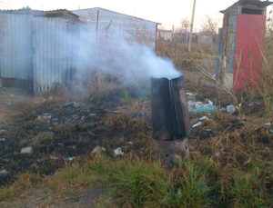
Lessons and Reflections
What was hard?
Having to maintain a positive helping attitude within stench filled environment, which is possibly compromising to the health of the social worker as well.
How did you overcome obstacles?
By utilising masks
What did you learn?
Social work is starkly intertwined with environmental justice.
Idea: a quote from a beneficiary- Re hema ntsere totoba.

Slide 8
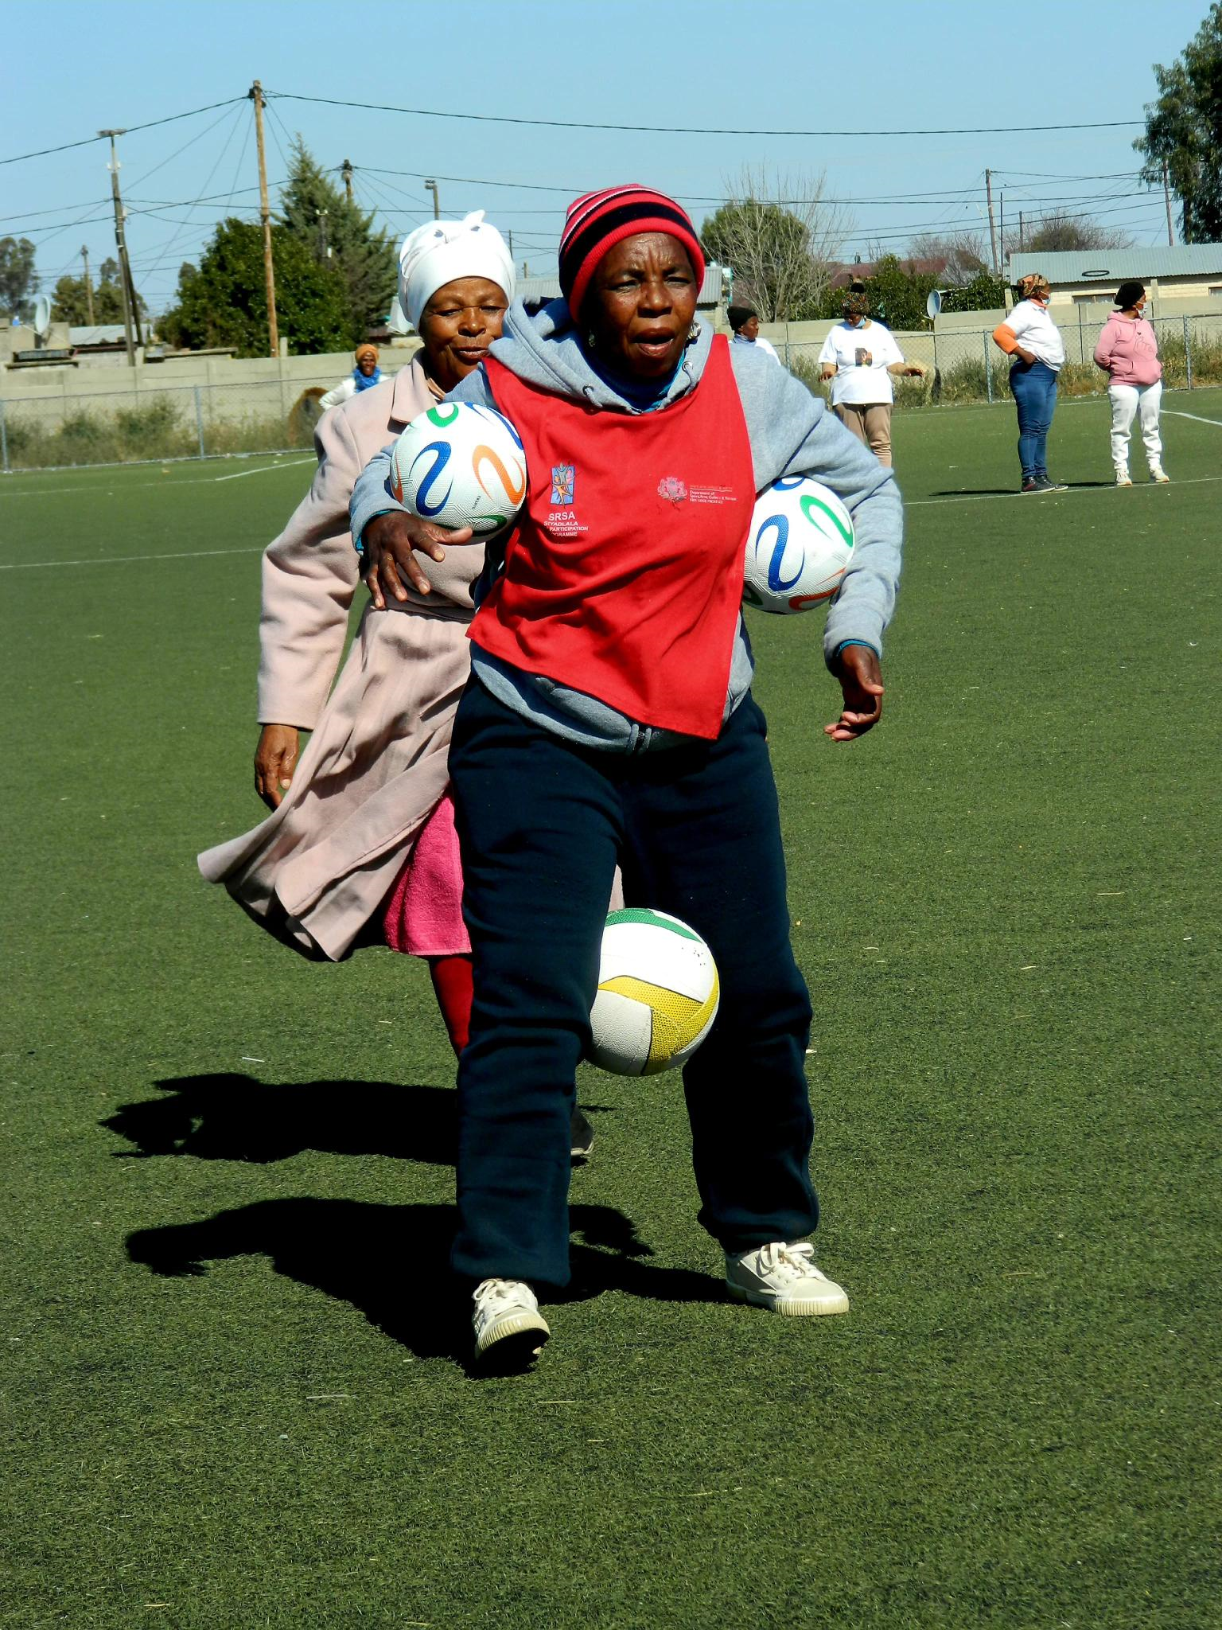
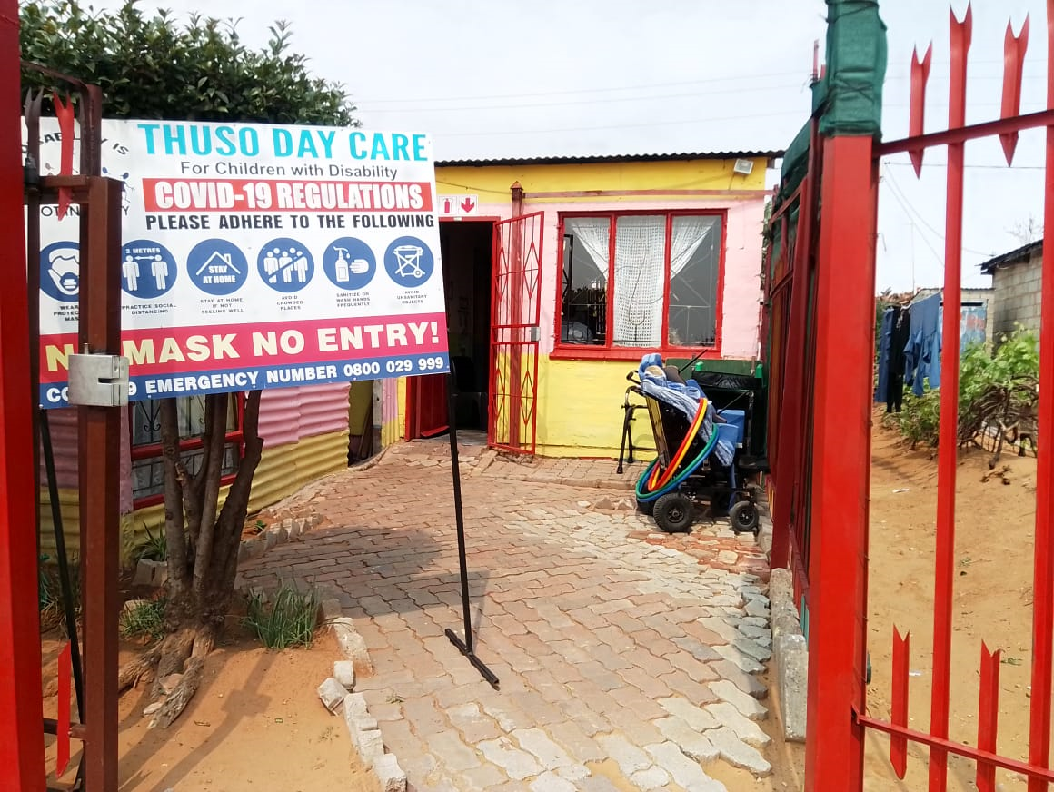
What Needs to Change
What support do you need?
Local municipality should be accountable for the communities they serve, especially with regards to man-made environmental challenges
Legislation and bylaws specifically drafted for cooperation between various stakeholders.
What message do you want others to take from your story?
Green Social Work as a practice model is long overdue within social work, therefore more research needs to conducted in order to serve as catalyst toward fostering collaborative and implementation of Green Social Work.
Prompt:
“If I could tell future social workers or policymakers one thing, it would be” Social work is starkly intertwined with environmental justice.‘’

Slide 9
Thank You
Presenters
K. C Kwena
P. S. C Douw
Isiah 1: 17
Seek justice, rescue the oppressed, defend the orphaned, plead for the widow.

