Slide 1
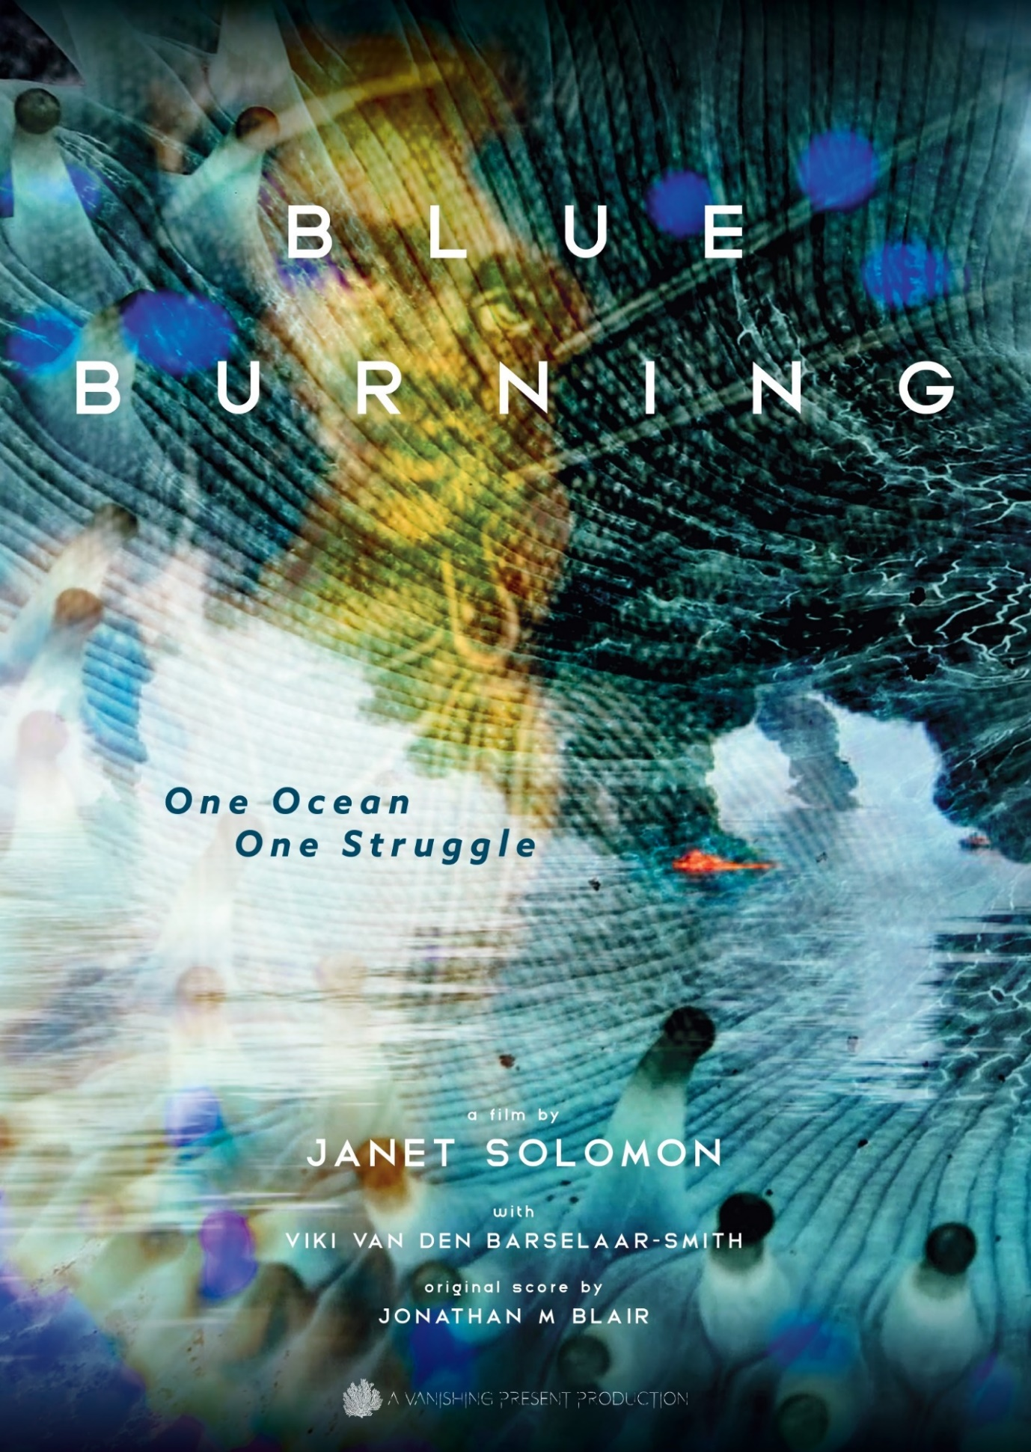


GREEN SOCIAL WORK
DOCUMENTARY EVENT
BLUE
BURNING
THURSDAY 11 SEPTEMBER 2025
Time: 10H30 – 12H20
Venue: Plenary - MODLEC Hall - University of the Free State
90mins | Video Documentary
Director and Producer: Janet Solomon
Cinematographer and Editor: Viki van den Barselaar-Smith
Original Music Score: Jonathan M. Blair
Final Mix: Johan Prinsloo
Preview: https://www.blueburning.africa
Screening and discussion facilitated Prof. John Rautenbach
This documentary invites social workers to engage with green social work’s focus on ecological sustainability and radical social work’s emphasis on transformative resistance against systemic harm, offering a compelling call to action for the ocean commons and climate justice.

