Slide 1
My name is Anna Motsoeneng. I work at the Department of Social Development Bethlehem Office in the Free State. I work as a child and protection Social Worker. I have been a Social Worker for 7 years. Today, I will be sharing how we have been supporting children and families as the vulnerable population within our community”.

Slide 2
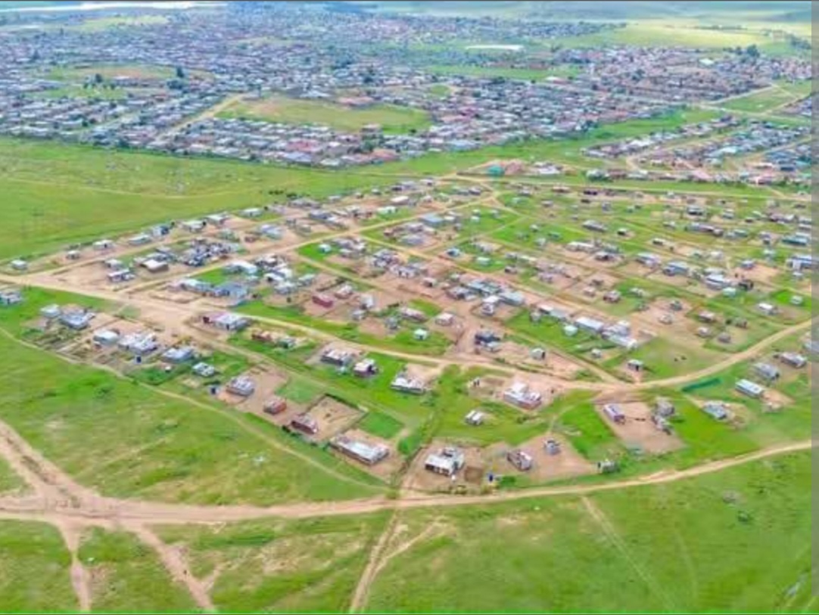
Bethlehem Community

Slide 3
CONT.
Bethlehem in the Free State is known for its agricultural significance as a key wheat producing region, its beautiful natural surroundings including the Maluti Mountains and access to Golden Gate Highlands National Park.
The challenge faced by the community at large is substance abuse.
The topic chosen for this team is vulnerable population. This topic matters because children are seen as the most vulnerable population in this community. Furthermore, due to the challenge faced by the community which is substance abuse children become vulnerable.

Slide 4
What We Did (Part 1)
The most common problem that is being tackled within the community is child neglect as a result of substance abuse.
Action taken to overcome this problem was that as child protection social workers firstly, we conducted awareness campaigns to empower the parents regarding the use of substance abuse which result to them neglecting their children. Secondly, Supporting parental roles and responsibilities through promoting family resilience in crises and strengthening family systems. Lastly, place the child in temporary safe care, while empowering parents.
The awareness was done with Parents, School teachers, SAPS, NGOs and Health practioners being involved in the process.

Slide 5
Case Story
One of the Scenario is that we had a case where parents were neglecting the child due to the substance.
The Social Worker arranged parental skills and guidance sessions.
The parents were empowered regarding the substance use, referring them to the substance abuse practitioners.
However the parents were in denial, which lead to the removal of the child to the extended family members.
Due to parents not cooperating with the extended family members.
The child was removed from the family to temporary safe care.

Slide 6
Lesson and reflection
Struggle to find the safety placement.
To overcome the challenge we encouraged the current foster parents and recruit the new safety parents.
We learned that separating the children from their families it affects them psychologically and emotional.
It is important to keep the child within the family and maintain family preservation.

Slide 7
What Needs to Change
As Generic Social Workers we need debriefing sessions to be arranged.
Employ an office based Wellness Practioners who will always monitor and check up on our well-being.
If I could tell future social workers one thing it would be that children are our future leaders, it is imperative to take care of them.
“We look out for kids no
matter who they belong to!!
That’s LAW”
By: Marco Blue Johnson.

Slide 8
THANK YOU

