Slide 1


Topic: The impact of climate-related disasters on marginalized and vulnerable population
Presenter: Reitumetse Tsolo

Slide 2

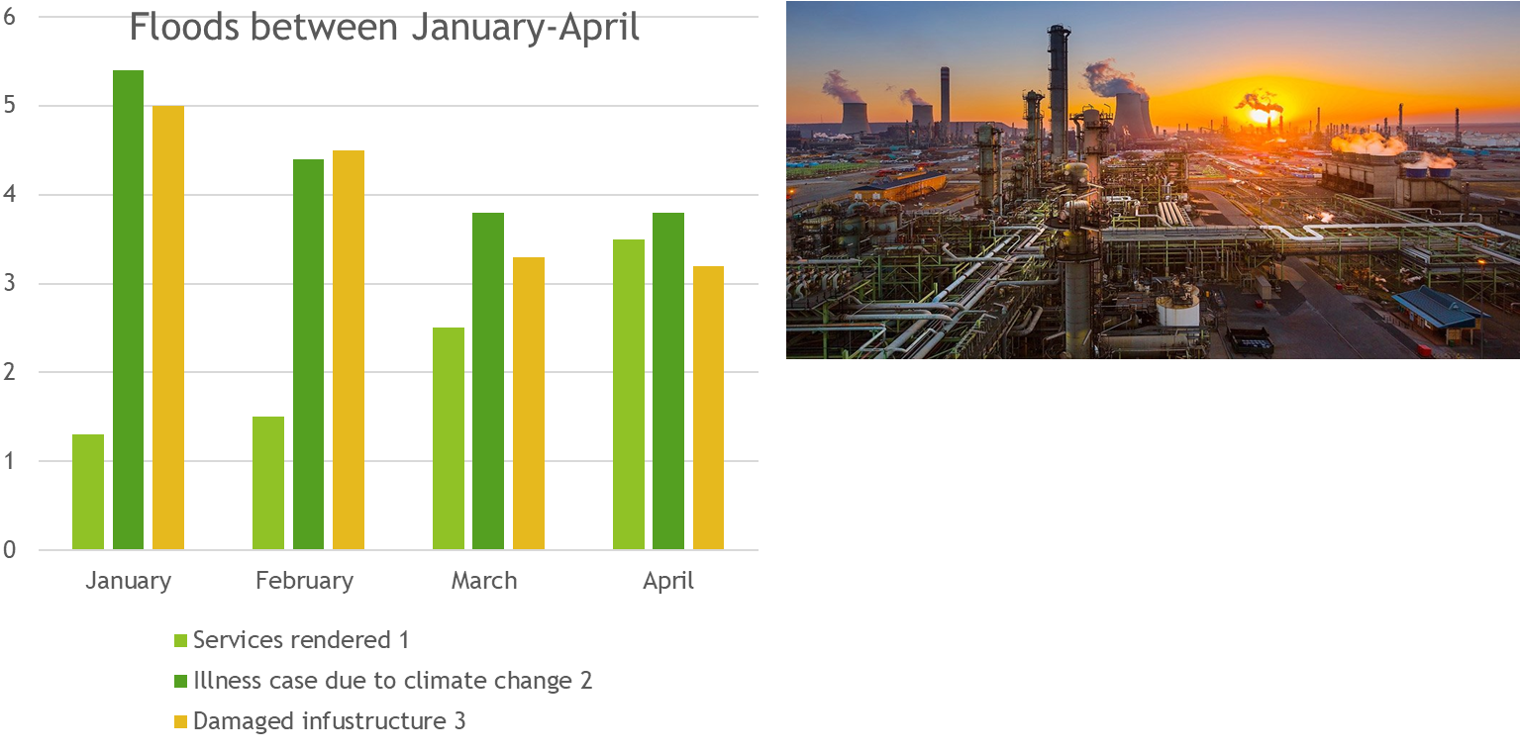
Introduction
The study evaluates the impact of climate-related disasters at Zamdela between January-April 2025
During the period of disasters, individual in the households are unable to access services and informal businesses are negatively impacted due to unfavorable weather conditions.

Slide 3
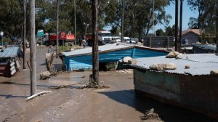
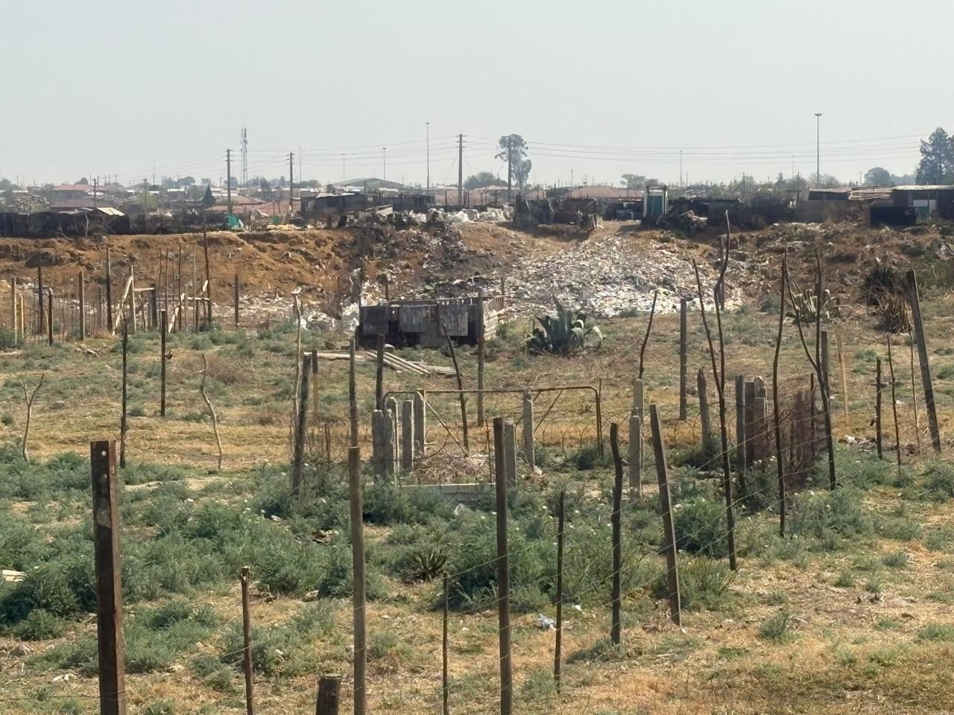
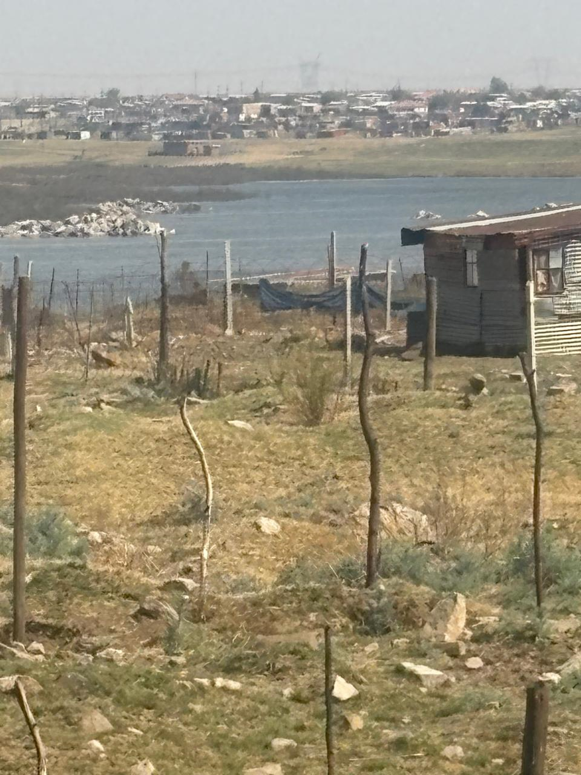
Introduction
People make a living by working on the streets are unable to provide for their families, limiting their ability to recover from poverty.
In areas such as Iraq, which is characterized by lot of shacks. Thus, vulnerable individuals are not able to walk on the streets that are flooding which can take weeks to a month to dry.

Slide 4
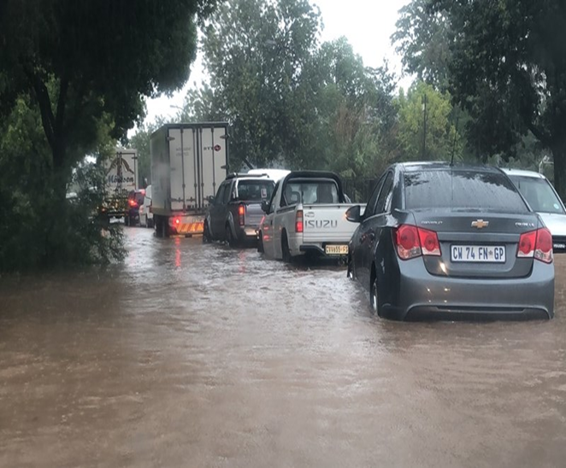
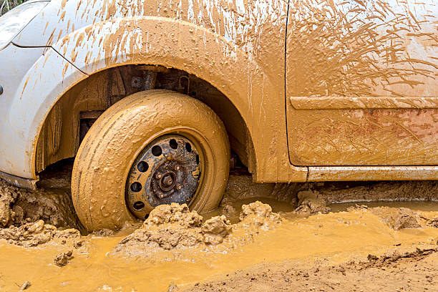
Introduction
Furthermore, the officials such as social workers are unable to respond swiftly to the crisis cases due to state vehicles that are not suitable for the purpose and get stuck in the mud
Air pollution is one of the long-standing challenges in the area of Zamdela
Exposure to air pollution and climate change increases the risk of poor immune, heart and lung diseases. As a result, the residents in this area are victims to industries that causes air pollution.
Children are mostly affected with respiratory and eye problems

Slide 5
The aim of the study: To inform the public about the challenges experienced by marginalized and vulnerable population of Zamdela during climate disasters.
The objective of the study:
To propose solutions that will help the department to render services to the communities despite the climate-related disasters.

Slide 6
Methodology
This study adopts a qualitative research approach, emphasizing understanding processes rather than solely focusing on outcomes
Data collection: ten households were interviewed, families shared stories on how climate disasters affected them.
Some of the information was collected through observation.
Visual aids and material was taken by presenter at Zamdela and from the internet.
Data collection tools: interview guide, survey questionnaire and observation.

Slide 7
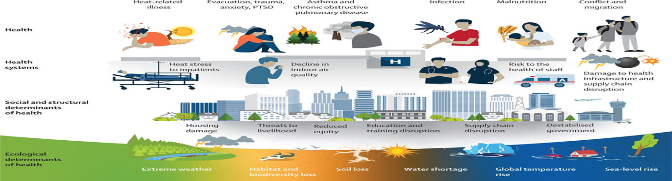
Results and Discussions
The results show that the population is negatively impacted by climate related disasters
The finding in this study, suggest that the Department of Social Development should take proactive steps to mitigate and adapt to the impact

Slide 8
Conclusion
Employing the batho principle of access during climate change will ensure that all citizens have equal access to services
This principle underscores the necessity of ensuring that all citizens, regardless of their socio-economic status or geographical location, have equitable access to government services.
In addition, implementation of social relieve programme,such as food parcel and cash transfers can help vulnerable populations to recover from climate-related disasters.

Slide 9
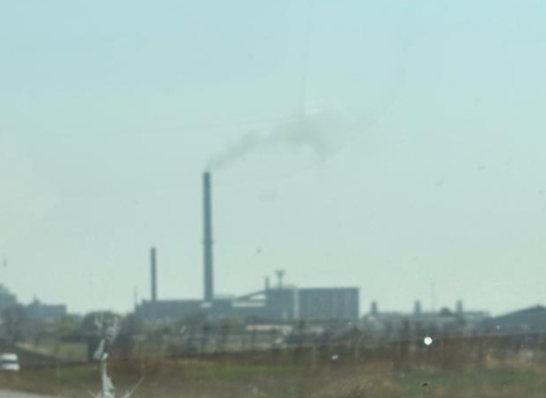
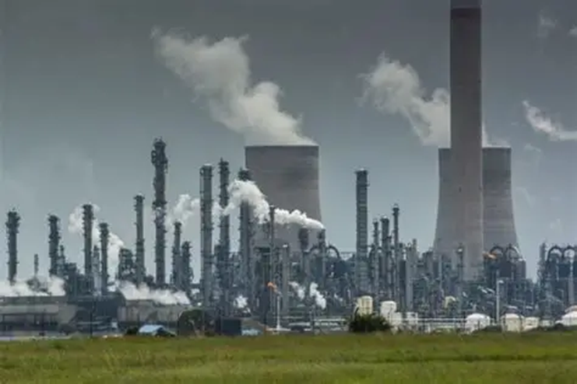
Lesson Learned and Recommendations
The study recommends that green social workers should look into having office spaces within informal settlements.
This will allow vulnerable clients to have access to the services during climate disasters.
We should be ready to adopt to the change of environment

Slide 10
Thank you for your attention

