Slide 1


Social Workers’ Practices with LGBT Clients: Gaps and Challenges in Advancing the Sustainable Development Goals (SDGs)
Mr. Johan Fourie
Dr. Anja Human-Hendricks
Dr. Neil Henderson

Slide 2
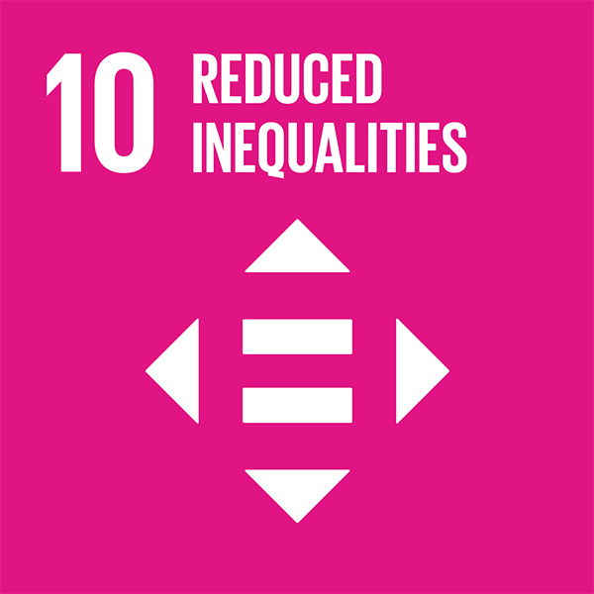

INTRODUCTION
LGBT clients face discrimination and marginalization globally — including within social work services (Dentato, 2012; Marais & Adlem, 2024).
Guided by Tronto’s Political Ethics of Care (2013).
Research gap: Very limited studies in the Global South (Kasa, 2024; George & Ekoh, 2020), especially South Africa (Addinall, 2002; Tao & Jacobs, 2023; Marais & Adlem, 2024).
Aim: Report on the practices and knowledge-base of social workers as well as the interventions needed to address both these knowledge gaps as well as the critical gap and promote inclusive, affirming practice.
It is aligned with SDG 10 (Reduced Inequalities) & SDG 16 (Peace, Justice & Strong Institutions).
This Presentation: Findings of a larger Master's study - the 2nd only known South African study in 23 years examining social workers’ knowledge, attitudes & skills in service delivery with LGBT clients.
Notes:
This is not just anecdotal. Multiple studies — both globally and in South Africa — have shown that LGBT people experience discrimination not only in healthcare but also in social work and related helping professions. This includes exclusionary attitudes, lack of training, and in some cases, direct bias from service providers
LGBT affirming social work practice requires attentiveness, responsibility, competence, responsiveness and trust. The absence of these directly limit social work’s ability to deliver inclusive, queer affirming and human rights-based services.

Slide 3
METHODOLOGY
RESEARCH APPROACH, DESIGN & SAMPLING
Qualitative, explorative-descriptive study.
DATA ANALYSIS:
Thematic analysis using Tesch's 8 steps.
DATA COLLECTION
In-depth semi-structured interviews with 20 Social Workers (14 female & 6 male)
Tronto’s 4 Elements of Care: i)Attentiveness, ii) Responsibility, iii) Competence, iv) Trust
Literature control
TRUSTWORTHINESS
ETHICAL CONSIDERATIONS
Informed Consent, Voluntary Participation, Confidentiality.
Credibility: Participants Quotes and triangulation through a literature control.
Transferability: Detailed description of the research setting, context, and demographic details.
Dependability: Detailed description of the research methodology.
Confirmability: Reflexivity
Convenience & Snowball sampling techniques

Slide 4
KEY FINDING 1: CISHETERONORMATIVE PRACTICE
All participants do not routinely inquire about clients’ sexual orientation or gender identity, due to assumptions based on cis-heteronormative norms or clients’ self-disclosure.
“I have never asked a client what their sexual orientation is.”
”I would not bother myself by asking: Are you gay? Are you lesbian?”
“You get the client. You see its gender. You don't get into that “are you heterosexual or homosexual.”
“I never got to ask. It just so happened when we like in the initial phase, they openly shared about their sexual orientation.”
Notes:
This avoidance reflects a pervasive norm of assuming heterosexuality and cisgender identity, which risks erasing LGBT clients’ identities and needs from social work practice.
It places a barrier to attaining SDG 10.2, which calls for empowering and promoting the social inclusion of all people — regardless of their identity or status — by 2030.
Ethical element of Attentiveness is absent.

Slide 5
KEY FINDING 2: KNOWLEDGE GAPS IN LGBT IDENTITY DEVELOPMENT
All participants demonstrated limited knowledge of LGBT identity development.
“I'm not even familiar with the process of identity development.”
“I truly don’t know what you mean by identity development of LGBT people.”
“Oh, my goodness. I don't know.”
"I'm not clued up with the identity development thing."
Notes:
1. Knowledge of LGBT identity development is essential to understanding and supporting LGBT clients holistically. Without this foundational knowledge, social workers may be unable to recognise or support the specific needs and challenges faced by LGBT clients.
This reveals a critical gap in social work education and training.
Without this knowledge, social workers cannot offer culturally competent or developmentally appropriate care.
It also weakens inclusive, accountable service delivery — a key aim of SDG 16, which calls for:
“Promoting peaceful and inclusive societies... and building effective, accountable and inclusive institutions.”
The ethical care element of competence (Tronto, 2013) is notably absent.

Slide 6
KEY FINDING 3: KNOWLEDGE GAPS OF AFFIRMING REFERRAL RESOURCES
The majority (16) reported limited knowledge of LGBT-affirming referral options and often referred LGBT clients to general services that may not meet their specific needs.
“There are no specific services that is meant to deal with a client from that community.”
“I do not think there’s organisations that caters for or prioritise the LGBTQI community. I think it’s the same resources that we’d refer any other client.”
“There is no specific NGO that only works with Lesbians and Gays.”
Notes:
This reflects a broader gap in service mapping and referral knowledge.
Referring LGBT clients to general services risks further marginalization or traumatization.
It undermines responsiveness (Tronto, 2013) — the ethical obligation to meet specific needs with appropriate care.
It also hinders progress towards SDG 10 (Reduced Inequalities), which promotes equal access to services for all.
Despite most participants reporting limited awareness,
a minority demonstrated knowledge of LGBT-affirming referral options — and referred clients accordingly to inclusive and appropriate services.
This reflects emerging pockets of inclusive practice within the system, highlighting the potential for scaling up affirming care through targeted training and resource development.

Slide 7
KEY FINDING 4: LGBT FOCUSED CPD AS A STRATEGY FOR LGBT-AFFIRMING SOCIAL WORK PRACTICE
Participants identified LGBT-focused CPD activities as a crucial strategy to equip social workers to provide affirming services.
“First things first: intensive training.”
“It should not [be] like pick point who needs that training — because everybody does.”
“To first be able to assist or intervene with them, we first need to have proper trainings.”
Notes:
This finding is consistent with other studies and reflects a level of professional self-awareness and readiness to improve, even among participants with limited current knowledge.
Social workers expressed a clear need for structured, LGBT-focused CPD — highlighting that affirming practice requires ongoing education and skill-building.
This demonstrates Tronto’s (2013) ethical elements of attentiveness and responsibility — as participants recognized their own learning needs and expressed a willingness to engage in continuous professional development to better serve LGBT clients.

Slide 8
DISCUSSION
LGBT affirming social work practice requires attentiveness, responsibility, competence, responsiveness and trust yet these are often absent in practice with LGBT clients.
This absence is exacerbated by cisheteronormative presumptions and a limited LGBT knowledge-base which renders the care needs of LGBT clients invisible.
Limited interorganisational collaboration limit opportunities for professional engagement and knowledge sharing.
The limited inclusion of LGBT-related content in both social work education and continuous professional development programmes exacerbate this.
These gaps undermine social workers’ contribution and advancement of the Sustainable Development Goals, especially SDG 10 (Reduced Inequalities) and SDG 16 (Peace, Justice and Strong Institutions).
While current practice is limited, participants recognized the need for growth. This suggest a strong potential for transformation through training, collaboration, and professional responsibility.

Slide 9
RECOMMENDATIONS & CONCLUSION
Embed LGBT-focused content in social work training curricula
→ Ensure students are exposed to identity development, inclusive language, and practice frameworks.
Implement ongoing professional development (CPD)
Deliver targeted, LGBT-affirming training to practicing social workers.
Foster inter-organizational collaboration
Partner with LGBT-focused organizations to improve knowledge exchange and referral pathways.
Build competencies aligned with ethical practice
This is central to professional competence and ethical obligation towards this client group, thus, not optional.
Thank you for your attention!
Notes:
These strategies are essential for strengthening the profession’s contribution to reducing structural inequality (SDG 10) and building just, inclusive institutions (SDG 16) within diverse communities. Advancing SDG 10 and SDG 16 requires inclusive, affirming, and equitable social work practice. Tronto’s Ethics of Care reminds us that social workers have an ethical duty to apply qualities of care to LGBT clients.
By investing in education, CPD, and collaboration, social workers can shift from invisibility and gaps → toward affirmation, equity, and justice.

Slide 10
REFERENCE LIST
Addinall, R. (2002). Gay men in the social work profession: A study of the experiences of gay male social workers in the workplace. Master’s thesis. University of Cape Town.
Dentato, M.P. (2012). Queer theory and social work: Toward a more inclusive practice. Social Work, 57(2), pp.163–165.
Marais, C. and Adlem, A. (2024). Social work practice with LGBTQI+ persons in South Africa: Challenges and possibilities. Social Work/Maatskaplike Werk, 60(1), pp.1–12.
Mkhize, N., Bennett, J., Reddy, V. and Moletsane, R. (2010). The country we want to live in: Hate crimes and homophobia in the lives of black lesbian South Africans. Cape Town: HSRC Press.
Tao, S. and Jacobs, L. (2023). Experiences of lesbian, gay, bisexual, transgender and intersex (LGBTI) clients in healthcare services in South Africa. African Journal of Primary Health Care & Family Medicine, 15(1), pp.1–8.
Tronto, J.C. (2013). Caring democracy: Markets, equality, and justice. New York: New York University Press.

