Slide 1





NARRATIVES FROM STAFF AT AN LGBTQIA+ SHELTER: APPLYING ECOLOGICAL SYSTEMS THEORY TO A HOMELESSNESS INTERVENTION IN CAPE TOWN, SOUTH AFRICA
Mr J Fourie
Dr M Gattis
Dr N Henderson
Dr A Kemmerer
Dr J Schaub

Slide 2

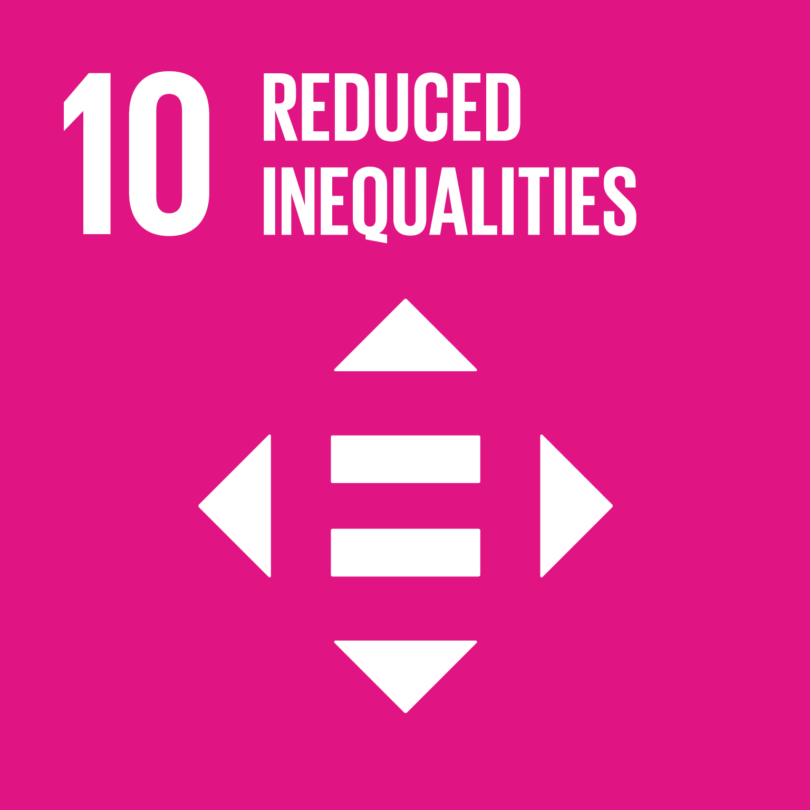
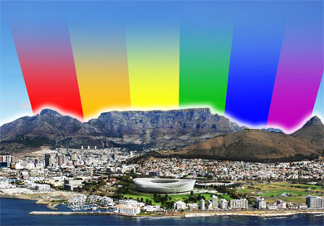
INTRODUCTION
LGBTQIA+ people are disproportionately affected by homelessness globally (Gattis et al., 2024; Fraser et al., 2019).
Limited studies on this scholarship area in the Global South, especially South Africa and Cape Town (Gattis et al., 2023)
In Cape Town, Africa’s Queer Capital, post-apartheid inequalities, racial segregation, & anti-LGBTQIA+ attitudes influence homelessness.
Aim: Explore staff experiences and challenges in managing an LGBTQIA+ shelter.
Analysis informed by Ecological Systems Theory & Minority Stress Theory
Links to SDG 10 (Reduced Inequalities) & SDG 11 (Sustainable Cities & Communities).

Slide 3
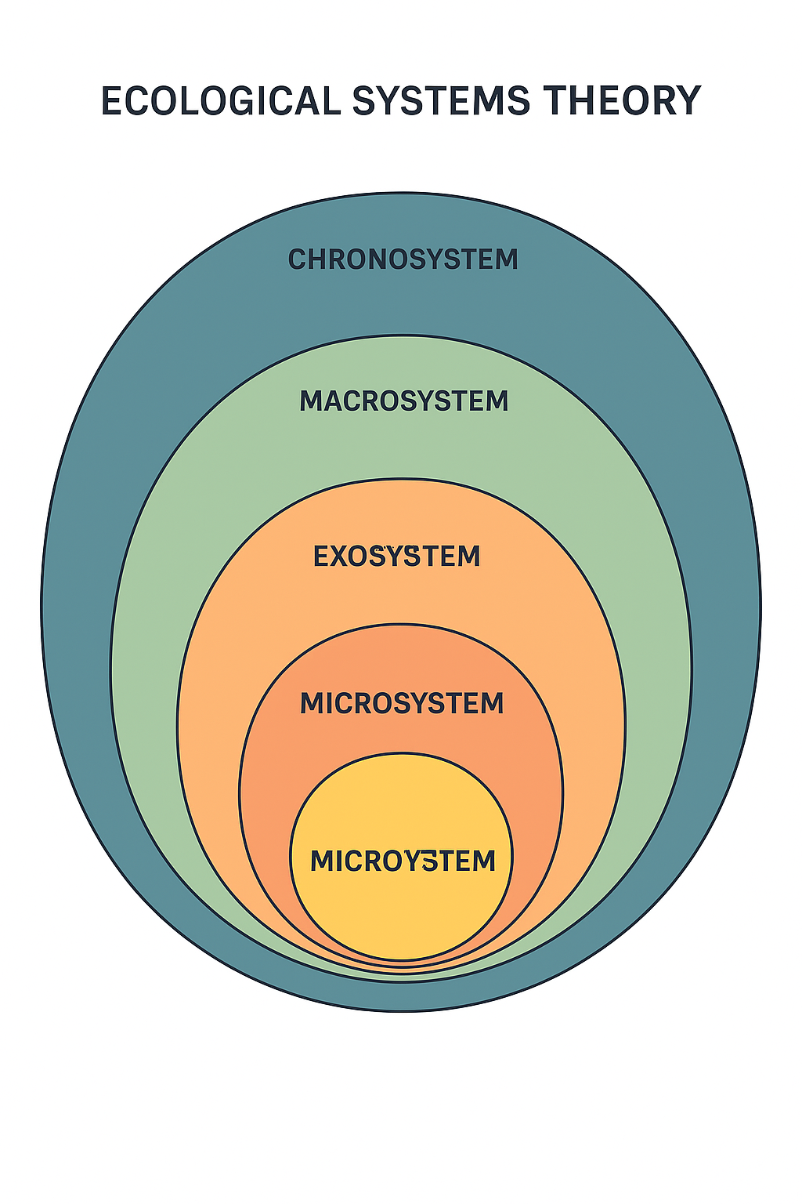

Slide 4
METHODOLOGY
RESEARCH DESIGN:
Part of a larger mixed-methods project, but this presentation focuses on QUALITATIVE findings.
Exploratory and descriptive design.
DATA COLLECTION:
5 participants (4 staff, 1 board member).
In-depth semi-structured interviews (in-person & online).
DATA ANALYSIS:
Narrative Analysis (Riessman, 1993).
Dual coding on Dedoose.
ETHICAL PRINCIPLES:
Informed Consent, Confidentiality, and Voluntary Participation.

Slide 5
KEY FINDING (1) – MICRO LEVEL INTERVENTIONS: PSYCHOSOCIAL SUPPORT
COUNSELLING
JOB READINESS
SAFE SPACE
core service
trauma recovery;
substance use;
resilience building
“Trauma forms a big part of counselling due to various or different traumas.... Many of them use substances to cope with their circumstances or situation, and this will be the focus of the counselling.”
“The shelter supports the residents with finding employment. They have access to the internet, so we encourage job search online… I usually write letters of support … to help them market themselves in the labour market.”
You can be who you are, you can be gay, lesbian, trans … you don’t have to hide or cover up. When you are here you can take off your mask, you can be who you want to be, who you identify with … a safe space.

Slide 6
Key Findings (2) – BARRIERS & CHALLENGES
Shelter capacity is strained as bed demands outweigh supply.
"We are sitting with a waiting list that is very long… it is due to discrimination in other shelters where queer people feel violated. So, they are looking for a place where they feel accepted and embraced.”
Family rejection common = poor prognosis for family reintegration = reinforces increased risk for homelessness.
“Integration into their family is slim due to reasons such as non-acceptance of sexuality in the family of origin…some families cannot accept the fact the children are part of the ... continuum.”
Financial vulnerability due to dependence on DSD funding & donations.
Racial neighbourhood tensions as the shelter is situated in a predominantly White area.

Slide 7
DISCUSSION
Using the Ecological Systems Theory, this study reveals how LGBTQIA+ youth homelessness in Cape Town and South Africa is shaped by dynamic interactions across micro- (e.g., shelters), meso-, exo-, and macro-level systems—underscoring the need for holistic, multi-level, systemic and sustainable interventions that align with the inclusive goals of SDGs 10 and 11.
Shelters act as safe(r) spaces for LGBTQIA people provided that is LGBTQIA inclusive; however, structural change is needed.
Current shelter model demonstrates positive outcomes but is under-resourced and vulnerable to political shift.
SDG 10 calls for the reduction of systemic discrimination, which LGBTQIA+ youth continue to face through exclusion from housing, services, and employment.
SDG 11 highlights the need for safe, inclusive, and sustainable cities—but without stable funding and affirming spaces like the shelter, LGBTQIA+ individuals remain at risk. The shelter serves as a microcosm of how both SDGs can be realized when inclusion, safety, and dignity are prioritized.

Slide 8
RECOMMENDATIONS
Social workers to advocate:
For LGBTQIA+ inclusive shelter practices and spaces.
For systemic policy change to reduce structural barriers.
Trauma-informed & minority stress care training and service delivery.
Expand LGBTQIA+ shelter capacity across Cape Town & South Africa by: •Including LGBTQIA identities in homelessness data.
Strengthening partnerships with government (DSD) for sustained funding
Securing sustainable, long-term funding
Reviving, enhancing, and expanding job readiness & skills training programmes as well as education support.

Slide 9
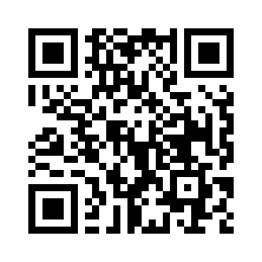
CONCLUSION
SCAN FOR LINK TO FULL ARTICLE
This study highlights need for both micro-level interventions (counselling, support) and macro-level change (policy, funding, anti-discrimination work
Shelters provide vital lifeline but require stronger, sustainable support.
Social workers must lead efforts for systemic change to ensure inclusive, sustainable housing solutions.
Thank you for your attention!

Slide 10
REFERENCES
Fraser, B., Pierse, N., Chisholm, E., & Cook, H. (2019). LGBTIQ+ Homelessness: A Review of the Literature. International Journal of Environmental Research and Public Health, 16(15), 2677. https://doi.org/10.3390/ijerph16152677. PMID: 31357432; PMCID: PMC6695950.
Gattis, M., Henderson, N., Kemmerer, A., & Fourie, J. (2024). Psychosocial Experiences of LGBTQIA+ Youth Experiencing Homelessness in Cape Town, South Africa. Southern African Journal of Social Work and Social Development, 36(1), 1–22. https://doi.org/10.25159/2708-9355/13496
Kemmerer, A., Fourie, J., Schaub, J., Henderson, N., & Gattis, M. (2024). Narratives from Staff at an LGBTQIA+ Shelter: Applying Ecological Systems Theory to Homelessness Intervention in Cape Town, South Africa. South African Journal of Social Work and Social Development. https://doi.org/10.25159/2415-5829/14918
The ecology of cognitive development: Research models and fugitive findings. Development in Context: Acting and Thinking in Specific Environments, 3–44.
Meyer, I. H. (2003). Prejudice, social stress, and mental health in lesbian, gay, and bisexual populations: Conceptual issues and research evidence. Psychological Bulletin, 129(5), 674–697. https://doi.org/10.1037/0033-2909.129.5.674United Nations. (2015).
Transforming our world: The 2030 Agenda for Sustainable Development. United Nations.(Relevant for SDG 10: Reduced Inequalities, SDG 11: Sustainable Cities and Communities)
Tubertini, A., Martino, A. M., & Graniero, A. (2023). LGBTQ+ homelessness: A systematic review of research findings on prevalence, pathways, and interventions. International Journal of Environmental Research and Public Health, 20(1), 432. https://doi.org/10.3390/ijerph20010432

