Slide 1




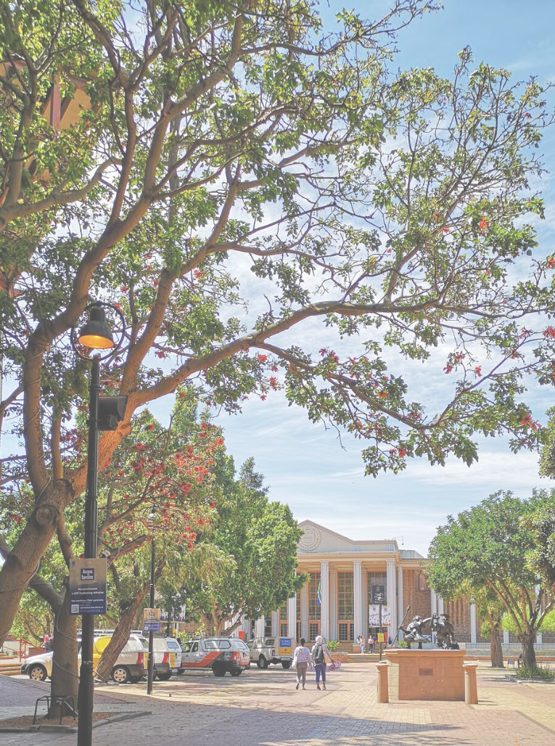
Department of
Social Work
Department of
Social Work
ASASWEI CONFERENCE 2025
“Social Issues Affecting Social Cohesion in Low-resource Communities in
South Africa”
s
PRESENTER: Mr. Andre Lewaks and Dr. A. Human-Hendricks
CONFERENCE DATE: 9-12 September 2025

Slide 2
Introduction
Department of
Social Work
Based on the article “Social Issues Affecting Social Cohesion in Low-resource Communities in South Africa” by Leoba Nyathi et al. (2024), Published December 2024.
Publication: Social Issues Affecting Social Cohesion in Low-resourceCommunities in South Africahttps://doi.org/10.36369/2616-9045/2024/v13i2a7Online ISSN: 2616-9045.Print ISSN: 2218-5615 (PDF) Social Issues Affecting Social Cohesion in Low-resource Communities in South Africa. Available from: https://www.researchgate.net/publication/387174170_Social_Issues_Affecting_Social_Cohesion_in_Low-resource_Communities_in_South_Africa#fullTextFileContent [accessed Sep 08 2025].
Authors/Team: LEOBA NYATHI, TOLULOPE BALOGUN, JANINE DE LANGE, ANJA HUMAN-HENDRICKS, FUNDISWA KHAILE , KEZIA OCTOBER, and NICOLETTE ROMAN
s

Slide 3
Background
Department of
Social Work
Context: South Africa is one of the most unequal societies globally, with rural communities disproportionately affected by poverty, unemployment, and lack of access to basic services.
Problem Statement: These systemic inequalities threaten social cohesion, defined as the strength of relationships and the sense of solidarity among members of a community.
Gap Identified: While urban social cohesion has been studied extensively, rural and low-resource communities remain under-researched.
Purpose: To explore how social issues—such as unemployment, substance abuse, violence, and family instability—affect social cohesion in rural South African communities.
s

Slide 4
Literature Review: Key Themes
Department of
Social Work
a. Family Dynamics
Dysfunctional family structures (e.g., absent fathers, teenage mothers, grandparent-headed households) weaken intergenerational bonds.
Historical legacies (e.g., apartheid, urban migration) and modern pressures (e.g., unemployment) reshape family roles and cohesion.
b. Violence and Substance Abuse
Crime and violence are both symptoms and causes of weak social cohesion.
Alcohol and drug abuse are prevalent coping mechanisms in the face of poverty and hopelessness.
c. Gender-Based Violence (GBV)
GBV is deeply rooted in patriarchal norms and exacerbated by social fragmentation.
Lack of social cohesion reduces community capacity to intervene or support victims.
d. Youth and Education
High dropout rates, lack of role models, and limited recreational or developmental opportunities contribute to youth deviance.
A “youth bulge” without employment prospects increases risks of unrest and crime.
e. Unemployment and Economic Exclusion
Persistent joblessness undermines dignity, family stability, and community participation.
Skills development and entrepreneurship are underutilized pathways to empowerment.
f. Health and HIV/AIDS
Stigma and cultural beliefs hinder effective HIV/AIDS management, especially in Black communities.
Social cohesion can improve health outcomes by fostering trust and collective action.
s

Slide 5
Methodology
a. Design
Qualitative, phenomenological approach to explore lived experiences.
Grounded in Bronfenbrenner’s Ecological Systems Theory, examining micro to macro influences on social cohesion.
b. Sites
Four rural communities: Philippolis (Free State), Lamberts Bay, Caledon, and Grabouw (Western Cape).
c. Sampling
Non-probability sampling (convenience and snowball).
The study employed thematic analysis of interviews with 25 participants across four rural South African communities 25 participants: parents and community stakeholders (aged 18+).
Department of
Social Work
d. Data Collection
In-depth interviews in English, Afrikaans, and isiXhosa.
Topics: parenting, communication, trust, family values, race, and social cohesion.
e. Analysis
Thematic analysis (Braun & Clarke, 2006).
Transcripts were coded to identify recurring themes and subthemes.
s

Slide 6
Key Findings(1)
1. Community-Level Challenges
Substance abuse, youth deviance, family instability, unemployment, and HIV/AIDS were consistently identified as major social problems.
Participants described a lack of recreational infrastructure, neglect of children, and absence of role models, contributing to social fragmentation.
2. Substance Abuse and Violence
Alcohol and drug misuse are widespread, especially during month-end periods, leading to increased assaults and domestic violence.
Substance abuse is linked to poverty, hopelessness, and escapism, creating a cycle of social disintegration.
Communities with low perceived cohesion showed higher rates of substance use and related crime.
3. Youth Vulnerabilities
School dropouts are prevalent due to neglect, lack of parental involvement, and poor educational infrastructure.
Deviant behavior among youth, including petty crime and vandalism, reflects frustration and lack of guidance.
Limited activities and aspirations hinder youth development and community engagement.
4. Family Structure and Role Models
Many families are headed by single parents or grandparents, with absent fathers being a recurring theme.
The lack of positive male role models contributes to youth disengagement and behavioral issues.
Grandparents play a critical role in caregiving but often lack resources and support.
Department of
Social Work
s

Slide 7
Key Findings(2)
5. Unemployment and Economic Exclusion
Chronic unemployment is a major barrier to social cohesion, affecting dignity, family stability, and community participation.
Participants expressed a desire for skills development (e.g., sewing, entrepreneurship) and economic opportunities.
The informal sector is growing but lacks structural support, perpetuating inequality.
6. Health and HIV/AIDS
HIV/AIDS remains a significant issue, with cultural stigma affecting treatment and prevention, especially in Black communities.
Coloured communities showed more openness and less stigma, facilitating better health outcomes.
Social cohesion is linked to improved sexual health behaviors, but only when a threshold of trust and solidarity exists.
7. Educational Disparities
Poor infrastructure, overcrowding, and lack of resources in schools contribute to educational disengagement.
Dropout rates are linked to long-term consequences such as poverty, crime, and reduced social mobility.
8. Lack of Community Infrastructure
Participants highlighted the absence of sports facilities, safe play areas, and community centers.
This lack of infrastructure limits opportunities for youth engagement and community bonding.
Department of
Social Work
s

Slide 8
Recommendations
Department of
Social Work
To foster social cohesion and address systemic challenges, the study recommends:
Community Empowerment:
Facilitate platforms for collective action and grievance redress.
Strengthen civic engagement and local leadership.
Policy Reform:
Prioritize inclusive education and vocational training.
Improve service delivery and infrastructure in rural areas.
Youth Development:
Implement holistic dropout prevention strategies.
Create mentorship programs and safe recreational spaces.
Economic Inclusion:
Support entrepreneurship through training and micro-financing.
Reduce dependency on social grants by promoting self-sufficiency.
Health Interventions:
Address HIV/AIDS stigma through culturally sensitive education.
Integrate health promotion with community-building efforts.
s

Slide 9
Conclusions
Department of
Social Work
Social cohesion in South Africa’s low-resource communities is under threat from a complex web of interrelated social issues.
Addressing these challenges requires multi-level, inclusive, and context-sensitive interventions.
By empowering communities, reforming policies, and investing in youth and families, South Africa can build a more resilient, equitable, and cohesive society.
s

Slide 10

Questions and comments?
Thank you for your time and consideration.

