Slide 1




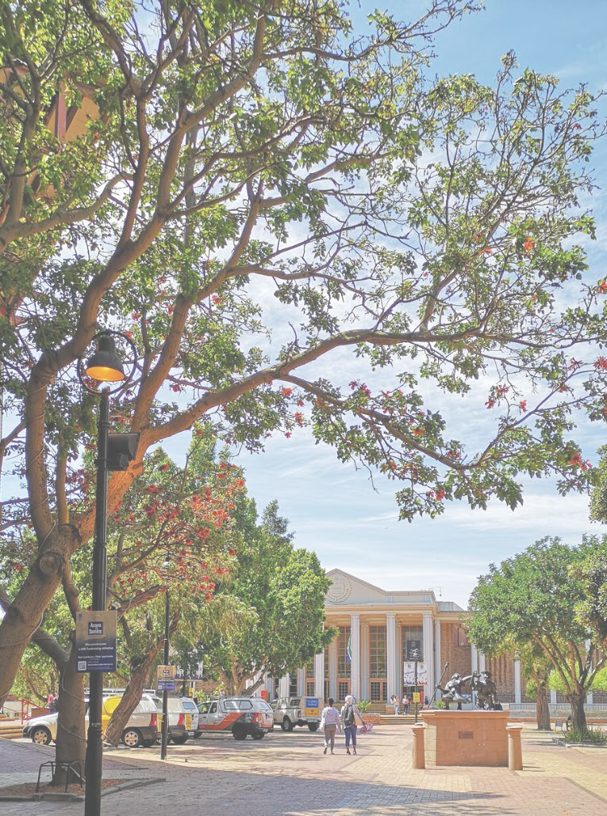
Department of
Social Work
Department of
Social Work
ASASWEI CONFERENCE 2025
Strengthening Family Bonds:
A Systematic Review of Factors and Interventions That Enhance Family Cohesion
s
PRESENTER: Dr. A. Human-Hendricks
CONFERENCE DATE: 9-12 September 2025

Slide 2
Introduction
Department of
Social Work
Title: "Strengthening Family Bonds: A Systematic Review of Factors and Interventions That Enhance Family Cohesion“
Based on a research project focused on Social Cohesion, and publication from June 2025
South African Research Chair (SARChI) in The Development of Human Capabilities and Social Cohesion through the Family
DOI: 10.3390/socsci14060371
Authors/Team: Nicolette V. Roman, Tolulope V. Balogun, Letitia Butler-Kruger, Solomon D. Danga, Janine Therese de Lange, Anja Human-Hendricks, Fundiswa Thelma Khaile, Kezia R. October and Olaniyi J. Olabiyi.
Presented by Dr. Anja Human-Hendricks
s

Slide 3
Core Components of the Literature Review
Department of
Social Work
The literature review. Definition and Importance of Family Cohesion is organized around several key themes:
Social Cohesion defined
Family cohesion is defined as emotional bonding and unity among family members.
It is linked to positive outcomes in academic performance, mental health, and social competence.
Cultural and Historical Contexts
The review highlights how cultural traditions (e.g., Ubuntu in Africa, bayanihan in the Philippines) shape family cohesion.
In South Africa, apartheid policies severely disrupted traditional family structures, with long-term impacts on cohesion.
Family Structures and Diversity
The review acknowledges the rise of diverse family configurations (e.g., single-parent, blended, same-sex families).
These structures face unique challenges but also demonstrate resilience.
Barriers to Cohesion
Socioeconomic stressors (poverty, unemployment, housing insecurity).
Health issues (HIV/AIDS, chronic illness).
Community violence and social exclusion.
Pathways to Resilience
Extended kinship networks, cultural values, and community support systems are identified as protective factors.
s

Slide 4
Methodology Conducted
Department of
Social Work
The study followed a rigorous systematic review process:
Framework
Adhered to PRISMA guidelines.
Used the Mixed Methods Appraisal Tool (MMAT) to assess study quality.
Search Strategy
Databases: African Journals Online, CINAHL, EBSCOhost, JSTOR, MEDLINE, PubMed, Sabinet, Sage, ScienceDirect.
Timeframe: Studies published between 2015 and 2023.
Keywords: “family cohesion,” “family functioning,” “mental health,” “social competence,” “resilience,” “interventions.”
Inclusion Criteria
English-language studies.
Peer-reviewed articles and grey literature.
Focus on positive family factors and interventions.
Screening and Selection
Initial records: 767
Final included studies: 41
Studies were reviewed by multiple independent reviewers to ensure rigor.
s

Slide 5
Results: A Thematic and Comparative Synthesis
Department of
Social Work
s

Slide 6
Results:1. Core Dimensions of Family Cohesion
Department of
Social Work
The review identifies four interrelated dimensions of family functioning:
Emotional Bonding: The affective ties among family members.
Adaptability: The ability to reorganize roles and routines in response to stress.
Communication: The quality, frequency, and openness of intra-family interactions.
Support: Emotional and instrumental assistance within the family system.
These dimensions were consistently linked to positive psychosocial outcomes across 41 studies, to include:
Academic performance
Mental health resilience
Social competence
Family stability under socioeconomic stress
s

Slide 7
Results: 2. Cross-Cultural and Contextual Variations
Department of
Social Work
South African Context
Historical Disruption: Apartheid policies (e.g., forced removals, migrant labor systems) fractured traditional African family structures, undermining multigenerational cohesion and kinship networks.
Ubuntu Philosophy: Despite structural violence, collectivist values such as Ubuntu fostered resilience, communal caregiving, and intergenerational support.
Contemporary Challenges: Poverty, HIV/AIDS, and community violence continue to strain family cohesion, especially in under-resourced townships.
Global Comparisons
Brazil & Philippines: Extended kinship networks and cultural practices (e.g., bayanihan) buffer economic hardship.
East Asia: Family piety(devotion and religiousness) and intergenerational obligation shape cohesion differently than Western models.
Western Contexts: Emphasis on individual psychological well-being and structured interventions (e.g., therapy, school-based programs).
s

Slide 8
Results: 3. Empirical Findings Across Domains
Department of
Social Work
Academic Outcomes
Cohesive families provide emotionally secure environments
Motivation
Self-regulation
School engagement
Homework support
Mental Health
High cohesion and adaptability correlate with:
Lower depression and anxiety
Better emotional regulation
Protective effects against trauma and chronic illness
Social Competence
s

Slide 9
Results: 3. Empirical Findings Across Domains (Cont..)
Department of
Social Work
Families with strong communication and support foster:
Empathy
Conflict resolution
Peer relationship skills
Socioeconomic Stressors
Low-SES families face:
Reduced parental availability
Housing instability
Financial strain
Resilience emerges through:
Community programs
Cultural values upheld
Informal support networks
Technology and Media Use
Excessive screen time linked to:
Reduced face-to-face interaction
Impaired routines
Lower cohesion
s

Slide 10
Intervention Strategies
Department of
Social Work
Effective interventions include:
Parenting workshops
Family therapy
Community-based programs
Culturally adapted approaches
Policy that supports (e.g., housing, mental health services)
Policy and Practice Implications
Emphasize culturally sensitive, community-driven interventions.
Invest in structural supports (housing, food security, education).
Integrate family support services into schools and community centers.
s

Slide 11
Conclusions
Department of
Social Work
Universal Components of Family Cohesion
Emotional bonding, adaptability, communication, and support are core dimensions across cultures.
Cultural and Socioeconomic Influences
The expression and effectiveness of these components vary by cultural norms and socioeconomic conditions.
Families in low-SES contexts face more challenges but show resilience when supported.
Future Directions
Encourage comparative, cross-cultural research.
Develop inclusive frameworks that reflect diverse family realities.
Address emerging challenges like digital media use, housing, poverty, and changing family roles.
s

Slide 12

Questions and comments?
Thank you for your time and consideration.

