Slide 1


Exploring Financial Literacy as a Tool for Empowerment
Reflections from the Field
Theme: Social Work and the Achievement of Sustainable Development Goals
Presented by: [Your Name] on behalf of Ndileka Puthumo, Rorisang Sekhasa, Pretty Seoe, Sindisiwe Tshabeni & Mandisa Kubeka
Department of Social Development, Lejweleputswa

Slide 2
Introduction / Background Families in foster care face financial struggles. Child protection often focuses on safety, education, and relationships — but money matters too. Financial literacy = ability to use financial skills effectively. Rarely integrated into social work interventions. Grounded in Empowerment Theory → supporting clients to gain control & make informed decisions. Aim: integrate financial literacy into foster care & parenting programs.

Slide 3
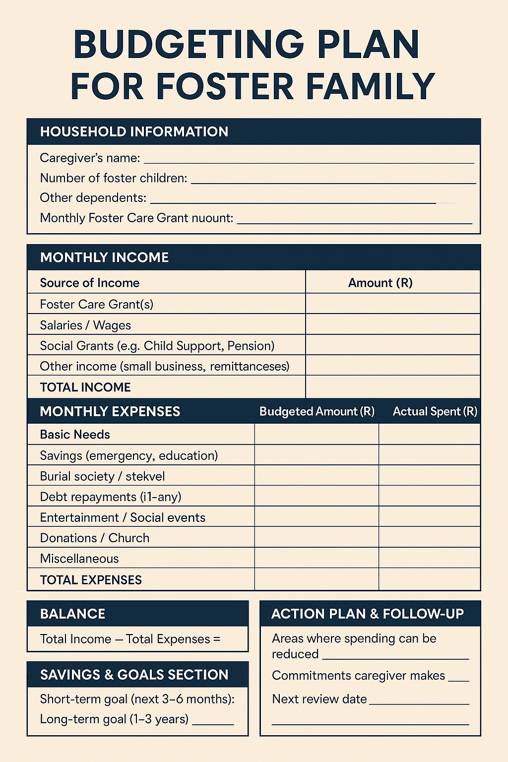
Methodology
Approach: Group work & casework.
Foster care supervision → budgeting plans for clients
Parenting programs → discussions on financial management.
Explored financial habits: spending, saving, use of foster care grants.
Practical, conversational approach → families shared experiences & solutions

Slide 4
Findings (1/2)
Limited knowledge of basic financial concepts.
Struggled to track spending & plan long-term.
Prioritized immediate needs over future needs.
Some used Stokvels (effective traditional saving method).

Slide 5
Findings (2/2)
Lack of standardized financial literacy content.
Social workers created their own approaches.
Clients appreciated open conversations about money.
Discussions were seen as rare but highly valuable.

Slide 6
Discussion
Financial literacy = empowerment tool, not just money.
Builds independence, informed decision-making & security.
Foster care grants (Children’s Act 38 of 2005) → must serve child’s best interest.
Theoretical support:
Erik Erikson → trust, identity & autonomy supported when caregivers manage money well.
Maslow’s Hierarchy → budgeting secures food, shelter & safety needs.
Gap: financial literacy is not formally structured in programs.

Slide 7
Conclusion
Financial literacy = empowerment, dignity & breaking poverty cycles.
Supports sustainable development goals: ending poverty & promoting well-being.
Empowers families beyond survival → fosters stability, resilience & hope.

Slide 8
Lessons Learned
Clients welcome financial literacy in practice.
Money conversations can transform communities.
Traditional saving (Stokvels) works alongside modern tools.
Need structured, standardized content for lasting impact.

Slide 9
Recommendations
Develop standardized financial literacy programs.
Use culturally relevant practices (e.g., Stokvels).
Train social workers in financial empowerment.
Advocate inclusion of financial literacy in foster care, parenting programs & policy frameworks.

Slide 10
Closing
Financial literacy = giving families skills & confidence.
Helps protect children, provide opportunities, and break poverty cycles.
Even small resources, when well-managed, build independence & resilience.
“Planting seeds of self-reliance for a stronger society.”
Thank you — Questions & Reflections welcome.

