Slide 1
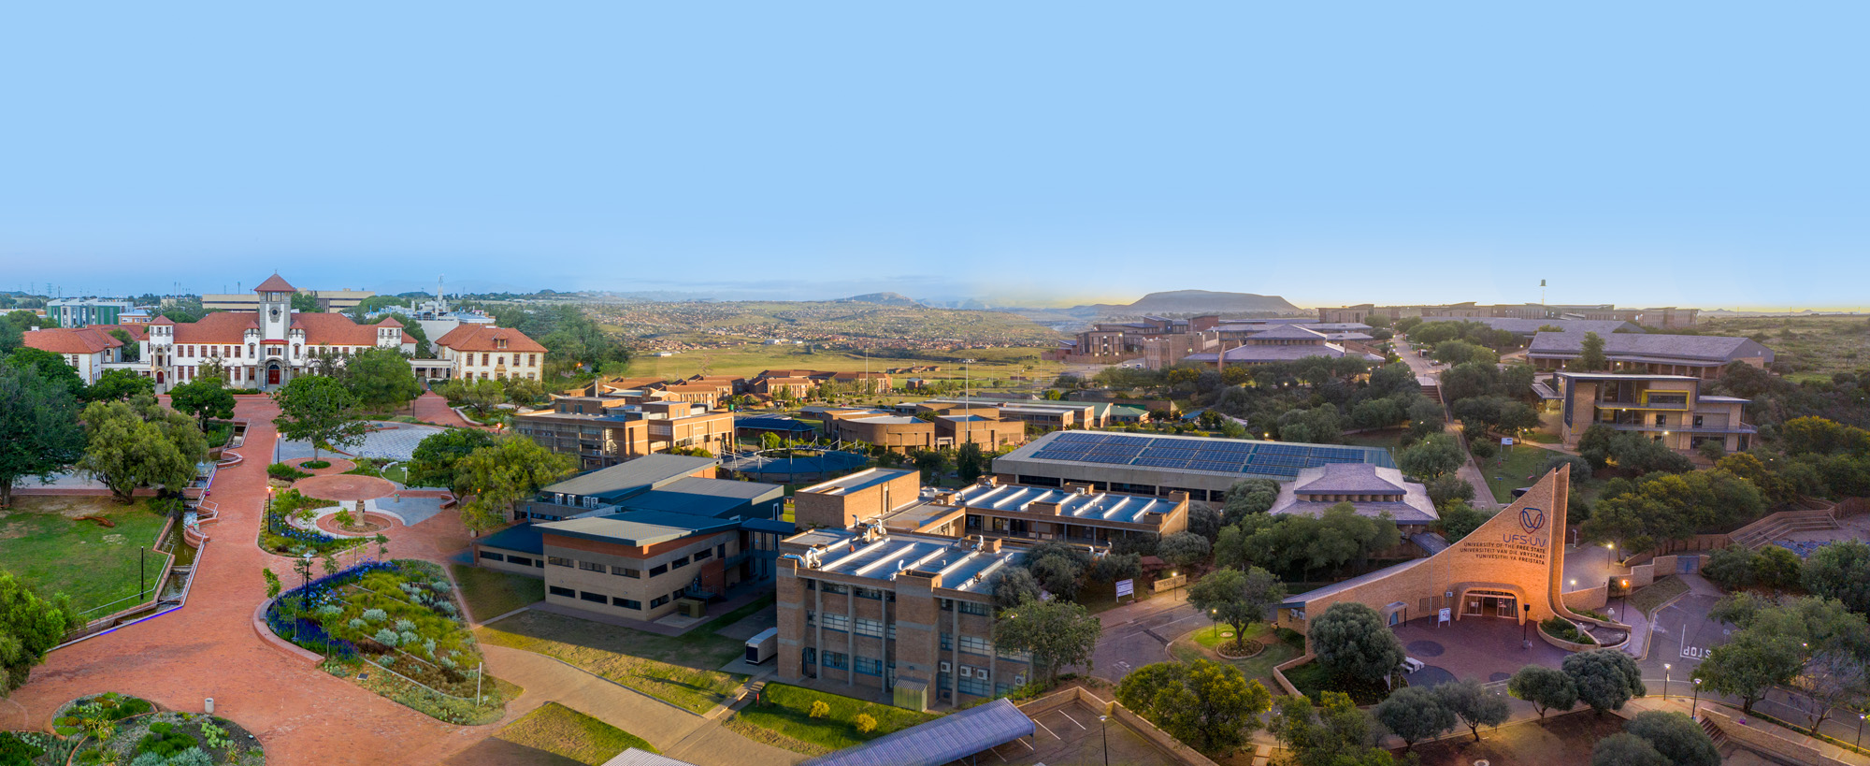


FROM RISK TO RESILIENCE: UNDERSTANDING THE CRIMINOGENIC RISK, PROTECTIVE FACTORS AND OCCULT DIMENSION OF YOUTH GANG SUBCULTURE IN THE FREE STATE PROVINCE
Dr A.R. Phillips
University of the Free State
ASASWEI Conference 2025
phillipsar@ufs.ac.za
+27 (0)76 535 4422

Slide 2
Background and rationale
Risk factors
Pathways and recurrent risk
Occult dimension
Protective factors
Gang involvement a serious concern
Exclusion, inequality and economic adversity
Surge in gang-related crime and violence
Dearth of research

Slide 3
40 Gangs
5000 Members
Conventional and occult gangs
Murder, rape and organ harvesting
Triple 6, BTK, IJP and Maroma

Slide 4
Methodology
Data Collection:
39 semi-structured interviews with offenders
  23 Gang members and 16 offenders
  14 to 38 years
18 interviews with criminal justice professionals
  34 to 73 years
  Educators, social workers, nurses, correctional officials and childcare workers
Reflexive thematic analysis of data
Ethical Considerations:
Confidentiality and anonymity of participants
Gaining informed voluntary written consent
Credibility and trustworthiness of data
Ethical clearance
Qualitative methodology
Semi-structured interviews
Gang members, offenders, key service providers
Trauma Therapy Centre
Correctional Centre
2 Secure Care Centres

Slide 5
Key findings
Risk Factors
Age
Protection
Peer influence, protection and belonging
Protection and poverty
Alcohol/Narcotics
Poverty
Peer influence
Belonging
Family dysfunction, protection and substances
Protection and family members in gang
Poverty and belonging
Poverty, belonging and absent father figures
Pathways
Gender
Parental or sibling gang involvement
O9: When I am going to school, I need to get some sort of protection because I go to a school where there are Maromas, so the best way for me to go to school was to join BTKs so I can get protection.
O15: Where I come from, certain areas is for BTKs, other areas is for Romans. We grow up in such society, you can’t go to another side so you must join a gang. It’s for protection.

Slide 6
Occult gangs
Spiritual power
Financial gain
O10: I am also a 666 member – I know the 666 drink blood, it’s their ritual. It gives you power, but you are now going too deep and I cannot answer more.
And most of them join not only for the money or the physical power, they join for spiritual power over other people (S2).
O24: The IJP and Roma, muti assists to give them power, they have ‘power belts’ to protect them. The BTK and 666 get bad spirits, when they attack other gangs, they speak to Lucifer to give them powers.

Slide 7
Occult
Impossible
Barriers to reintegration
No support within community
Traditional healers
Lack of programmes
Social stigma and rejection
No replacement for gang benefits
Religion/prayer
Gang retaliation and threats
Protective factors
Gang awareness
Prosocial recreation
Employment
Avoid deviant peers

Slide 8
O2: Is to pray because God can change them. I think they will also stop if they play sports because it will keep them busy. It’s to pray because God can change them. He will take the evil things out.
O5: To stay away from bad friends who influence you and to go to church, so you believe in God – then you won’t do wrong things and get involved with gangs
O6: Church, because church can give them words they need. They pray to the devil and if you do that you can’t serve God. I had a family member who was in 666, when he had a baby, they wanted him to sacrifice his baby – then he ran away but they found him and chopped him into pieces. They get power when they do sacrifices, power from the demons. They chopped him up because he didn’t want to kill his baby.

Slide 9
Concluding remarks
Not homogenous
Protective factors and risk-intervention
National and Provincial anti-gang strategies
Proactive vs reactive strategies

Slide 10
Thank you
AR Phillips
Department of Criminology
University of the Free State
phillipsar@ufs.ac.za

