Slide 1

Towards the development of guidelines for pre-service training of prospective foster parents: A scoping review
Presenter: Dr Manthosi Frans

Slide 2
BACKGROUND AN RESEARCH PROBLEM
Providing prospective and current foster parents with the intention to improve their satisfaction and wellbeing is crucial, as the opposite can lead to foster care breakdowns (Harding, 2020).
There is less emphasis on pre-service training for prospective foster parents compared to in-service training for current foster parents (Shklarski, 2019).
Despite less emphasis, pre-service training is globally practiced in the child protection sector as it offers a proactive approach to equip foster parents with necessary knowledge and skills for demanding responsibilities (Festinger & Baker, 2013; Cooley et al., 2019).

Slide 3
South Africa has a limited body of literature concerning pre-service training (PST) programs or curricula for prospective foster parents.
The Children's Act 38 of 2005 does not contain provisions for the pre-service training of prospective foster parents.
A lack of local research, legislative guidance, and established guidelines has resulted in welfare organizations independently developing their own manuals or social workers conducting individual pre-service training sessions (Carter 2013; Carter & Van Breda, 2016; Murray, 2016).
This decentralized approach lacks a standardized methodology for the pre-service training of prospective foster parents, potentially leading to subjective placement decisions (Carter 2013; Carter & Van Breda, 2016; Murray, 2016).

Slide 4
AIM AND RESEARCH QUESTION
Aim: To explore the components of pre-service training of prospective foster parents through a scoping review.
Research question: ‘What are the key components for the pre-service training of prospective foster parents?’

Slide 5
RESEARCH METHODOLOGY
SELECTION CRITERIA
The inclusion criteria
fully-texted, peer-reviewed studies written in English
within the time frame of 2017 to 2021
focusing on the pre-service training of individuals aspiring to become foster parents.
The exclusion criteria
non-English texts, paid content
studies older than five years (2016 or earlier), and
studies that focused on aspects unrelated to the objectives of this study.

Slide 6
The data extraction sheet/tool proposed by Peters, Godfrey, McInerney, Munn, Tricco, and Khalil (2020)
Data was collected between July 2021 and August 2021 from various search engines, including Elsevier, Wiley Online, Google Scholar, Science Direct, Sabinet, EBSCOhost, Francis online journals, Sage publications Tylor, Springer and Oxford Journals.

Slide 7
Data analysis
The data was thematically analysed using the Atlas Ti software tool.
Arksey and O'Malley's (2005) six-step approach.
The initial reviewer (1) established the research question, (2) identified pertinent studies, (3) selected the studies, (4) documented the data, (5) compiled, summarised, and reported the findings, and (6) consulted with the second reviewer.

Slide 8
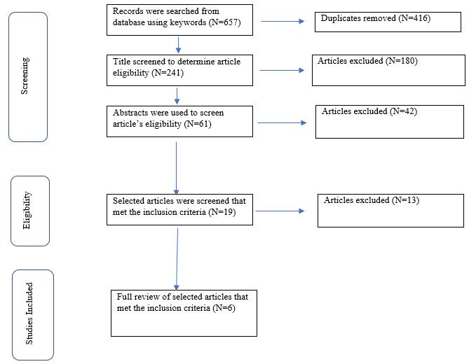
PRISMA flow diagram

Slide 9



RESULTS
1
5
6
REVIEWED STUDIES PER COUNTRY

Slide 10
3
Benesh and Cui, 2017
Cooley et al., 2019
Kaasbøll et al., 2019
Systematic reviews
3
Barnett et al., 2018
Jedwab et al., 2020
Salazar et al., 2020
Mixed methods

Slide 11
FINDINGS
Type and aim of programmes
THEMES
Structure of the programme
Structure of the programme
The content of the programmes
The delivery model
Theories used in pre-service training programme
Obstacles in pre-service training

Slide 12
DICUSSION
Six selected studies identified ten pre-service training programs for prospective foster parents, detailing their type, aim, structure, content, delivery, theoretical basis, and challenges.
Common programs mentioned across studies include KEEP, MAPP, and PRIDE.
Training delivery methods varied, encompassing individual face-to-face sessions, group face-to-face sessions, online formats, or combinations thereof, with all face-to-face sessions incorporating roleplays.
Program duration varied, with sessions lasting 45 minutes to 1.5 hours, and programs consisting of one to eighteen sessions.
There is a divergence of opinion regarding theoretical underpinnings, with some studies arguing for theoretical basis and others noting a lack of it.

Slide 13
Pre-service training is characterized by its psycho-educational nature, incorporation of real-life situations, and facilitated discussions.
Enhanced instruction on trauma and children's psychological needs is considered necessary.
Pre-service training is recognized as crucial for foster parent preparation, with evidence suggesting reductions in child behavior issues following programs like KEEP.
Identified challenges include insufficient information provided to foster parents about the child's background and a lack of transparency or realistic expectation setting.
Despite its benefits, pre-service training cannot fully equip parents with all necessary fostering knowledge and skills.

Slide 14
CONCLUSION
A scoping review of scholarly literature analyzed training programs for prospective foster parents.
The phenomenon is under-researched, with only ten identified programs, three widely used, primarily in the United States.
Most studies lacked clear details on program nature, organization, and content.
Identified gaps and challenges, including those concerning gender and cultural diversity, are present in the reviewed programs.
Despite limitations, the programs offer valuable insights for South African child welfare agencies developing standardized pre-service training for prospective foster parents.

Slide 15
RECOMMENDATION
This study excluded published dissertations and theses, as well as unpublished reports, that may have investigated pre-service training.
It is recommended that future research be conducted where published dissertations and theses and unpublished reports on pre-service training be included to gather a more comprehensive and diverse set of results on this phenomenon.

Slide 16



