Slide 1

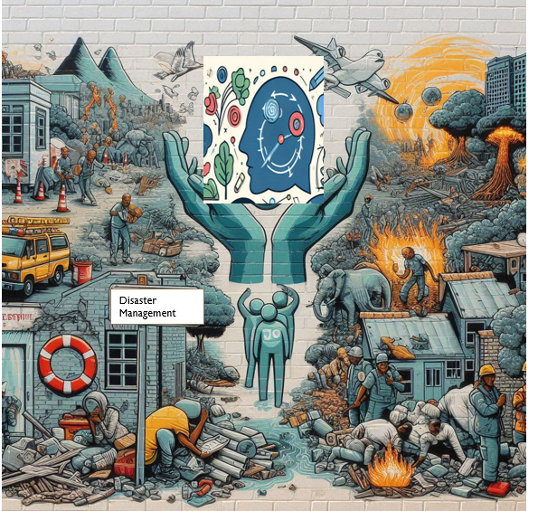
Proposed integrated disaster risk reduction social work (IDRRSW) framework for teaching, research, and practice to enhance mental health and psychosocial support services
Advancing Social, Economic, and Environmental Justice, Peacebuilding, and Sustainable Development through teaching, research and practice.
Theme 4 - Social Work Education, Transdisciplinarity and Curriculum Development (4)
Dr M van Straaten
10 September 2025

Slide 2
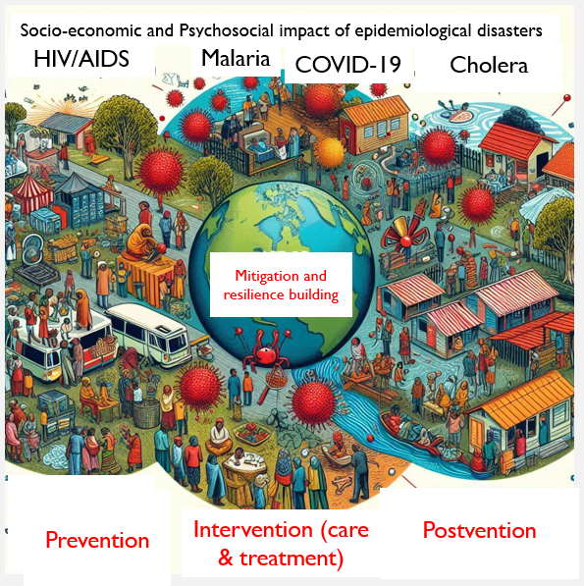
AIM OF THE WORKSHOP
To assist social workers in rendering adequate Mental health and psychosocial services to frontline responders and disaster-stricken communities.

Slide 3
Introduction
Despite international and national agreements, guidelines, laws, and policies designed to ensure effective disaster management and social work services, vulnerable communities and multidisciplinary frontline responders often face significant challenges in accessing essential mental health and psychosocial services (MHPSS) during disasters.
The novel Coronavirus Disease of 2019 (COVID-19) outbreak further exacerbated these challenges in South Africa, revealing critical policy-practice gaps.
This study aimed to address these gaps by integrating the Disaster Risk Management Helix, the Eco-Social Model, and the Resilience Theory into a newly conceptualised theoretical and practical framework, viz., the proposed Integrated Disaster Risk Reduction Social Work (IDRRSW) Framework.
Notes:
Despite international and national agreements, guidelines, laws, and policies designed to ensure effective disaster management and social work services, vulnerable communities and multidisciplinary frontline responders often face significant challenges in accessing essential mental health and psychosocial services (MHPSS) during disasters. The novel Coronavirus Disease of 2019 (COVID-19) outbreak further exacerbated these challenges in South Africa, revealing critical policy-practice gaps. This study aimed to address these gaps by integrating the Disaster Risk Management Helix, the Eco-Social Model, and the Resilience Theory into a newly conceptualised theoretical and practical framework, viz., the proposed Integrated Disaster Risk Reduction Social Work (IDRRSW) Framework. Using a cross-sectional convergent sequential mixed-method approach to interview social workers in Mangaung Metro, the emerging qualitative themes were triangulated with the quantitative data to determine similarities and differences in the social workers’ responses during the different lockdown levels. The study resulted in the proposed IDRRSW Framework incorporating key lessons learnt from the COVID-19 pandemic. The framework outlines key definitions and the theoretical foundations underpinning its design. Furthermore, it includes a quick reference legislative summary and practical guidelines aimed at supporting social workers' MHPSS efforts in disaster-stricken areas tailored to the South African context. The framework was reviewed by social work and disaster management professionals and academics, ensuring its grounding in practical expertise and theoretical knowledge.

Slide 4
A cross-sectional convergent sequential mixed-method approach was followed.
Online questionnaires and semi-structured interviews
Population: Mangaung Metro social workers.
The emerging qualitative themes were triangulated with the quantitative data, determining similarities and differences in the social workers’ responses during the different lockdown levels.
The study resulted in the proposed IDRRSW Framework incorporating key lessons learnt from the COVID-19 pandemic.
The framework outlines key definitions and the theoretical foundations underpinning its design.
It includes a quick reference legislative summary (Table 2) and practical guidelines (Table 1) aimed at supporting social workers' MHPSS efforts in disaster-stricken areas, tailored to the South African context.
The framework was reviewed by social work and disaster management professionals and academics, ensuring its grounding in practical expertise and theoretical knowledge.

Slide 5
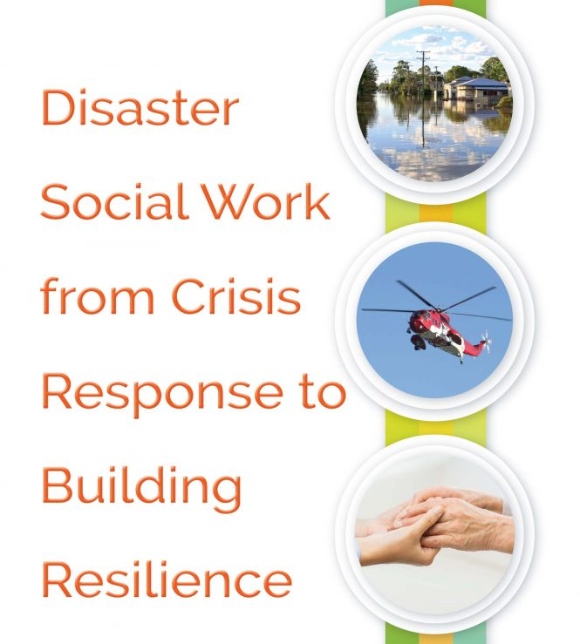
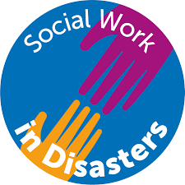
Key definitions and concepts in
disaster social work

Slide 6
DEFINITION OF A DISASTER – DISASTER MANAGEMENT ACT 57 OF 2002 & DISASTER MANAGEMENT AMENDMENT ACT 16 OF 2015
Disaster means a progressive or sudden, widespread or localised, natural or human-caused occurrence which:
(a) Causes or threatens to cause –
(i) death, injury or disease;
(ii) Damage to property, infrastructure or the
environment; or
(iii) Disruption of the life of a community;
(b) Is of a magnitude that exceeds the ability of those
affected by the disaster, to cope with its effects using only their own resources.

Slide 7
WHO DEFINITION
The World Health Organisation (WHO) defines disaster as:
“Any occurrence that causes damage, economic destruction, loss of human life and deterioration in health and health services on a scale sufficient to warrant an extraordinary response from outside the effected community or area”.
Some outstanding criteria: severity, sudden onset, sometimes prolonged onset (drought, viral diseases), death, external assistance.

Slide 8
DISASTER MANAGEMENT
According to the Disaster Management Act No 57 of 2002
“disaster management” means a continuous and integrated multi-disciplinary process of planning and implementation of measures aimed at
(a) preventing or reducing the risk of disasters;
(b) mitigating the severity or consequences of disasters;
(c) emergency preparedness;
(d) a rapid and effective response to disasters;
(e) post-disaster recovery and rehabilitation.

Slide 9
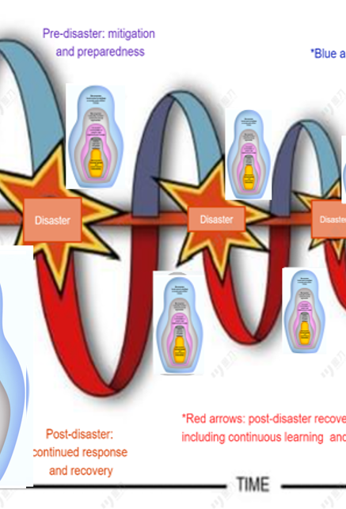
DISASTER RISK MANAGEMENT HELIX
Disaster Management is divided into three phases, namely: pre-disaster, during-disaster, and post-disaster phases (Schmidt & Peter, 2017).
The Disaster Risk Management Helix is a holistic approach focusing on interrelationships between these stages.
Your MHPSS interventions can include proactive measures (blue arrows) to reduce the frequency and severity of identified risks
In the post-disaster phase, you will render recovery and rehabilitation MHPSS interventions (red arrows).
The ultimate goal is to minimise, or possibly eradicate, the impact of future disasters (Bosher, Chmutina & Van Niekerk, 2021).
The Resources/Effort axis illustrates that, over time, sustainable multi-disciplinary and intersectoral disaster risk management practices may require fewer resources, potentially extending the intervals between disasters.
Over time, resource demands can change as practices improve (Bosher, Chmutina & Van Niekerk, 2021).

Slide 10
Frontline responders
Also known as first responders, for example, firefighters, police, and emergency medical personnel, are usually on the disaster scene first, dealing with the challenges and dangers of the situation.
They not only deal with physical danger but are also the first to provide emotional support to the survivors.
Social workers are also frontline responders and can be part of the multidisciplinary frontline team rendering services to disaster-stricken communities.
Social workers can be service providers to other frontline workers, assisting them in coping with the psychosocial effects of rendering services during disasters.

Slide 11
Resilience
‘The ability of a system, community or society exposed to hazards to resist, absorb, accommodate, adapt to, transform and recover from the effects of a hazard in a timely and efficient manner, including through the preservation and restoration of its essential basic structures and functions through risk management’ (UNDRR, 2017, p.22).
Ubuntu
Ubuntu is conceptualised as ‘each individual’s humanity is ideally expressed in relationship to others’ (Mayaka et al., 2023, p.60).
Ubuntu, therefore, combines social (the relationships between individuals that create community and a shared humanity) and ethical (the standard of our interactions with others, e.g respect and care) components.
As a result, the idiom - a person is a person through other people – is well-known as the definition of Ubuntu (Mayaka et al., 2023, p.60).
Vulnerability
‘the conditions determined by physical, social, economic and environmental factors or processes which increase the susceptibility of an individual, a community, assets or systems to the impacts of hazards’(UNDRR,2017, p.24).

Slide 12
WHERE DOES MENTAL HEALTH FIT IN DISASTER MANAGEMENT
The WHO (2018) defines health as “a state of complete physical, mental and social well-being and not merely the absence of disease or infirmity”.
From this definition, it is clear that mental health forms part of the holistic health of a person and therefore, mental health aspects need to be just as important as physical health aspects.
During disasters, a person’s state of well-being is affected and therefore, it is essential to include mental health services during disaster risk management that focus on the protection and restoration of affected community members and humanitarian service providers.
Globally, one in five (22.1%) people living in areas affected by conflict is estimated to have a mental health condition (Charlson et al., 2019)

Slide 13
OPTIMAL MENTAL HEALTH INCLUDES
an individual realizes his or her own abilities,
can cope with the normal stresses of life,
can work productively and
is able to make a contribution to his or her community (WHO, 2018).

Slide 14
MENTAL HEALTH AND PSYCHOSOCIAL SUPPORT (MHPSS)
Mental health and psychosocial support (MHPSS): The composite term “mental health and psychosocial support” is used to describe any type of local or outside support that aims to protect or promote psychosocial well-being and/or prevent or treat mental health conditions.
MHPSS needs include a wide range of issues, including interpersonal problems, emotional distress, common mental disorders (such as depression and anxiety disorders, e.g. post-traumatic stress disorder (PTSD)), severe mental disorders (such as psychosis), alcohol and substance abuse and intellectual disabilities.
Mental health condition: A broad term covering mental disorders and psychosocial disabilities. It also covers other mental states associated with significant distress, impairment in functioning or risk of self-harm.
Source: IASC MHPSS Reference Group, 2022.

Slide 15
WHAT IS SOCIAL WORK?
Social work = practice-based profession & academic discipline – promotes social change, development, social cohesion, empowerment & liberation.
Principles of social justice, human rights, collective responsibility & respect for diversity central to social work.
Underpinned by theories of social work, social sciences, humanities & indigenous knowledges, social work engages people & structures to address life challenges & enhance well-being.
Source: IFSW (2014)

Slide 16
GLOBAL AGENDA FOR SOCIAL WORK & SOCIAL DEVELOPMENT
Global Agenda was launched by social work global bodies:
International Association of Schools of Social Work (IASSW),
International Council on Social Welfare (ICSW), &
International Federation of Social Workers (IFSW)
at 2010 Joint World Conference on Social Work and Social Development in Hong Kong.
And has since then been central in social work activities & advocacy.
Source: IASSW, ICSW & IFSW (2020)

Slide 17
SOURCE: IASSW, ICSW & IFSW (2020)
Four pillars of Global Agenda
Promoting social & economic equalities
Promoting dignity & worth of people
Promoting community & environmental sustainability
Recognising importance of human relationships

Slide 18
UNITED NATIONS DISASTER RISK REDUCTION (UNDRR)
is the United Nations focal point for disaster risk reduction.
UNDRR oversees the implementation of the Sendai Framework for Disaster Risk Reduction 2015-2030, supporting countries in its implementation, monitoring and sharing what works in reducing existing risk and preventing the creation of new risk.

Slide 19
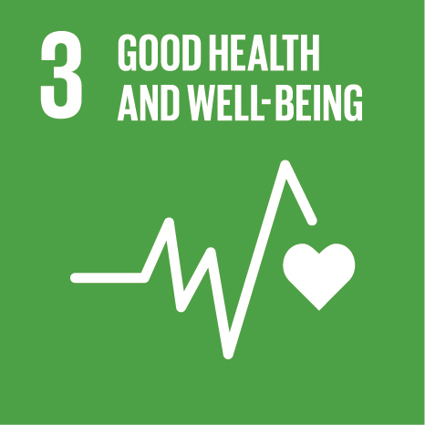
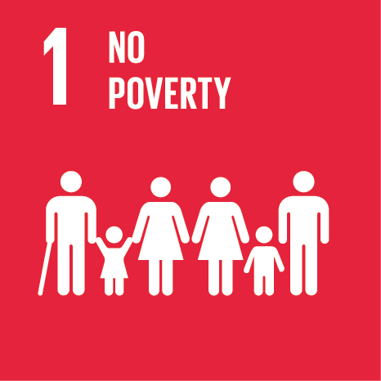
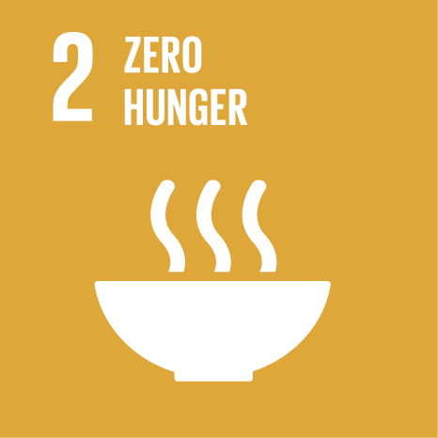
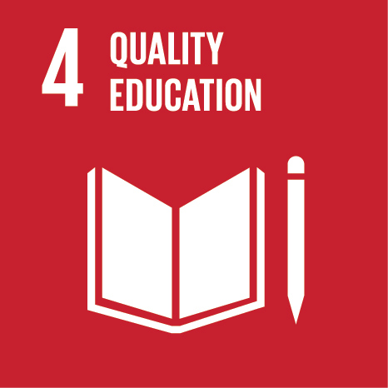
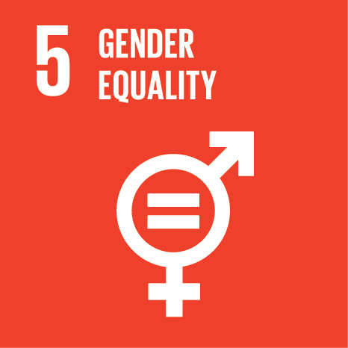
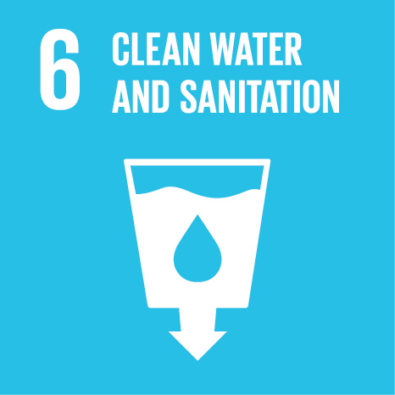
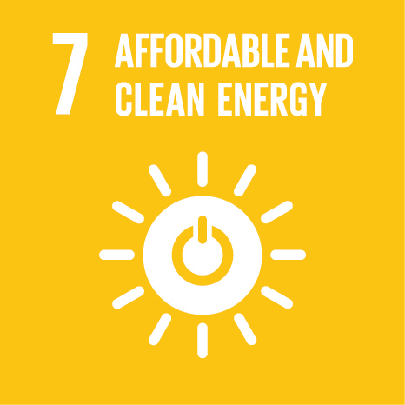

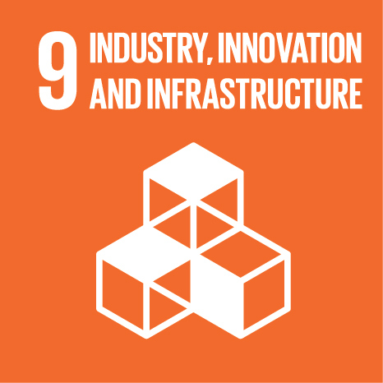
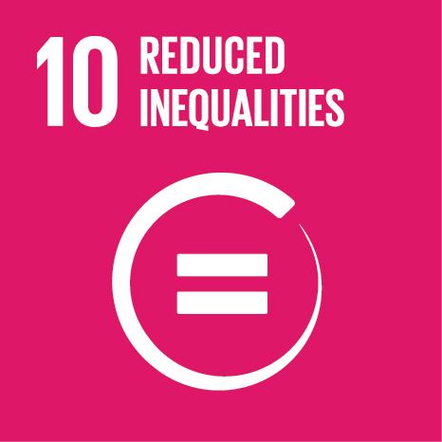
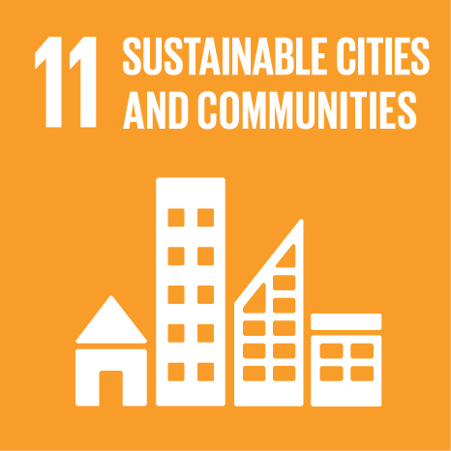
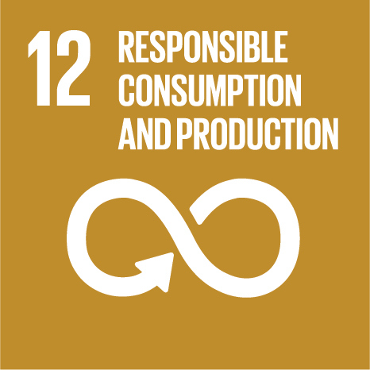
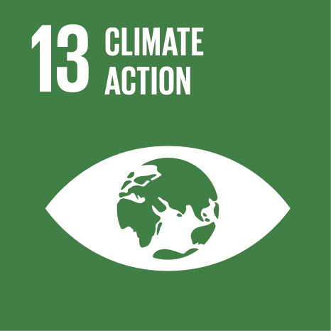
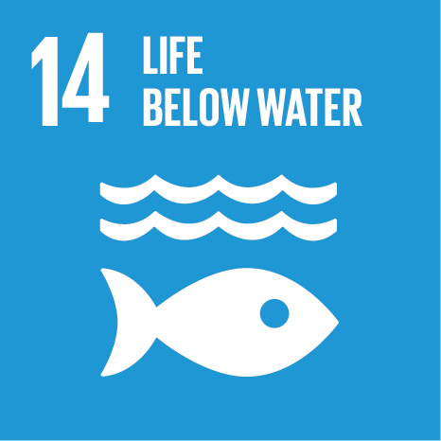
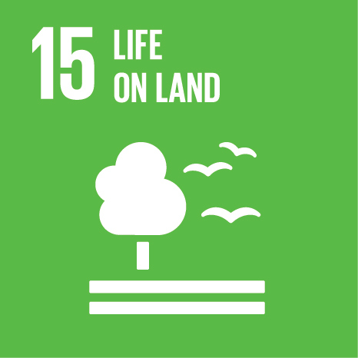

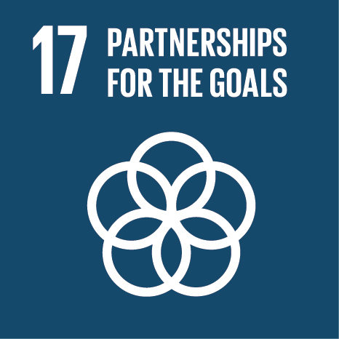

SDG & SENDAI FRAMEWORK
The need to give more attention to mental health services in disaster risk management has been identified by the United Nations Member States and therefore has been included as the third goal in the 2030 Agenda for Sustainable Development (United Nations, 2015b)
and in the Sendai Framework for Disaster Risk Reduction under Priority 3: Investing in disaster risk reduction for resilience (United Nations, 2015a).
MENTAL HEALTH AND DISASTER MENTAL HEALTH (DMH)

Slide 20
SENDAI FRAMEWORK FOR DISASTER RISK REDUCTION (SFDRR)
The SFDRR was created to address the deficiencies of the HFA.
Priority 3: Investing in DRR. for Resilience stresses the necessity of mental health and psychosocial support services (UN, 2015a, p. 23).
The SFDRR takes a holistic approach to DRR, integrating and incorporating various environments ('economic, structural, legal, social, health, cultural, educational, environmental, technological, political, and institutional') to strengthen communities' resilience and reduce vulnerabilities (UN, 2015a, p. 13).
This framework can guide social workers on holistically rendering resilient disaster mental health and psychosocial interventions at the various system levels (UN, 2015a)

Slide 21
SPHERE PROJECT: HUMANITARIAN CHARTER AND MINIMUM STANDARDS IN HUMANITARIAN RESPONSE
The Inter-Agency Standing Committee (IASC, 2007, p. 1) and the Sphere Handbook (Sphere Association, 2018)
provide guidelines for humanitarian service providers and communities to design, set up and arrange a set of minimum multidisciplinary reactions to secure and improve the individual's mental health and psychosocial well-being in the midst of a crisis or disaster.

Slide 22
AGENDA 2063
is a framework with 20 goals designed to direct Africa's growth for the next 50 years.
The twenty goals of Agenda 2063 contain the 17 SDGs.
The social, economic, and environmental components are the only ones covered by the SDGs.
The scope of Agenda 2063 is broader, embracing political, cultural, and other African concerns and general social, economic, and sustainability factors.
To achieve the goals of the Global Agenda, Agenda 2063, and the SDGs, it is necessary to focus on disaster risk reduction and strengthen communities' resilience and their environments.

Slide 23
SOUTHERN AFRICAN DEVELOPMENT COMMUNITY PROTOCOLS
Southern African Development Community (SADC) protocols (SADC, 2012)
motivates community-based non-discriminatory and unifying practices to prevent and mitigate the effects of social determinants and build resilience.

Slide 24


THE SPHERE PROJECT
MENTAL HEALTH AND DISASTER MENTAL HEALTH (DMH)
The Sphere handbook provides humanitarians with guidelines, protection principles and duties that assist with service delivery during disasters to adhere to the minimum standards in humanitarian response.
The fundamental importance of human dignity and the right to participate in decisions of affect community members are the core of the Sphere (Sphere Association, 2018, p. V).

Slide 25
CORE STANDARDS TO HUMANITARIAN SERVICES
The Core Humanitarian Standard Alliance developed notes and indicators on how to implement the nine commitments of the Core Humanitarian Standard (CHS) (Core Humanitarian Standard Alliance, 2015).
Commitment 3. Communities and people affected by crisis are not negatively affected and are more prepared, resilient and less at-risk as a result of humanitarian action. Humanitarian response strengthens local capacities and avoids negative effects.
Commitment 4. Communities and people affected by crisis know their rights and entitlements, have access to information and participate in decisions that affect them. Humanitarian response is based on communication, participation and feedback.

Slide 26
ECO-SOCIAL MODEL
The Eco-Social Model is rooted in the Ecological Systems Theory.
Pioneered by Bronfenbrenner (1979), this theory explains the complex interplay between individuals and their environments, ranging from the microsystem to the macrosystem.
Boetto (2017) considered the actions, interventions, and strategies used by social workers in everyday interactions with individuals, families, and communities to develop the dimensions of eco-social work.

Slide 27
THE INTEGRATED DISASTER RISK REDUCTION SOCIAL WORK (IDRRSW) FRAMEWORK
Humans cannot live in isolation and constantly interact with their environments on various levels (micro, meso, exo and macro).
The IDRRSW Framework has four distinct levels: Micro Resilience, Relational Resilience, Ubuntu Resilience and ‘Rainbow Nation’ Resilience.
However, these levels constantly interact, and changes in one level will affect the other (Boetto, 2017; Bronfenbrenner, 1979).
During each Disaster Management Helix phase, social workers have to render their MHPSS interventions on all of these levels to ensure a holistic IDRRSW response.

Slide 28
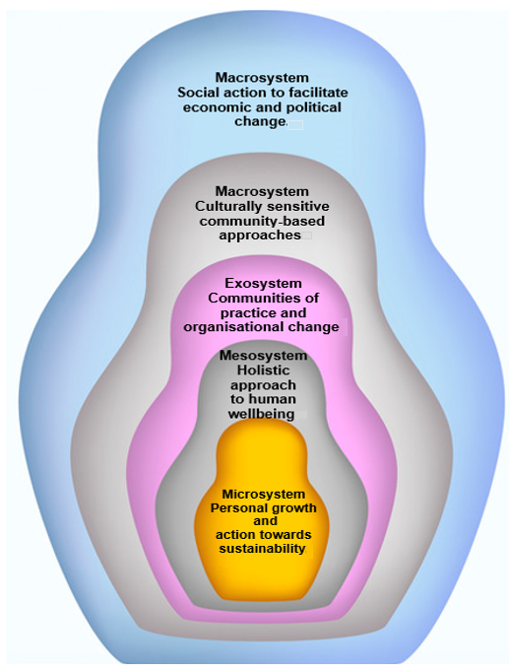
DIMENSIONS OF THE ECOLOGICAL SYSTEMS THEORY AND ECO-SOCIAL MODEL
Source: Compiled from Boetto (2017) and Bronfenbrenner (1979)

Slide 29
Micro-system
MHPSS intervention services to individual clients are at the smallest system level, known as the Micro Resilience level. Focus on client’s personal growth, inner strengths, and abilities while enhancing actions towards sustainability to develop resilient individuals (Van Breda, 2018; Boetto, 2017). Interventions are age-appropriate and culturally sensitive.
While assisting clients to build and improve their relationships, you will be working on Relational Resilience level also known as the
Meso-system

Slide 30
Eco-system
Interventions include community practices and organisational changes (Boetto, 2017), on the Ubuntu Resilience level. The indirect environment - the individual is not directly involved but is still influenced by the environment (Bronfenbrenner, 1979).
The Ubuntu philosophy emphasises the interconnectedness of individuals within a community, highlighting the collective nature of existence and well-being

Slide 31
The largest system level, named the ‘Rainbow Nation’ Resilience level, has two dimensions. The (a) socio-political systems level - MHPSS interventions will focus on social action that promotes economic and political change related to epidemiological disasters.
Rendering MHPSS interventions on (b) the cultural-legal system’s level - focus is directed towards the dynamic effect of the unique cultures, values, and legislative frameworks that interact across the various levels (Boetto, 2017).
These system levels are dynamic and some of the disaster MHPSS interventions can be done on any or all of the levels.

Slide 32
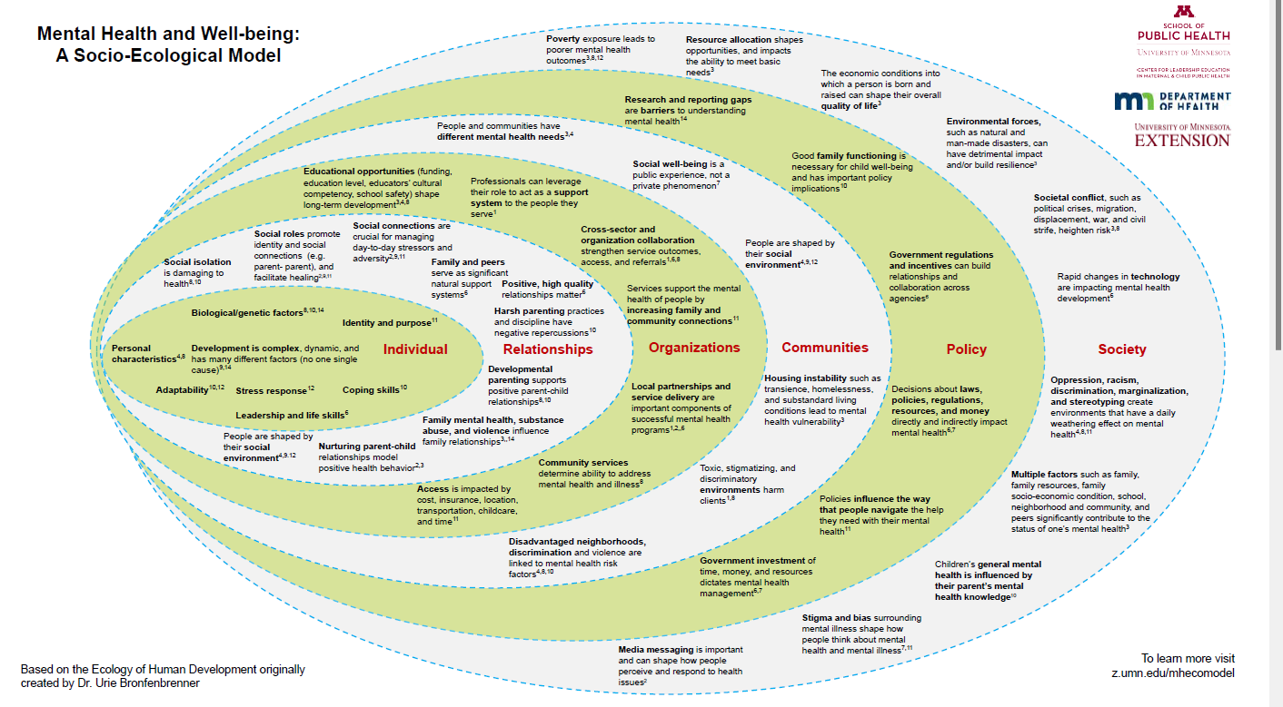

Slide 33
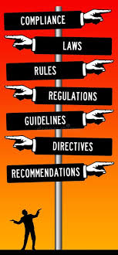
Table 2: Summary of agreements, guidelines, laws, and policies on the various system levels

Slide 34
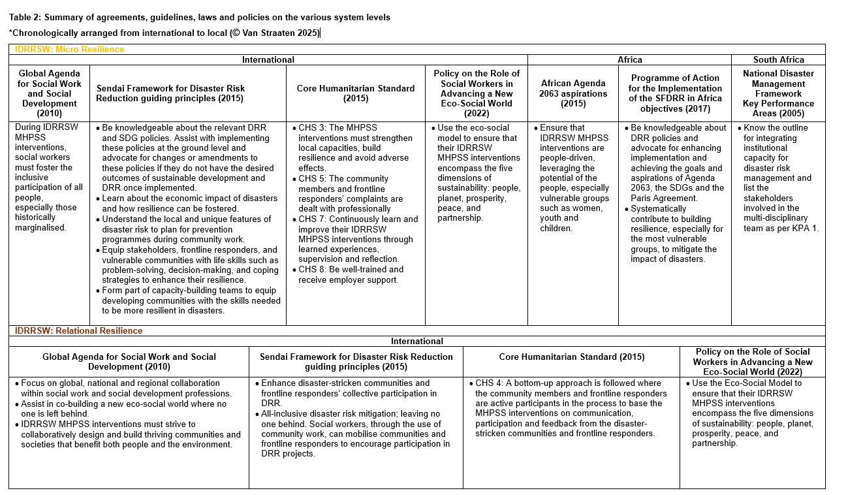

Slide 35
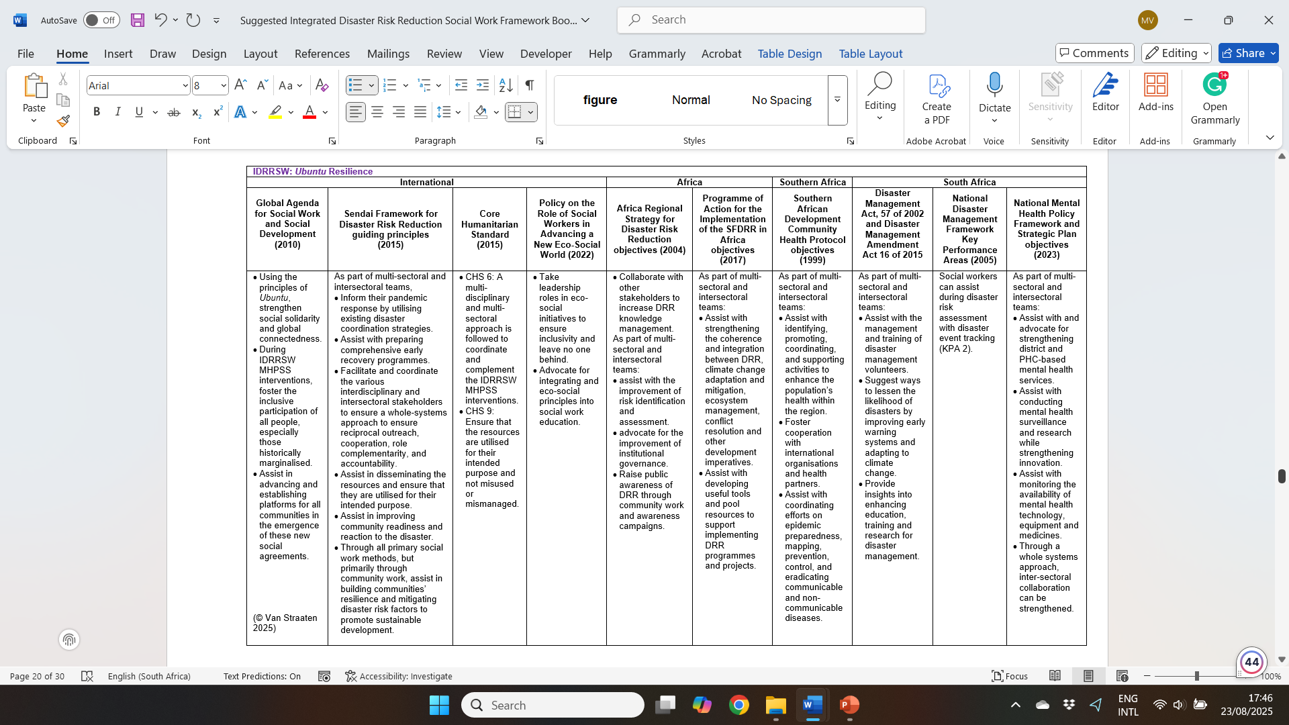

Slide 36
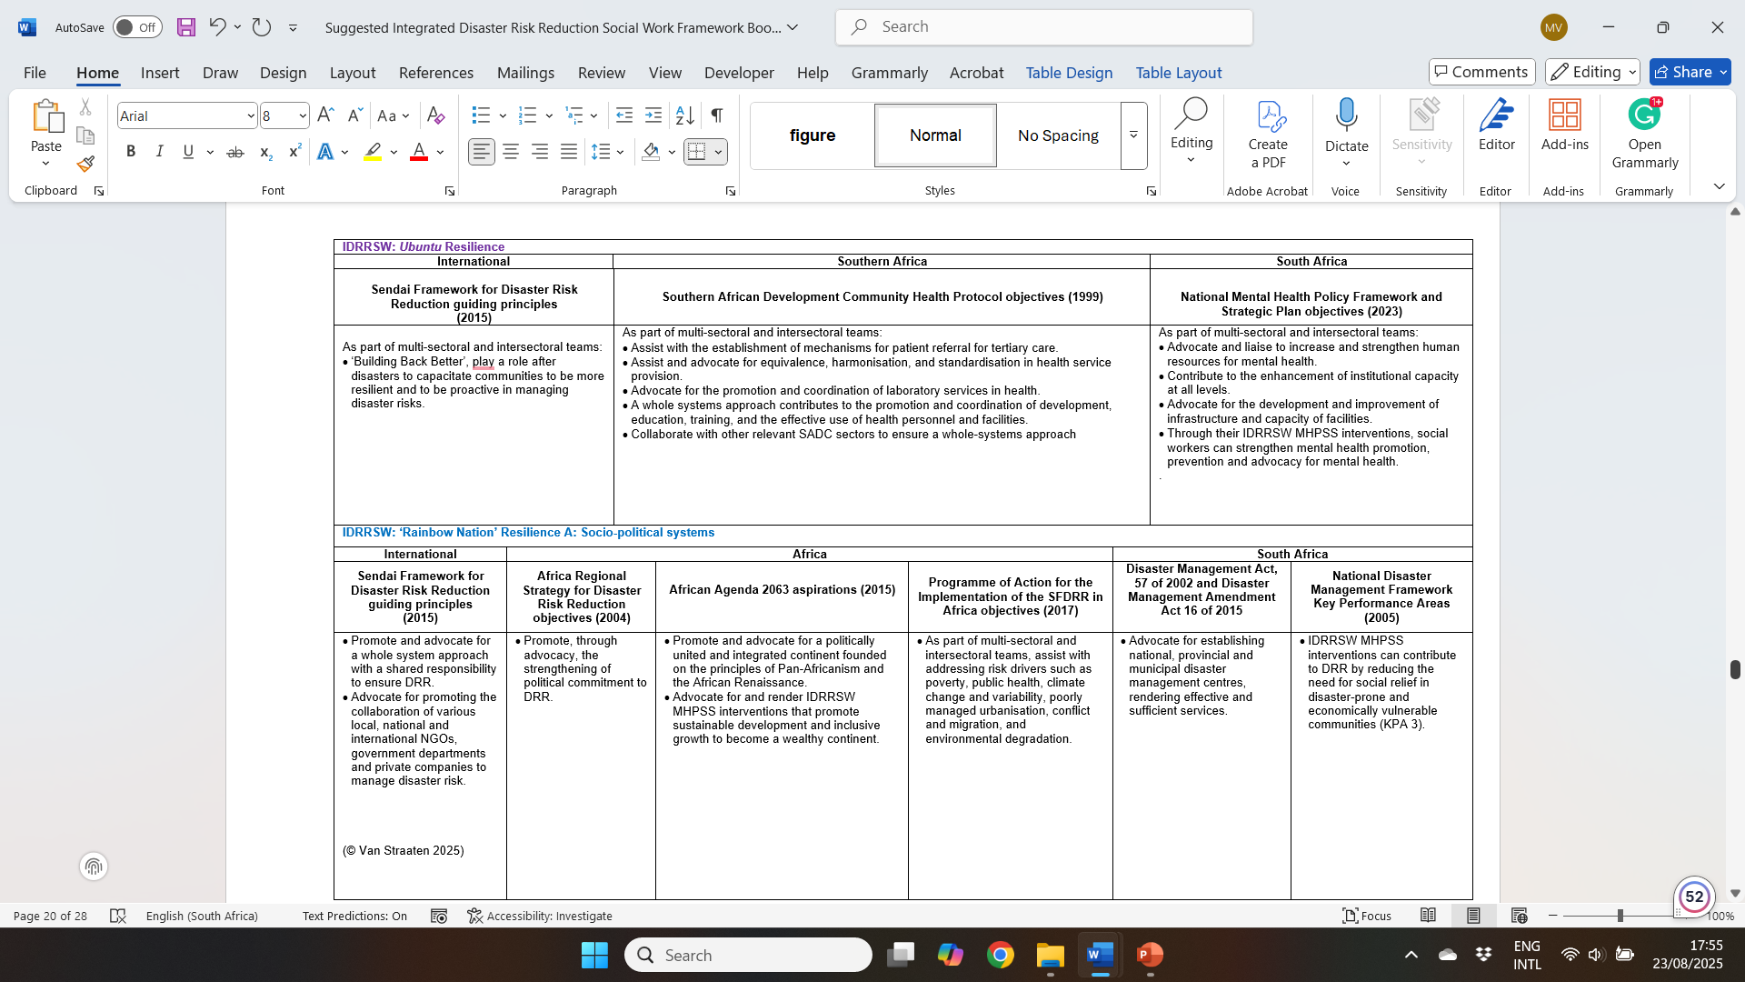

Slide 37
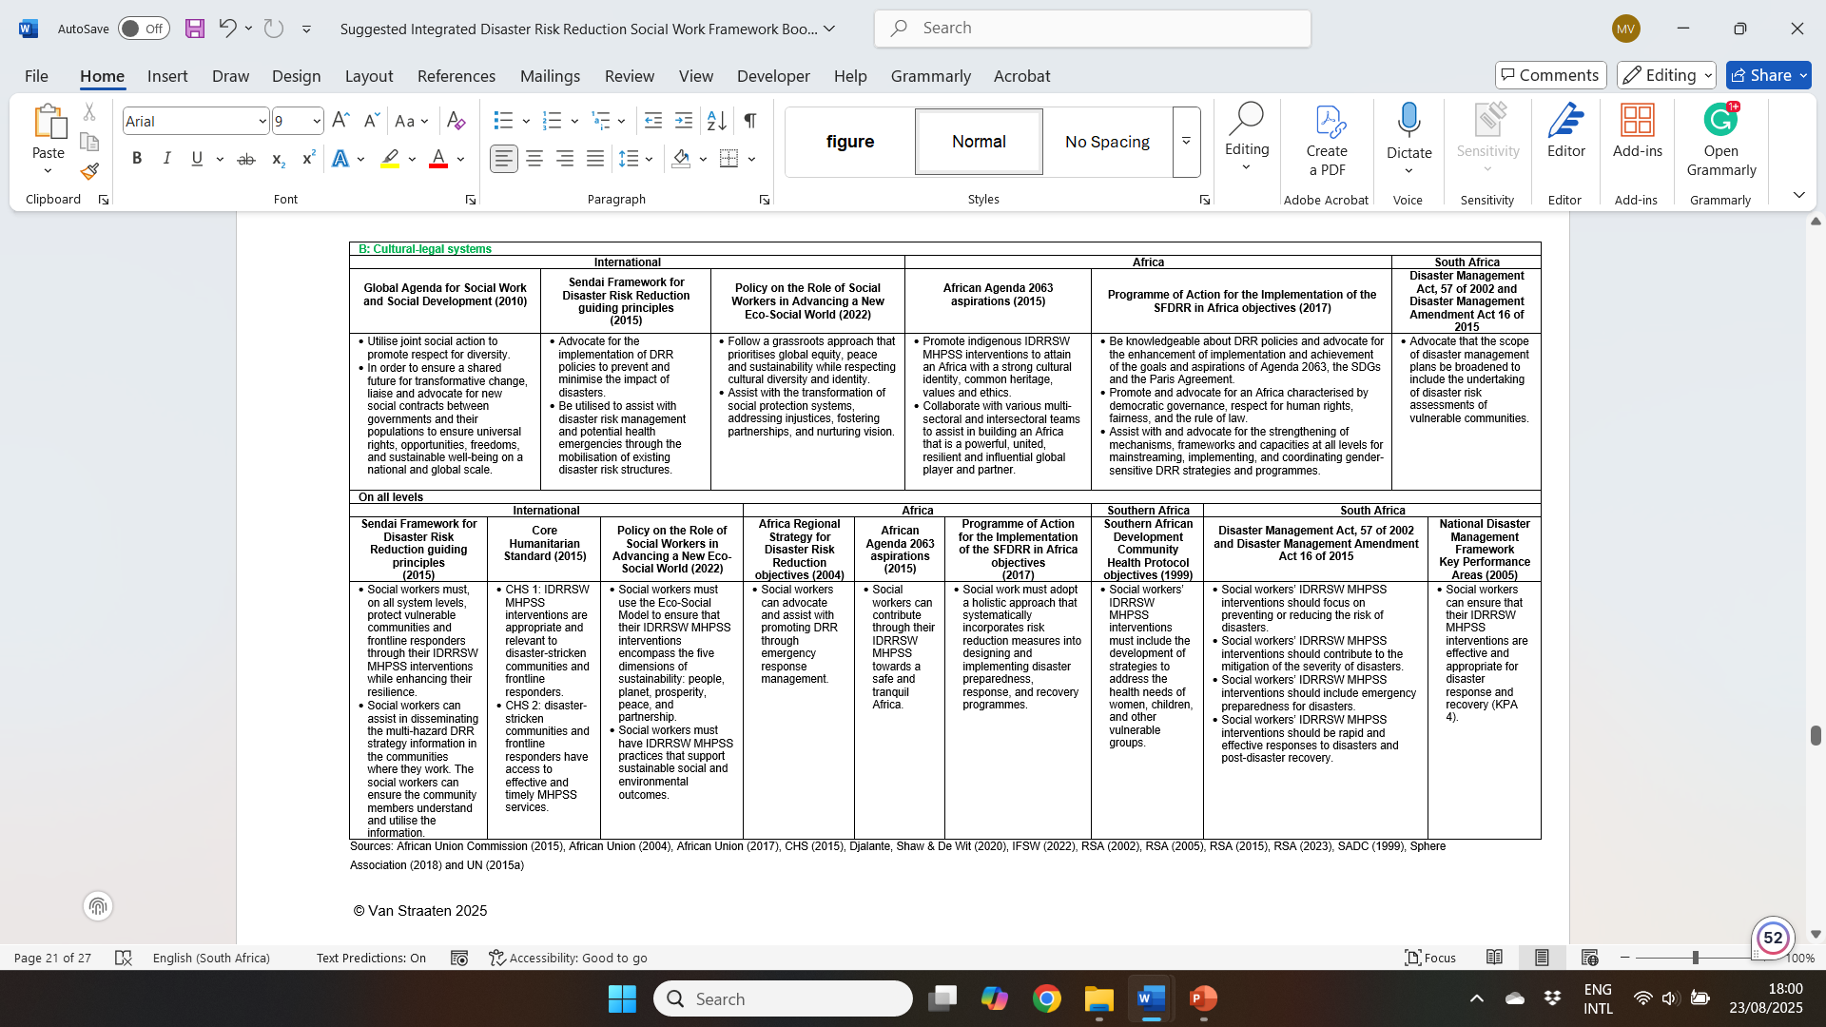

Slide 38

Table 1
The guidelines are designed for flexible applications across various disaster scenarios, allowing adaptability to different levels of disaster impact and community needs.
A user-friendly Excel sheet featuring colour-coded dropdown options, the tool is divided into two sections.
1st section offers guidelines to assess and monitor social workers’ knowledge, support and resources.
2nd section provides guidelines across the system levels, ensuring a whole-systems approach to rendering MHPSS interventions to disaster-stricken community members and frontline responders that remain responsive, contextually appropriate, and effective.
Please refer to the separate Excel document for more details about interventions on the various levels

Slide 39

QUESTIONS?

Slide 40
References
African Union (2004) Disaster risk reduction for sustainable development in Africa. Africa Regional Strategy for Disaster Risk Reduction.
Available at: https://www.preventionweb.net/files/4038_africaregionalstrategy1.pdf (Accessed: 17 June 2024).
African Union (2017) Programme of Action for the Implementation of the Sendai Framework for Disaster Risk Reduction 2015-2030 in Africa.
Available at: https://www.preventionweb.net/files/67054_poaimplementationofthesendaiframewo%5B1%5D.pdf (Accessed: 17 June 2024).
African Union Commission (2015) Agenda 2063: The Africa We Want. Ethiopia: African Union Commission.
Boetto, H. (2017) A transformative eco-social model: Challenging modernist assumptions in social work. British Journal of Social Work, 47,
pp.48–67.
Bosher, L., Chmutina, K. & Van Niekerk, D. (2021) Stop going around in circles: towards a reconceptualisation of disaster risk management
phases. Disaster Prevention and Management: An International Journal, 30(4/5), pp.525-537.
Bronfenbrenner, U. (1979) The Ecology of Human Development: Experiments by nature and design. 1st ed. London: Harvard University
Press.
Brückner, S. (2001) South Africa - a rainbow nation. Available at: https://www.grin.com/document/100874?lang=en (Accessed: 3 August
2023).
Buqa, W. (2015) Storying Ubuntu as a rainbow nation. Verbum et Ecclesia, 36(2), pp.1-8.
CDC (Centers for Disease Control and Prevention) (2024) About Disaster Epidemiology. Available at: https://www.cdc.gov/disaster-
epidemiology-and-response/php/disaster/?CDC_AAref_Val=https://www.cdc.gov/nceh/hsb/disaster/epidemiology.htm (Accessed: 20
October 2024).
CHS (Core Humanitarian Standard Alliance) (2015) CHS guidance notes and indicators. 1st ed. Switzerland: CHS Alliance.
Djalante, R., Shaw, R. & De Wit, A. (2020) Building resilience against biological hazards and pandemics: COVID-19 and its implications for
the Sendai Framework. Progress in Disaster Science, 6, pp.2-7.
Elliot, D. (2010). A social development model for infusing disaster planning management and response in the social work curriculum. In D.
Gillespie and K. Danso (Eds.), Disasters and concepts and issues. A guide to social work education and practice (pp. 89- 110). Alexandria,
Virginia: CSWE-Press.
Herberg, M. & Torgersen, G. (2021) Resilience competence face framework for the unforeseen: Relations, emotions and cognition. A
qualitative study. Frontiers in Psychology, 12, 669904.
Hokenstad, M.C. (2007) Social work education for disaster recovery and community building. Barbados: International seminar on disaster
planning management and relief. New responsibilities for social work education.

Slide 41
IASC (Inter-Agency Standing Committee) (2021) Technical Note, Linking Disaster Risk Reduction (DRR) and Mental Health and Psychosocial Support
(MHPSS): Practical Tools, Approaches and Case Studies. Geneva: IASC.
IFSW (International Federation of Social Workers) (2020a) 2020 to 2030 Global Agenda for Social Work and Social Development Framework: ‘Co-
building inclusive social transformation'. Available at: https://www.ifsw.org/2020-to-2030-global-agenda-for-social-work-and-social-development-
framework-co-building-inclusive-social-transformation/ (Accessed: 16 June 2024).
IFSW (2020b) Almost 20000 social workers were engaged in a webinar on the social work response to the COVID-19 crisis. Available at:
https://www.ifsw.org/almost-20000-social-workers-were-engaged-in-a-webinar-on-the-social-work-response-to-the-covid-19-crisis/ (Accessed: 18 April
2020).
IFSW (2020c) Updated information on IFSW and COVID-19. Rheinfelden: IFSW.
IFSW (2022) The role of social workers in advancing a new Eco-Social world. Available at: https://www.ifsw.org/the-role-of-social-workers-in-advancing-
a-new-eco-social-world/#:~:text=IFSW%20views%20an%20eco%2Dsocial,spirit%20of%20strengthened%20global%20solidarity%E2%80%9D
(Accessed: 13 July 2022).
Matlakala, F., Nyahunda, L. & Makhubele, J. (2021) Challenges faced by social workers dealing with victims and survivors of natural disasters. Eurasian
Journal of Social Sciences, 9(3), pp.189-197.
Mayaka, B., Van Breda, A.D., Uwihangana, C. & Mugumbate, R. (2023) The Ubuntu Practitioner in Historical and Contemporary Contexts. In Mayaka,
B., Uwihangana, C. & Van Breda, A.D. (Eds.) The Ubuntu Practitioner: Social Work Perspectives. Rheinfelden: IFSW, pp. 4-30.
Mentges, A., Halekotte, L., Schneider, M., Demmer, T. & Lichte, D. (2023) A resilience glossary shaped by context: Reviewing resilience-related terms
for critical infrastructures. International Journal of Disaster Risk Reduction, 96, 103893.
Onwuegbuzie, A.J., Collins, K.M. & Frels, R.K. (2013) Foreword: Using Bronfenbrenner's ecological systems theory to frame quantitative, qualitative,
and mixed research. International Journal of Multiple Research Approaches, 7(1), pp.2-8.
Rangachari, P. & Woods, L. (2020) Preserving Organizational Resilience, Patient Safety, and Staff Retention during COVID-19 Requires a Holistic
Consideration of the Psychological Safety of Healthcare Workers. International Journal of Environmental Research and Public Health , 17 (12), 4267.
Roberto, K. (2016) Abusive Relationships in Late Life. In George, L. & Ferraro, K. (Eds.), Handbook of Aging and the Social Sciences. 8th ed. New York:
Academic Press, pp.337-355.
RSA (Republic of South Africa) (2002) Disaster Management Act, 57 of 2002. Pretoria: Government Printers.
RSA (2005) National Disaster Management Framework. Available at:
https://www.westerncape.gov.za/text/2013/July/sa-national-disaster-man-framework-2005.pdf (Accessed: 25 March 2020).
RSA (2015) Disaster Management Amendment Act, 16 of 2015. Pretoria: Government Printers.

Slide 42
RSA (2020) Disaster Management Act, 2002: Amendment of regulations issued in terms of Section 27(2). Pretoria: Government Printers.
RSA (2023) National Mental Health Policy Framework and Strategic Plan 2023 – 2030. Pretoria: Government Printers.
SACSSP (South African Council for Social Service Professions) (2020) Guidance for social service professionals and their employers on sustained and
professional practice during the national state of disaster: COVID-19 pandemic. Pretoria: SACSSP.
Sawalha, I. (2020) A contemporary perspective on the disaster management cycle. Foresight, 22(4), pp.469-482.
Schmidt, L. & Peter, D. (2017) Workshop on Nature based solutions: Disaster Risk Reduction. Brussels: European Commission.
Sim, T., He, M. & Dominelli, L. (2021) Social work core competencies in disaster management practice: An integrative review. Research on Social work practice,
32(3), pp.310-321.
Sinkamba, R. & Maripe, K. (2014) Mainstreaming disaster risk reduction in the social work curricular: The case of University of Botswana. Global Assessment
Report on Disaster Risk Reduction 2015, pp.1-14.
SADC (Southern African Development Community) (1999) Protocol on Health in the Southern African Development Community. Maputo: SADC.
Southwick, S., Bonanno, G., Masten, A., Panter-Brick, C. & Yehuda , R. (2014) Resilience deﬁnitions, theory, and challenges: interdisciplinary perspectives.
European Journal of Psychotraumatology, 5, 25338.
Sphere Association (2018) The Sphere Handbook: Humanitarian Charter and Minimum Standards in Humanitarian Response 4th ed. Geneva: Shortrun Press.
Tunmore, J. 2017 General systems and ecological theories. In: Deacon, L. & MacDonald, S.J. (Eds.) Social Work Theory and Practice. Thousand Oaks (CA):
Sage, pp. 81-92.
Turton, J., Zimba, Z., Smith, L. & Perumal, N. (2020) The social worker sector speaks out: A radical response is urgently needed. Maverick Citizen. Available at:
https://www.dailymaverick.co.za/article/2020-06-03-the-social-work-sector-speaks-out-a-radical-response-is-urgently-needed/#gsc.tab=0 (Accessed: 27 June
2020).
UN (United Nations) (2015a) Sendai Framework for Disaster Risk Reduction 2015-2030. Available at:
https://www.preventionweb.net/files/43291_sendaiframeworkfordrren.pdf (Accessed: 30 September 2021).
UN (2015b) Sustainable Development Goals. Available at: https://sustainabledevelopment.un.org/?menu=1300 (1 March 2020).
UNDRR (United Nations Disaster Risk Reduction) (2017) Report of the open-ended intergovernmental expert working group on indicators and terminology relating
to disaster risk reduction. Geneva: UNDRR.
UNHCR (United Nations High Commissioner for Refugees) (2023) Mental health and psychosocial support. Geneva: UNHCR.
Van Breda, A.D. (2018) A critical review of resilience theory and its relevance for social work. Social Work/Maatskaplike werk, 54(1), pp.1-18.
Van der Merwe, J. (2022) Saving the rainbow nation: Education as challenge to the churches in South Africa. HTS Teologiese Studies/Theological Studies, 78(4),
pp.1-6.
Webb, J., Stone, J. & Shrestha, B. (2015) BRACED Myanmar Alliance: Community resilience assessment and action handbook. Myanmar: BRACED.
World Health Organization (2018) Mental health: strengthening our response. Available at: https://www.who.int/news-room/fact-sheets/detail/mental-health-strengthening-our-response (Accessed: 27 March 2020).

Slide 43
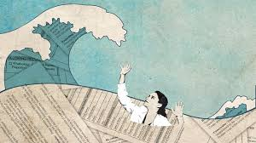
END

