Slide 1
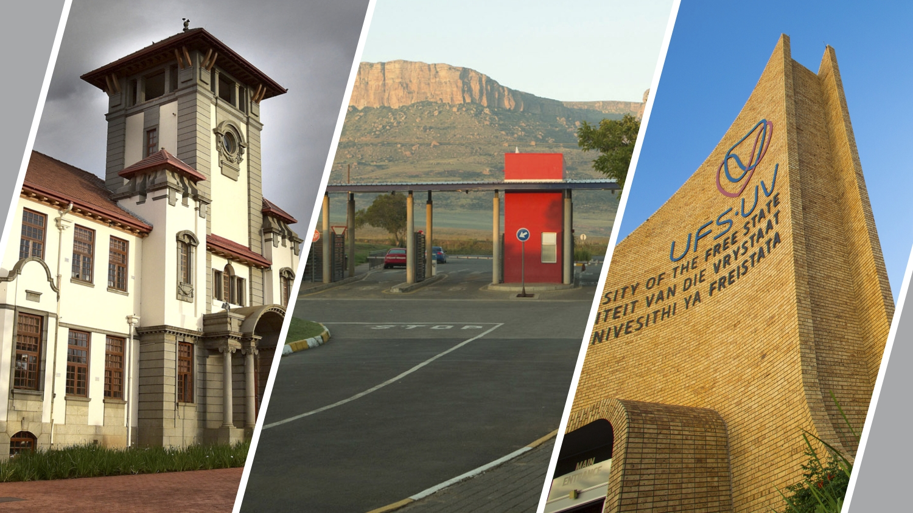


Enhancing Community Work Projects through
a Field Instruction Programme
ASASWEI International Conference
THEME 4: Social Work Education, Transdisciplinarity and Curriculum Development
SUB 4.5 Innovative teaching methodologies focused on sustainability.
Dr MC Esau and Dr MM van Straaten,
10 September 2025
T: +27 51 401 9111 | E: info@ufs.ac.za | www.ufs.ac.za

Slide 2
PRESENTATION OUTLINE
Background to study
Contextualising FIP
Conceptualising
Research methodology
Results
Recommendations
References
Aim of study
Building a professional identity

Slide 3
BACKGROUND to STUDY
Re-curriculated social work programme introduced 2022
Community work, phased in 2023, 2nd year of study
Pre-2022: community work theory: year 1, practicums: year 3
By the time they get to 3rd year, they have forgotten all theory
Thus, there was a need to synchronise theory with practice
To enable students to deliver more sustainable projects by engaging professionally and constructively with communities
Notes:
Equipping social work students with the necessary skills to engage professionally and constructively with communities is essential to guide them in making a meaningful difference. In this way, a more sustainable project spearheaded by the community’s participation and ownership could be possible. The Field Instruction Programme (FIP) aimed to make such a meaningful difference.

Slide 4
BACKGROUND (cont.)
Field Instruction Programme (FIP) was introduced to prepare students for a professional social work career
Grounded in principles of Experiential Learning (Kolb & Kolb, 2017) to bridge classroom lectures and practical application
Enabling students to apply knowledge gained in classroom and from textbooks to real-life situations, resulting in meaningful learning experiences (Chan, 2012; Kolb & Kolb, 2017)
This way, Experiental Learning aligns with purpose of FIP (Bogo, 2005; Schmidt & Rautenbach, 2016)
Notes:
FIP prepares students for professional social work career
Bridge between classroom lectures and practical application
Partnership between university and community agencies
Grounded in principles of Experiential Learning (Kolb & Kolb 2017)
Enabling students to apply knowledge gained in classroom and from textbooks to real-life situations, resulting in meaningful learning experiences (Chan, 2012; Kolb & Kolb, 2017).
Experiential learning Theory thus align with purpose of FIP (Bogo, 2005; Schmidt & Rautenbach, 2016)

Slide 5
CONTEXTUALISING FIP: UFS
Presented 2nd year – year module (theory and practice synchronise)
Expected to disconnect from a project that they have designed and delivered based on a challenge that was discovered and a future that was dreamt about (Nel et al. 2021)

Slide 6
CONTEXTUALISING (cont.)
Preparing students for practicum FIP focused on:
Management of diaries
Telephone and email etiquette
Conducting a conversation
Dealing with diverse communities
Dealing with anxieties and fears when engaging with communities
Respect
Recognising strengths
Apply the process of Appreciative Inquiry (AI) (Nel et al., 2021)

Slide 7
CONCEPTUALISING a PROFESSIONAL IDENTITY
Professional identity in social work is more than just following rules or definitions.
It’s about building specialised knowledge that prepares us to understand and respond to real challenges.
It also means living out the values and beliefs of the profession, such as respect, dignity, and service.
This identity is shaped not only in the classroom but also during field placements, where theory meets practice.
Through this process, students gain unique skills and a strong commitment to their communities.
Thus, as Wiles (2013), Nuttmaun-Shwartz (2017), and Fitzgerald (2020) remind us, professional identity combines knowledge, values, and practice into a clear commitment to serve.”

Slide 8
BUILDING a STUDENT’S PROFESSIONAL IDENTITY
Professional identity will enable students to act as agents of change to influence communities (Yang et al. 2021)
Professional identity shaped by satisfactory supervision practices, personal values
Therefore, supervision should focus on providing students with knowledge, confidence and sense of competence, enabling them to use personal and environmental resources

Slide 9
AIM of STUDY
To evaluate whether the FIP, with special emphasis on community work as a primary method of social work, fostered the professional identity of 2nd-year social work students and whether it contributed to the realisation of constructive and sustainable community work projects.

Slide 10
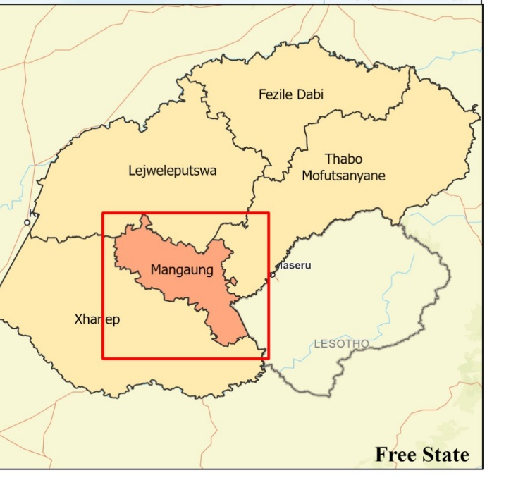


Slide 11
RESEARCH METHODOLOGY
Research Paradigm: constructivist approach positioning students and agency supervisors as collaborative partners in the process (De Vos et al., 2011; Cresswell & Clark, 2018)
Research Design: qualitative study through semi-structured interviews and a focus group with evaluation research as design (Fouché, 2011; Fouché, 2021) enabled the assessment of strengths and weaknesses of the FIP
Population: 2nd year social work students and their agency supervisors
Sampling: purposive sampling (Strydom, 2021)
Data Collection: ethical clearance, data collected through a focus group session with students and individual semi-structured interviews with agency supervisors till the point of saturation (Geyer, 2021)
Data analysis: 8-step thematic analysis tool (Thompson, 2022)
Notes:
Aim
Theoretical framework
Methods
Qualitative data were collected through semi-structured interviews with five agency supervisors and a focus group session with six second-year students. An eight-step thematic analysis tool guided the data analysis. Findings revealed both supportive and critical perspectives on the FI programme’s effectiveness.

Slide 12
RESULTS
Category/Theme | Key Observation
Student engagement & project choice | Some supervisors noted meaningful community engagement | Others observed a preference for easier, self-serving projects
Creativity & innovation | Supervisors noted a few innovative efforts | Students' creativity was limited, encouraging creative thinking & using recycled materials for helping aids
Effectiveness of FI classes | Some students found facilitation classes helpful for communication, facilitation, and problem-solving skills | Other students reported them as overly simplified compared to real-life scenarios
Notes:
Results
While some supervisors noted that students engaged meaningfully with the community, others observed a preference for easier, self-serving projects. Students’ creativity was limited, with few innovative efforts reported. All supervisors stressed the importance of encouraging creative thinking and using recycled materials to develop helping aids. Some students acknowledged that the facilitation classes, including role plays, helped develop communication, facilitation and problem-solving skills. While others reported these as overly simplified compared to real-life scenarios.

Slide 13
RESULTS (cont.)
Category/Theme | Key Observation
Programme improvements (General) | Clearer role definitions Stronger professional boundaries Enhanced training time management, communication, and digital skills.
Supervisors’ specific recommendations | Aligning students’ attributes with community placements Incorporating more hands-on activities Involving agencies more directly A more significant role for supervisors in identifying community challenges Receiving students’ reports
Students’ specific recommendations | More dynamic, realistic, and practical learning experiences Greater variety and creativity in teaching methods Randomised groupings to better prepare for practicum realities
Notes:
To improve the FI programme, all participants suggested clearer role definitions, stronger professional boundaries, and enhanced training in time management, communication and digital skills. This includes clarifying the "role of the social worker during community work," emphasizing "professional boundaries," and training in "time management and communications skills" and "use electronic diaries".
Supervisors further recommended aligning students’ attributes with community placements, incorporating more hands-on activities and involving agencies more directly. They emphasised that supervisors should have a more significant role in identifying community challenges and receive students’ reports. Students recommended more dynamic, realistic, and practical learning experiences, greater variety and creativity in teaching methods, and randomised groupings to better prepare them for practicum realities. Suggestions included "active diverse learning strategies," "learn through ice breaks," learning "outside the class or in a different environment," and "randomly pairing students to be comfortable with someone they didn't practice with".

Slide 14
RECOMMENDATIONS
Identified areas for further improving the FIP include:
Enhanced communication and supervisor involvement
Advanced sustainability knowledge
Pedagogical enhancements
Clarity and boundaries
Core skill enhancement
Fostering creativity
Notes:
Identified areas for further improving the FIP include:
Enhanced Communication and Supervisor Involvement: There is a need for improved communication with agency supervisors and more direct involvement from them in guiding students and providing reports. Suggestions include inviting them to participate in making helping aids during class.
Advanced Sustainability Knowledge: Participants suggested a need for advanced knowledge and practical techniques to ensure sustainable projects, addressing a noted "lack of theoretical application" in this area. Recommendations include embedding principles of sustainability early, using real project examples, and focusing on skills for sustainable constructive projects
Pedagogical Enhancements: Students recommended more dynamic, realistic, and practical learning experiences, including active diverse learning strategies such as ice breakers, learning outside the classroom, and randomly pairing students for group work.
Clarity and Boundaries: Suggestions were made for clearer role definitions for social workers in community work and establishing stronger professional boundaries.
Core Skill Enhancement: Further attention is needed for time management and communication skills, including the use of electronic diaries.
Fostering Creativity: Encouraging innovation, thinking "out of the box," and using recycled materials for helping aids were emphasized.

Slide 15
REFERENCES
Bogo, M. (2005). Field instruction in social work: A review of the research literature. The Clinical
Supervisor, 24(1), 321–336.
Chan, C. K. Y. (2012). Exploring an experiential learning project through Kolb’s Learning Theory using a
qualitative research method. European Journal of Engineering Education, 37(4), 405–415.
https://doi.org/10.1080/03043797.2012.706596
Cresswell, J. W., & Clark, V. L. (2018). Designing and conducting mixed methods research (3rd ed.).
Sage Publications.
De Vos, A. S., & Strydom, H. (2011). Scientific theory and professional research. In A. S. De Vos, H.
Strydom, C. B., Fouche, & C. S. Delport (Eds.), Research at Grass Roots for the Social Sciences and
Human Services Professions (4th ed., pp. 28–44). Van Schaik Publishers.
Fitzgerald, A. (2020). Professional identity: A concept analysis. Nursing Forum, 55(3), 447–472.
https://doi.org/10.1111/nuf.12450
Fouché, C. B. (2011). Evaluation research. In A. S. De Vos, H. Strydom, C. B. Fouche, & C. S. Delport
(Eds.), Research at Grass Roots for the Social Sciences and Human Services Professions (4th ed.,
pp. 449–472). Van Schaik Publishers.
Fouché, C. B. (2021). Evaluation research. In C. B. Fouche, H. Strydom, & W. J. Roestenburg (Eds.),
Research at Grass Roots for the Social Sciences and Human Services Professions (5th ed., pp. 437–
459). Van Schaik Publishers.
15

Slide 16
Geyer, L. S. (2021). Interviews as data collection method. In C. B. Fouche, H. Strydom, & W. J. Roestenburg
(Eds.), Research at Grass Roots for the Social Sciences and Human Services Professions (5th ed., pp.
355–378). Van Schaik Publishers.
Kolb, A. Y., & Kolb, D. A. (2017). The experiential educator: Principles and practice of experiential learning.
EBLS Press.
Nel, H., Louw, H., Schenck, R., & Skhosana, R. (2021). Introduction to participatory community practice (2nd
Revised). Unisa Press.
Nuttman-Shwartz, O. (2017). Rethinking professional identity in a globalized world. Clinical Social Work
Journal, 45(1), 1–9. https://doi.org/10.1007/s10615-016-0588-z
Schmidt, K., & Rautenbach, J. V. (2016). Field instruction: Is the heart of social work education still bearing in
the Eastern Cape? Social Work (South Africa), 52(4), 589–610. https://doi.org/10.15270/52-4-532
Strydom, H. (2021). Sampling techniques and pilot studies in qualitative research. In Research at Grass
Roots for the Social Sciences and Human Services Profession (5th ed., pp. 379–390). Van Schaik
Publishers.
Thompson, J. (2022). A Guide to Abductive Thematic Analysis. The Qualitative Report, 27(5).
Wiles, F. (2013). “Not easily put into a box”: Constructing professional identity. Social Work Education, 32(7),
854–866. https://doi.org/10.1080/02615479.2012.705273
Yang, H., Wang, R., & Chen, H. (2021). Professional identity construction among social work agencies.
Journal of Social Work, 21(4), 753–773. https://doi.org/10.1177/1468017320940587

Slide 17

Thank you
Enhancing Community Work Projects through
a Field Instruction Programme

