Slide 1

ADMINISTRATIVE OVERLOAD IN SOCIAL WORK: A SCOPING REVIEW ON THE IMPACT OF EXCESSIVE PAPERWORK
MR MAMUKEYANI ERIC
Limpopo Department of Social Development, Luckau one stop center, South Africa

Slide 2

INTRODUCTION AND BACKGROUND
Social work is a noble profession
Burnt out in social work is a Public Health issue (Ractcliff, 2024)
70% report high level of stress
65% of social workers worldwide consider leaving their job (Social worker Burntout statistics: reports 2025)
Source: https://www.shutterstock.com/search/exhausted-social-workers?msockid=37a155e9b73b6aac05ed43aab6f26b6c

Slide 3
METHODOLOGY
Qualitative
Scoping literature review design
06 related papers reviewed
Inclusion and exclusion
Included – 2019-2025, only qualitative studies, social workers and burnt out study topical area
Analysis
Organizing and synthesizing data
Thematic analysis – 6 steps of analysis by Braun and Clarke (2013)
Excluded – Older than six years
Research question: How does too much administration affect social workers?
Results
04 themes
Too much administration and paperwork causes;
Physical fatique,
Loss of interest
Mental fatique,
slow productivity

Slide 4


DISCUSSION: The effects of excessive paperwork in social work
Physical fatigue
Mental fatigue
Losing interest
Source: https://www.shutterstock.com/search/exhausted-social-workers?msockid=37a155e9b73b6aac05ed43aab6f26b6c

Slide 5


IMPLICATIONS AND RECOMMENDATIONS WHAT CAN WE DO?
Let us reduce, cut, cut the papers, bring something exciting and easy to use
Computer filing system- softwares
Cellphone Apps
Accessed through gadgets
Confidential-personally encrypted password access

Slide 6

CONCLUSION
LET US DO IT FOR OURSELVES AND FOR OUR CLIENTS!!!

Slide 7
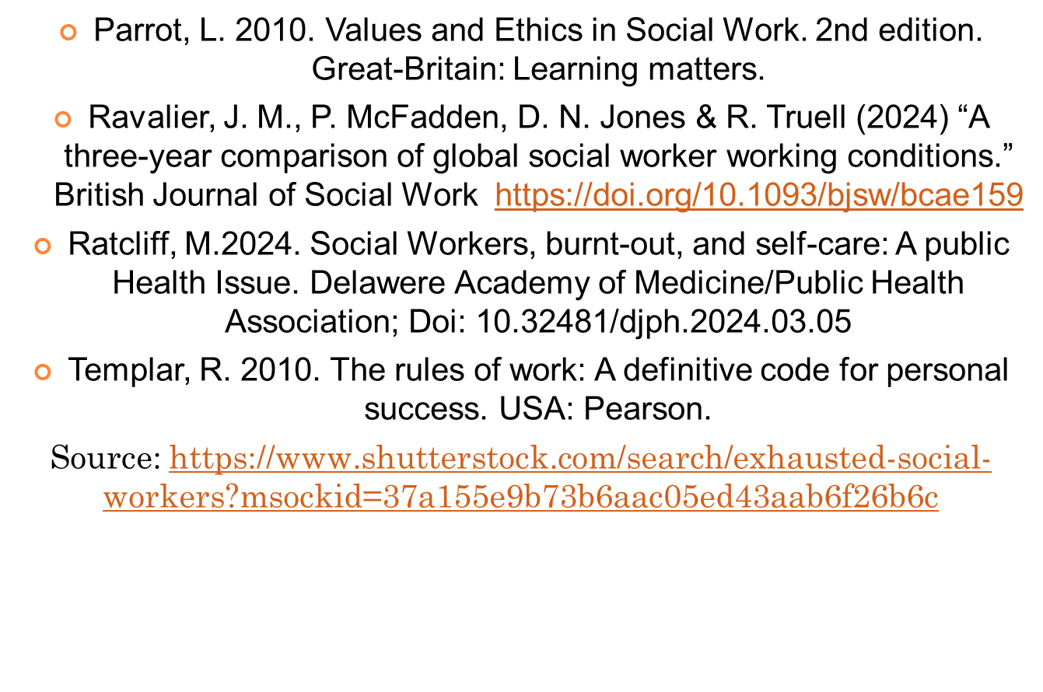
REFERENCES

