Slide 1


ASASWEI 2025 LIMPOPO PROVINCE

Slide 2

Social Work and the Achievement of Sustainable Development Goals (SDGs):

Slide 3
1. Introduction
Social work promotes positive change and empowers families, individuals and communities.
Social work promotes well being and quality of life.
SDGs aims to end poverty, protect planet and ensure peace and prosperity.
Social work contribute to achieving SDGs

Slide 4
1.1 Role of social work in achieving SDGs
Aligning social work with SDGs
Promoting Social Justice
Environmental Sustainability
Economic sustainability

Slide 5
1.2 Social work interventions.
Supporting SDGs through community development, advocacy and policy change.
Community development: Identifying needs and developing solutions.
Advocacy: Promoting policies and programs that support SDGs
Policy change: Changing policies and laws that perpetuate poverty and inequality.

Slide 6
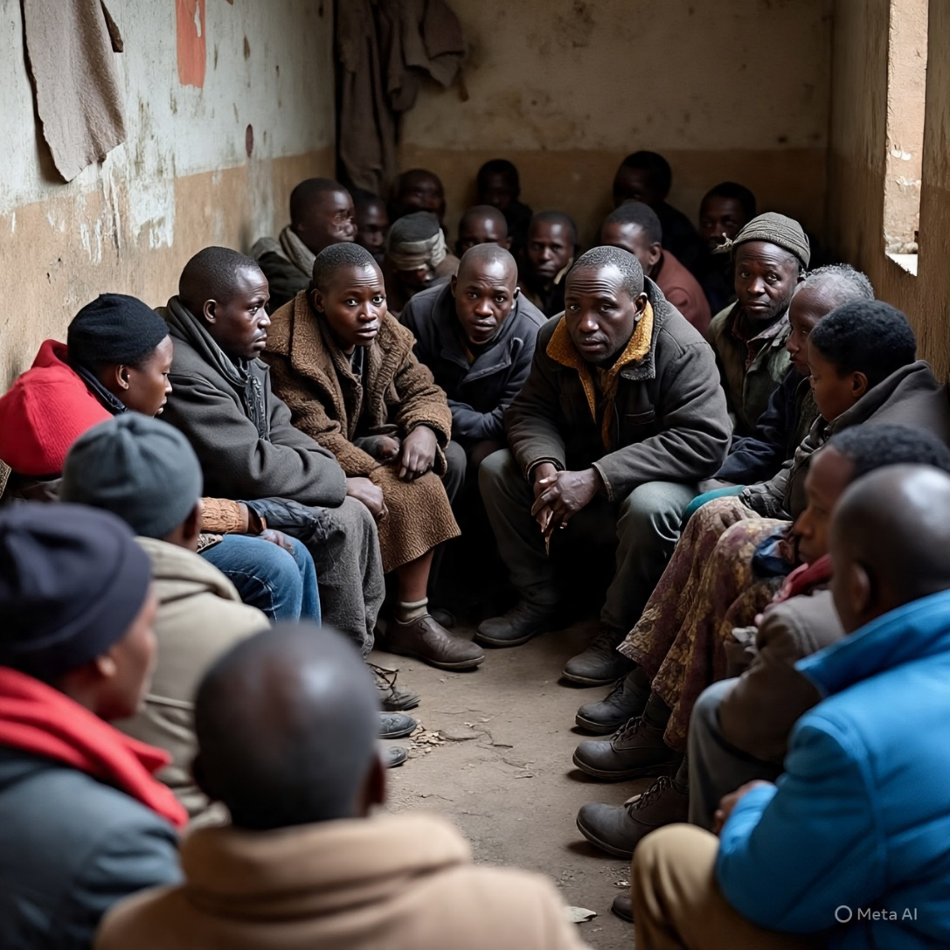
community coming together to address their social issues

Slide 7
2. RESEARCH METHODOLOGY
Literature review on social work and the achievement of SDGs
Review of existing literature on SDGs
Search of academic database and relevant organization websites
Qualitative research methodology

Slide 8
2.1 Data collection and analysis
Data analysis involved a thematic analysis of the literature.
Literature review of social work and achievement of SDGs
Thematic Analysis of data
Emerged themes
Importance of social work in achieving SDGs
Role of social workers in promoting sustainable development
Challenges and opportunities faced by social workers.

Slide 9
3. Findings
Literature review revealed that social work plays a crucial role in achieving the SGDs by:
Promoting social justice
Empowering marginalized communities
Addressing the root cause of poverty and inequality

Slide 10
Findings
Supporting SDGs through community development, advocacy and policy change.
Community development: Identifying needs and developing solutions.
Advocacy: Promoting policies and programs that support SDGs
Policy change: Changing policies and laws that poverty and inequality.

Slide 11
Findings continue
Contributing to poverty reduction, Education, Health and gender equality.
Poverty reduction: Identifying needs and developing solutions.
Health: Promoting healthcare for all
Gender equality: Promoting women empowerment and addressing gender-based violence
Education: Working with schools and other educational institutions to promote access to education for all.

Slide 12
4. Conclusion
Social work plays a vital role in achieving the SDGs through community development, advocacy and policy change

Slide 13
6. Lessons learned
Some lessons that can be learned are as follows
Interconnectedness
Community engagement
Holistic approach.
Empowerment.
Stakeholder partnerships and advocacy
Cultural sensitivity
Addressing root causes
Community based initiatives
Monitoring and evaluation

Slide 14
6.Recomendations
Increase funding for social work programs
Integrate social work principles into SDG implementation
Increase awareness about the SDGs
Encourage social workers to advocate for policy change
Increase awareness about the SDGs
Enhance social work education and training
Foster partnership between social workers and other stakeholders
Develop capacity building programs for social workers

Slide 15

THE END

