Slide 1


TITLE OF THE STUDY Orientating early career academics in decolonial discourses: a case study of the department of social work in a selected university
Dr Jeff Khosa
University of Johannesburg
Department of Social Work and Community Development
ASASWEI Conference 2025: 10-12 September 2025

Slide 2

Background & Context
Social work education in South Africa has historically been embedded in a Westernised higher education context.
Since the 1930s, it has largely adopted British and American models.
The original curriculum was designed for the white population and excluded the cultural realities and needs of Black South Africans.
This has created an epistemological gap where students learn Western theories that are difficult to apply in African contexts.
The disconnection reduces professional responsiveness to local communities and contributes to graduates being ill-prepared for practice.
Student protests ( #FeesMustFall) became a catalyst for discourse of decolonization in SA.

Slide 3

Problem Statement
There is limited research on how early career academics are inducted into decolonisation discourse.
Institutional orientation often focuses on administration rather than epistemic change.
This gap affects curriculum transformation
Social work is context driven discipline.

Slide 4

Aim of the study
To explore how early career social work academics are inducted into the discourse of decolonisation.

Slide 5

Objectives
To examine the induction experiences of early career social work academics with respect to decolonisation.
To assess their readiness to contribute to the decolonisation of social work education.
To explore ways to improve best practices of induction of early career academics to the decolonisation of social work education or ways to establish such induction where it is absent.

Slide 6

Theoretical Framework: Legitimation Code Theory (LCT)
The main assumption of Legitimation Code Theory (LCT) is that social practices are shaped by underlying organasing principles called legitimation codes.
These codes determine what is considered legitimate knowledge and who is recognised as a legitimate knower in a given context.
Relevance:LCT helps explain how certain types of knowledge are valued more than others in universities. This makes it useful for helping new academics understand and take part in decolonial ideas that question dominant ways of thinking in social work education.

Slide 7
Epistemic and Social Relations

Slide 8
Research Design & Methods
Qualitative, single-case study design.
Snowball sampling strategy was adopted.
Data collection: 5 semi-structured interviews (4 face-to-face, 1 online).
Data was analysed through Critical Discourse Analysis (CDA).

Slide 9
Participants’ Race and Nationality
Participant No. | Race | Nationality
Participant 1 | African | South African
Participant 2 | African | South African
Participant 3 | African | South African
Participant 4 | African | South African
Participant 5 | African | South African

Slide 10
Participants' Qualifications
Participant no | Bachelor of Social Work | Master of Art in Social Work | Masters in another field |  | PhD in Social Work | PhD in another field
Participant 1 | ✓ | ✓ |  |  | ✓
Participant 2 | ✓ |  |  | ✓ |  | ✓
Participant 3 | ✓ |  |  | ✓ |  | ✓
Participant 4 | ✓ | ✓ |  |  |  | ✓
Participant 5 | ✓ | ✓ |  |  | ✓

Slide 11
Participants’ Work Experience
Participant no | Years of practicing experience as a social worker |  | Years of working experience in academia
 | 0-3 years | 3-years or more | 0-3 years | 3 years or more
Participant 1 | ✓ |  |  | ✓
Participant 2 |  | ✓ |  | ✓
Participant 3 |  | ✓ | ✓
Participant 4 | ✓ |  |  | ✓
Participant 5 | ✓ |  | ✓

Slide 12

Key Findings: Themes
1. Discourse of lack of formal induction
2. Discourse of institutional and academic freedom
3. Discourse of silencing decolonisation
4. Discourse about theory and practice
5. Discourses of university’s deliverables expectations
Notes:
LCT (Maton: 1990) is an ally of social realism (SR) by Margaret Archer (1995)
SR - reality that exists independently of our awareness/perceptions.
SR focuses on the interplay between underlying objective structures and mechanisms that shape phenomena.
SR is a school of thought that takes knowledge seriously as an object of study.
LCT is about building knowledge in education
LCT- spectacles to see how the discourse of decolonization is introduced in ECAs
LCT itself is a sociology of legitimacy or a sociology of possibility
LCT is realist rather than realism: it is not a meta-theory of why such characteristics are ontologically necessary.
"Realism" is a broad concept encompassing a tendency to accept things as they are, while "realist" is a person who embodies that tendency, or someone who believes in or advocates for realism.
LCT embodies SR tendencies
Jeff uses LCT as his spectacles to see clearly on how the discourse of decolonisation is introduced in this institution to new social work lecturers.

Slide 13
Examples of quotes from participants
Discourse of lack of induction
"There was no specific induction, that now we orientate you around our curriculum or anything." (participant 2)
Discourse of academic freedom
“You are given curriculum as it is… it’s up to you now to be critical enough, redesign your own curriculum. You just need to present to HOD and motivate why you must change the contents.” (Participant 2)
Discourse about theory and practice
“I teach it, students are not understanding though the textbook I prescribed is South African, the content is still Western oriented it lacks South African context very important point

Slide 14
Examples of quotes from participants (continues)
Discourse of silencing decolonisation
“Decoloniality or decolonisation is still foreign, in as much as it's something that is old in terms of other disciplines but in social work is a foreign language.” (Participant 1)
“When you bring up the subject [decolonisation], you can sense a mixed response, some people are open to it, while others still perceive it as a disruption.” (Participant 1)
“We always think it’s those scholars that are leading in the field [decolonisation] who should lead those discussions, I also want to admit personally, I don’t see that [decolonisation] as my problem [laughs].” .” (Participant 4)
“This decolonisation is not seen as everyone’s agenda, I don't remember him [HOD] mentioning anything of curriculum decolonisation.. maybe to those with interest in decolonisation.” (Participant 3)

Slide 15
Examples of quotes from participants (continues)
Discourse of university deliverables
“…those ones [international journals] they would tell you to change some things, and you end up changing important things. However, for promotion and NRF rating you need to publish in those journals, and it affects the agenda of decolonisation.” (participant 5)

Slide 16
Implications & Recommendations
Need for structured induction focusing on epistemic transformation: There is an urgent need for a structured induction process that introduces early career academics to the principles of epistemic transformation and decolonial pedagogy.
Develop communities of practice and mentorship: Establishing communities of practice and mentorship can support early career academics in critically engaging with decolonial discourses and navigating institutional challenges.
Align induction with decolonisation policies: Induction programmes must be deliberately aligned with institutional decolonisation policies to ensure that transformation goals are embedded from the outset of academic careers.
Foster Collaboration Between Academia and Practice: Prioritise the recruitment, development, and retention of social work academics with substantial field experience, as such experience is not merely advantageous but essential for meaningful curriculum transformation.

Slide 17
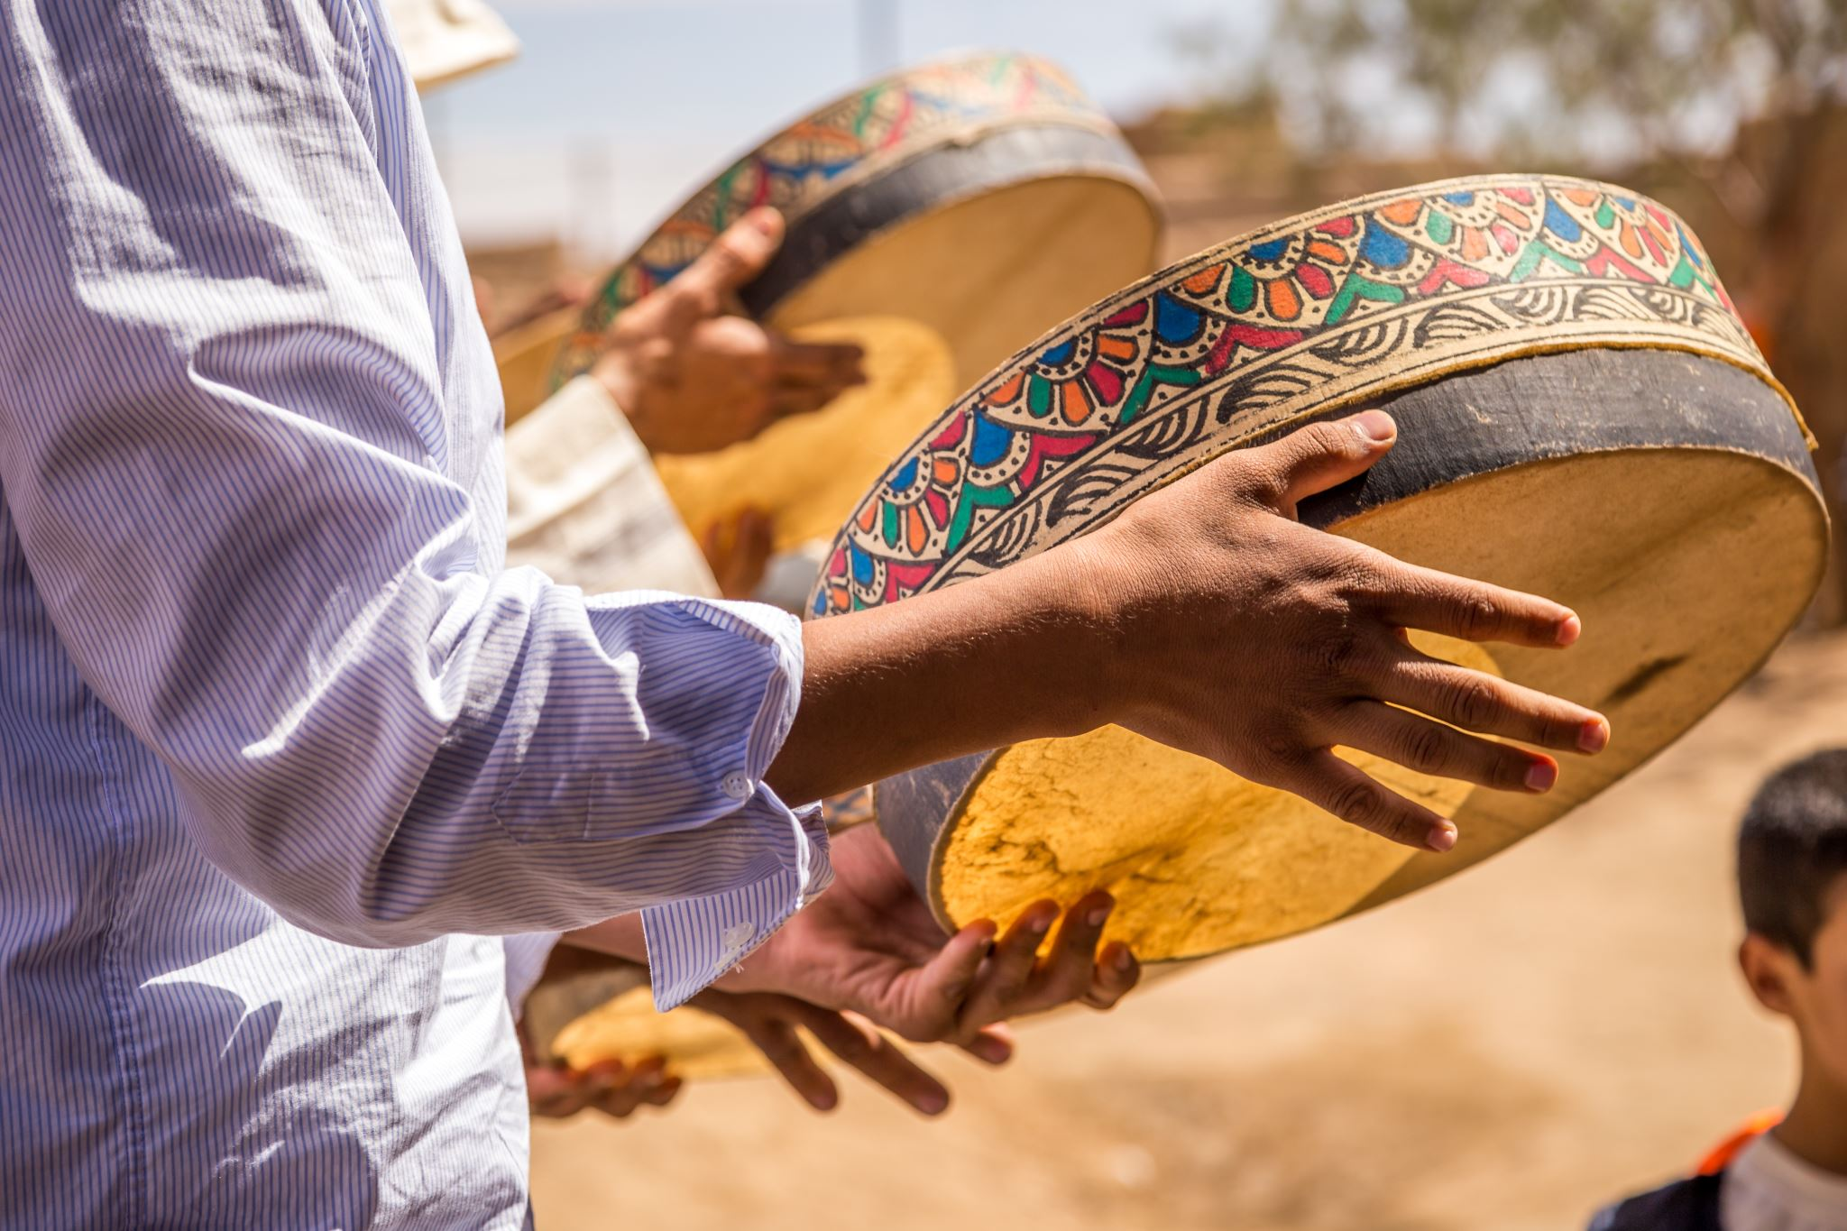
Conclusion
To change social work education in South Africa, universities need to make changes in both structure and culture. This means giving new academics proper support, valuing different kinds of knowledge (including indigenous knowledge), and rewarding work that supports decolonial goals. By doing this, social work will become more relevant and better at serving local communities with fairness and justice.

Slide 18

References
Alpaslan, N., 2019. Promoting social work graduates' employment through the social work curriculum: Employers' perspectives on the employability of Unisa's newly qualified social workers. Social Work, 55(3), pp.341-358.
Joyce, Y., 2023. Decolonisation of Education: Rethinking Higher Education Curricula and Pedagogy in Ghana (Master's thesis, Oslomet-storbyuniversitetet).
Manathunga, C. 2020. Decolonising higher education: Creating space for Southern knowledge systems. Scholarship of Teaching and Learning in the South, 4(1), 4-25.
Maton, K. (2014) Knowledge and Knowers: Towards a realist sociology of education, London: Routledge.
Maton, K. and Chen, R.T.H., 2019. Specialization codes: Knowledge, knowers and student success. In Accessing academic discourse (pp. 35-58). Routledge.
Mogorosi, L.D. and Thabede, D.G., 2018. Social work and indigenisation: A South African perspective. Southern African Journal of Social Work and Social Development, 30(1), pp.18-pages.
Rowe, S., Baldry, E. and Earles, W., 2015. Decolonising social work research: Learning from critical Indigenous approaches. Australian Social Work, 68(3), pp.296-308.
Ssempebwa, J., Teferra, D. & Bakkabulindi, F.E.K. 2016. ‘Swim or sink’: state of induction in the deployment of early career academics into teaching at Makerere University. Studies in Higher Education, 41(10):1854-1868.
Turton, Y. and Schmid, J., 2020. Transforming social work: Contextualised social work education in South Africa. Social Work, 56(4), pp.367-382.

Slide 19

Thank you!

