Slide 1

The Social Worker’s Compass: Navigating Manipulation in Mediation for child- Centered Outcomes
A South African Perspective
Christené Gaitskill
ASASWEI Conference
10 September 2025
Notes:
NOTE:
To change the image on this slide, select the picture and delete it. Then click the Pictures icon in the placeholder to insert your own image.

Slide 2
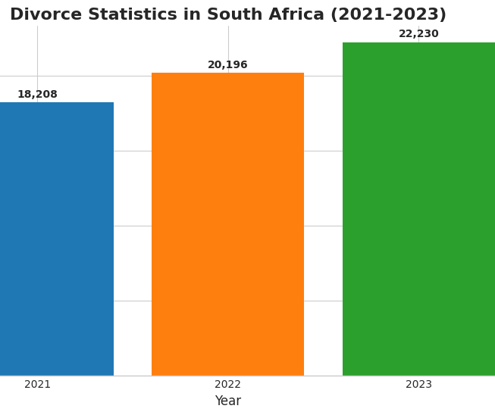
Divorce and Separation in South Africa
Stats SA data on Divorce rates, highlighting the significant number of children are affected
Focus on the human impact behind the statistics – you will find that families in South Africa are in distress
(Stats SA on 14 March 2024)

Slide 4
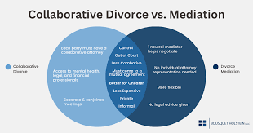
The Promise of Mediation
A Legal and cultural Mandate
The legal framework: The Children’s Act
and High Court Rules encourage
mediation.
The cultural framework: Drawing on
Ubuntu principles for a holistic approach.

Slide 5

The Hidden Threat
Manipulation in a Local Context
Manipulation is not just emotional: it is systemic
It exploits cultural, economic, and social vulnerabilities
Parents are weaponising the Child

Slide 6

Forms of Manipulation
Common Tactics in South Africa
Financial & Resource Control
Cultural & Family Pressure
Weaponising the Child

Slide 7
The Social Worker's Unique Role
Our Compass in Action
Using an ecological systems framework to see the bigger picture.
Identifying and addressing power imbalances.
Acting as a Child Advocate.

Slide 8
Conclusion
Towards a Peaceful Future
Mediation is a powerful tool, but it requires vigilance.
By integrating our professional skills with a culturally sensitive approach, we can ensure ethical and child-centered outcomes.
Our work helps build a more just and peaceful society, one family at a time.

Slide 9

Thank You & Q&A
Thank you!!!!
gaitskilljc@ufs.ac.za
Questions?
?????????????????

Slide 10
Literature Review
Gulbrandsen, W. & Haavind, H. (2018) 'Children, parents and the importance of parental conflict resolution: a qualitative study', Conflict Resolution Quarterly, 35(4), pp. 335–349.
Launspach, L. H. (2012) Gesinsberaders in Wes-Kaap se perspektiewe op oouerweerding tydens egskeiding. Master's dissertation. Stellenbosch University.
Republic of South Africa (2005) Children's Act 38 of 2005.
Statistics South Africa (2023). Statistics South Africa's Annual Report. Pretoria: Statistics South Africa.
Sudland, C. (2020) 'Challenges and dilemmas working with high-conflict families in child protection casework', Child and Family Social Work, 25(3), pp. 248–255.

